Slide 1
Building a Rich App Ecosystem: Automotive AOSP Opportunities & Approaches
Moving to SDV: an app ecosystem supplier perspective
15th May 2025

Slide 2

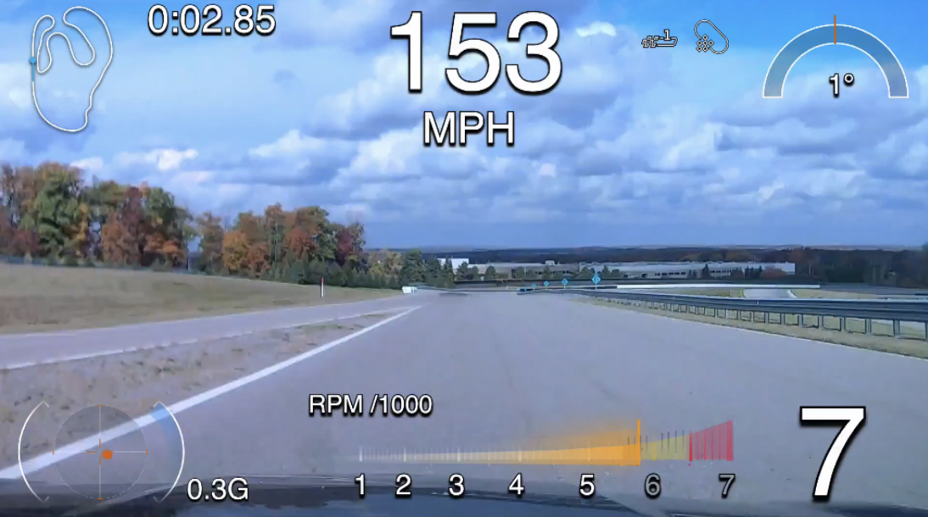
About Cosworth: AliveDrive
Enabling greatness
Primarily Motorsport
Control Electronics
Engines
Automotive
AliveDrive
High performance
Realtime data

Slide 3

Abstract
Transition to SDV from the viewpoint of a supplier – specifically, a Product Manager!
Currently, when suppliers implement hardware and software solutions for OEMs
  The value is often first seen in the HW
  Even though, currently, 80% of development cost is in software!
How do suppliers plan to switch to software value and SDV?
How do suppliers and OEMs work together towards the new ecosystem
What part could COVESA play in this?

Slide 4
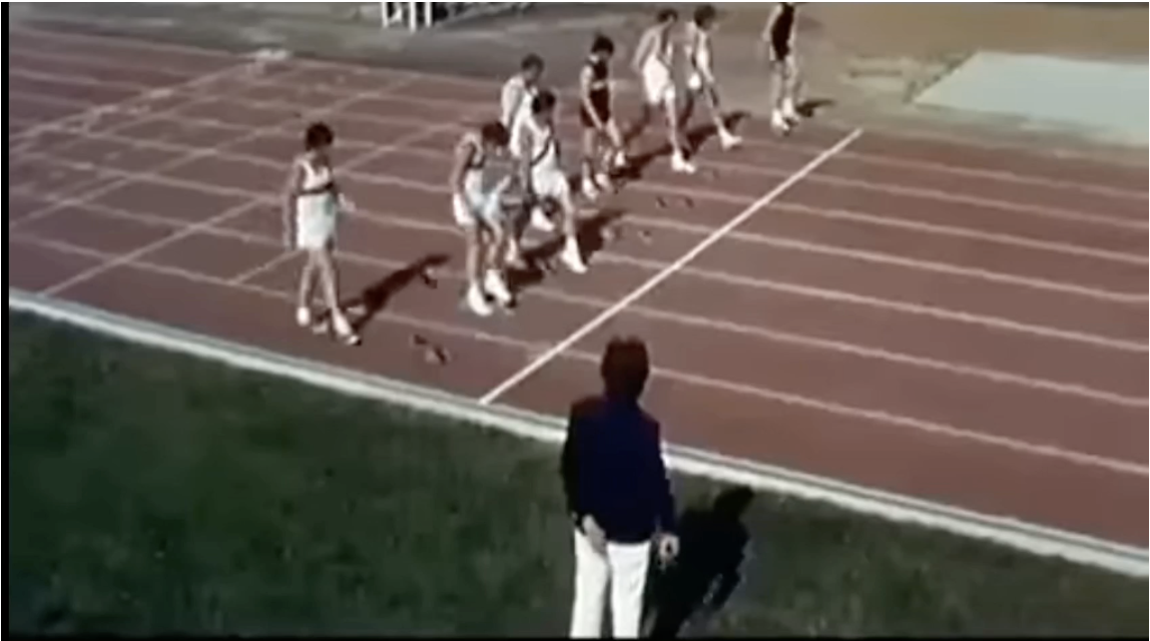
OEMs and suppliers are lining up for the SDV dash
COVESA has an important part to play
By helping to avoid this

Slide 5







Example HW/SW Supplier Ecosystem today
LAPTOP
CLOUD
LAPTOP
USB
INFOTAINMENT
CAMERA
ECU
PHONE
USB
The product boundaries of supplier systems are very well understood
Physical Integration is complex but a known problem
CAN/Ethernet/interfaces are de facto agreed
CAN Bus

Slide 6
Product Manager’s SDV Challenge
Business Model
SW Platform
HW value becomes SW value.
Value monetized over lifetime of product
System boundary moves to Container/ execution environment.
APIs and capabilities are completely new and as yet undefined
Product
Feature Planning
User Experience
Features are now shared across every supplier
Product UX is impacted by SDV. Do we have the freedom to give the customer what they want
Notes:
Previously our product managers with with delivery heads to specify a solution
Generally, the first thing we have to do to win a bid is to show that we are a good citizen on the CAN bus!
Now, our Product Managers need to work with the OEM product managers.

Slide 7
SDV Business Case
SDV business models are new to both suppliers and OEMs
HW/SW Abstraction
In order to
realize
So as to
provide
Software Value
Lifetime monetization
Separate HW/SW and expose capabilities through SW interfaces.
Realize features through software only.
Business case may require increased volumes and subs
Through OTA and continuous development,
CRM, after sales and lifetime of vehicle
We need to be mindful of:
The tendency to focus only on the value of shared hardware
The impact on the supplier business model
The complexities of software updates in vehicles

Slide 8
Creating a Business model
There is a real opportunity for realization of software value
  If we understand the customer
  Can improve UE and add value
  Personalize services
Relies in a well understood OTA strategy
  Containers
  Android/RT OS
Important to understand that SDV will not reduce the cost of development for many suppliers
  Will reduce COGS
  Will increase software complexity
Suppliers and OEMs need to work together to build workable business models for services

Slide 9
Container Strategy
There are many ways for an OEM to manage containers
  Android application execution environment
  Hypervisor OS containers
  Docker
  Kubernetes
  Singularity
Mapping functionality to containers requires significant effort
Careful decisions about interfaces
ECU
INFOTAINMENT
Containers
Containers
Containers

Slide 10
Capabilities and Data APIs?
Data APIs
  Android VHAL is a specific generalization of data
  We do not know what will be the specification of transactional data across other containers.
  APIs
  For example: android.car.FuelType
Capabilities are about services which, in addition to the above, include:
  Qualities
  Workflows
  Complex outcomes
  For example: A real-time time-stamped data stream service includes access to data made up of 50 sensor channels at specified rates and QoS.
  For example: a camera service that can be used by several independent applications with differing QoS and safety needs.
  Such capabilities has a marked impact on UE

Slide 11
Feature Planning Today
HW Product encapsulate its own features.
SW Features
Suppliers have a lot of control over their features
HW/SW Value.
Differentiation
SW/HW costs 80/20%
Product B HW
Product A HW

Slide 12
Feature Planning With SDV
We now have a radical shared product definition task
Any supplier can provide any feature
Consequences
OEM Product management reconciles feature set
Uncertainty
Shared HW

Slide 13
How can COVESA help?
By creating structures to help competitors collaborate?
For example:
  we could create a standardized way for suppliers to publish their required platform capabilities
    Using COVESA data model
    Structured qualitative performance requirements
    Structured capability-based description
    Business case elements
  We could provide these to SDV service stores for suppliers to fill out ahead of developing SDV product
    Need to protect and secure access to ideas with digital NDAs etc
  We could allow OEMs to view the service descriptions to gain confidence in platform architecture
    Use AI to model the impact.
    Develop platform requirements
Feedback from OEMs could support product business cases
Let’s discuss

