Slide 1
Vehicle Data Reverse Engineering
for Hardware Integration
14/05/2025

Slide 2
Introduction: Robert Leale
Founder of CanBusHack (2010)
20 Years of Vehicle Reverse Engineering
Car Hacking Village founder (Cybersecurity STEM outreach organization)

Slide 3
Preparation
Before we begin Reverse Engineering

Slide 4
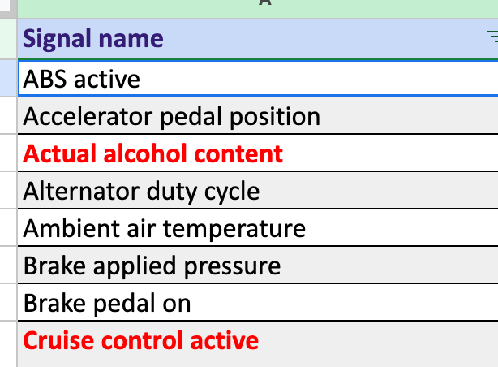
Establishing Scope
List of Target Vehicles
  2015-2018 Nissan Cabstar
  2020-2024 Renault Twingo
List of Parameters (Minimum Signal List)
  Engine Signals
  Brake Signals
Data Collection Method
  Normal Traffic
  Diagnostic Traffic
  Hybrid

Slide 5
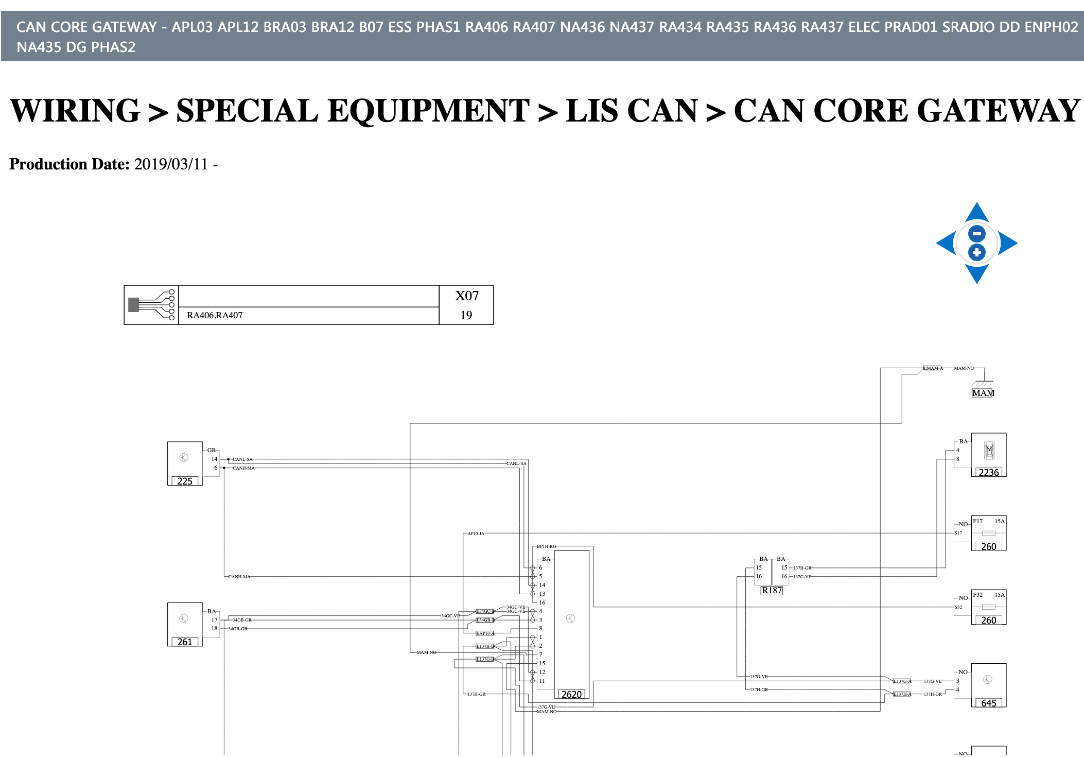
Gathering Vehicle Information: Preplanning
Wiring Diagrams
Understand Vehicle Electronic Platforms
  Normal Traffic Electrical Platform
  Diagnostic Communication Electrical Platform
Make a Map of these Platforms

Slide 6
Problems to be Solved
Normal Traffic
  CAN Bus Locations
  Baud Rates
  Coverage of Signals on the Bus (what network has the data we need)
Diagnostic
  Node Request and Respond IDs
  Protocols
  Scantool Initialization Information
Normal Traffic
  Wiring Diagrams
  In-House Tools to find baud rates and CAN Bus Wires (CAN Pulse)
  Vehicle Spy
Diagnostic
  In-House Tools: vsb -> vs3 (Scantool to vehicle spy)
  Identify services and message structure
  Connect to a vehicle with the scantool

Slide 7
Reverse Engineering
Methods and tools

Slide 8
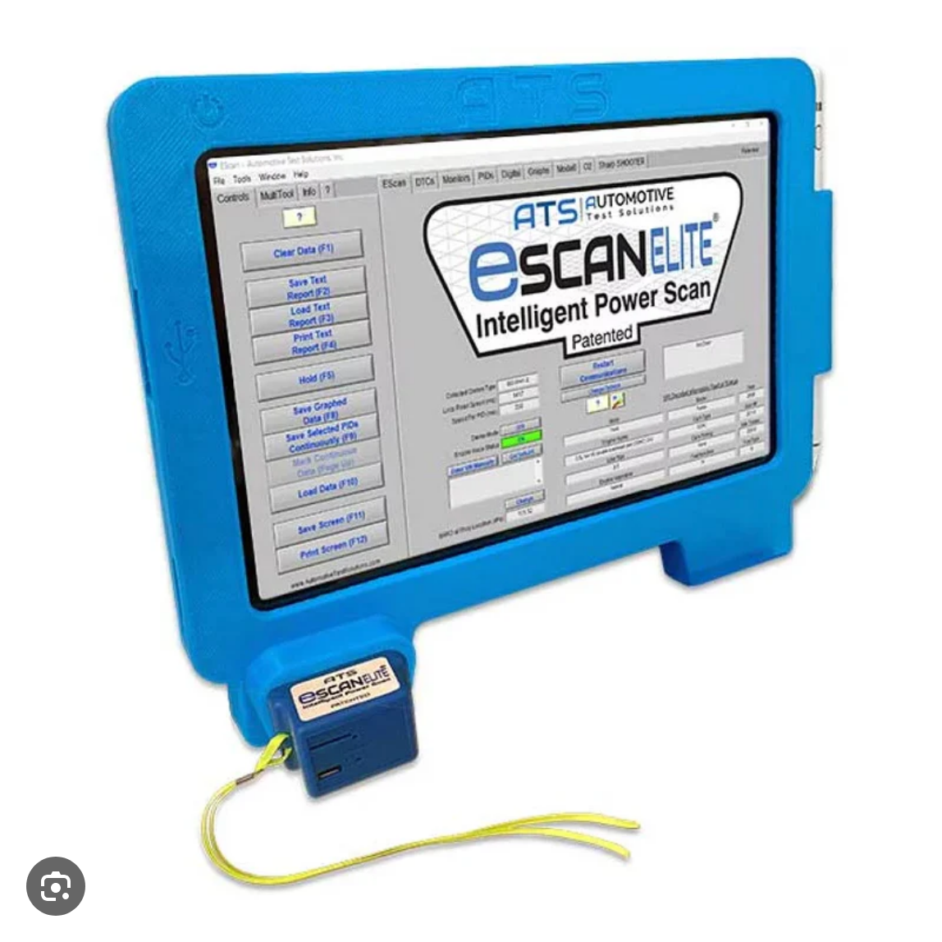
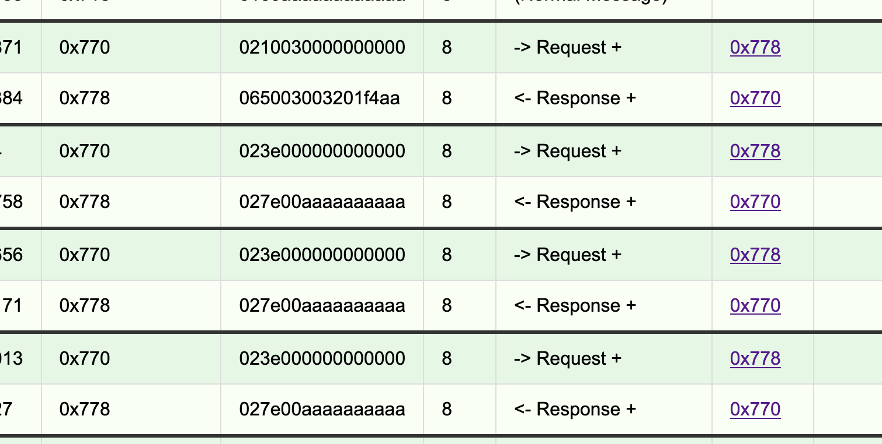
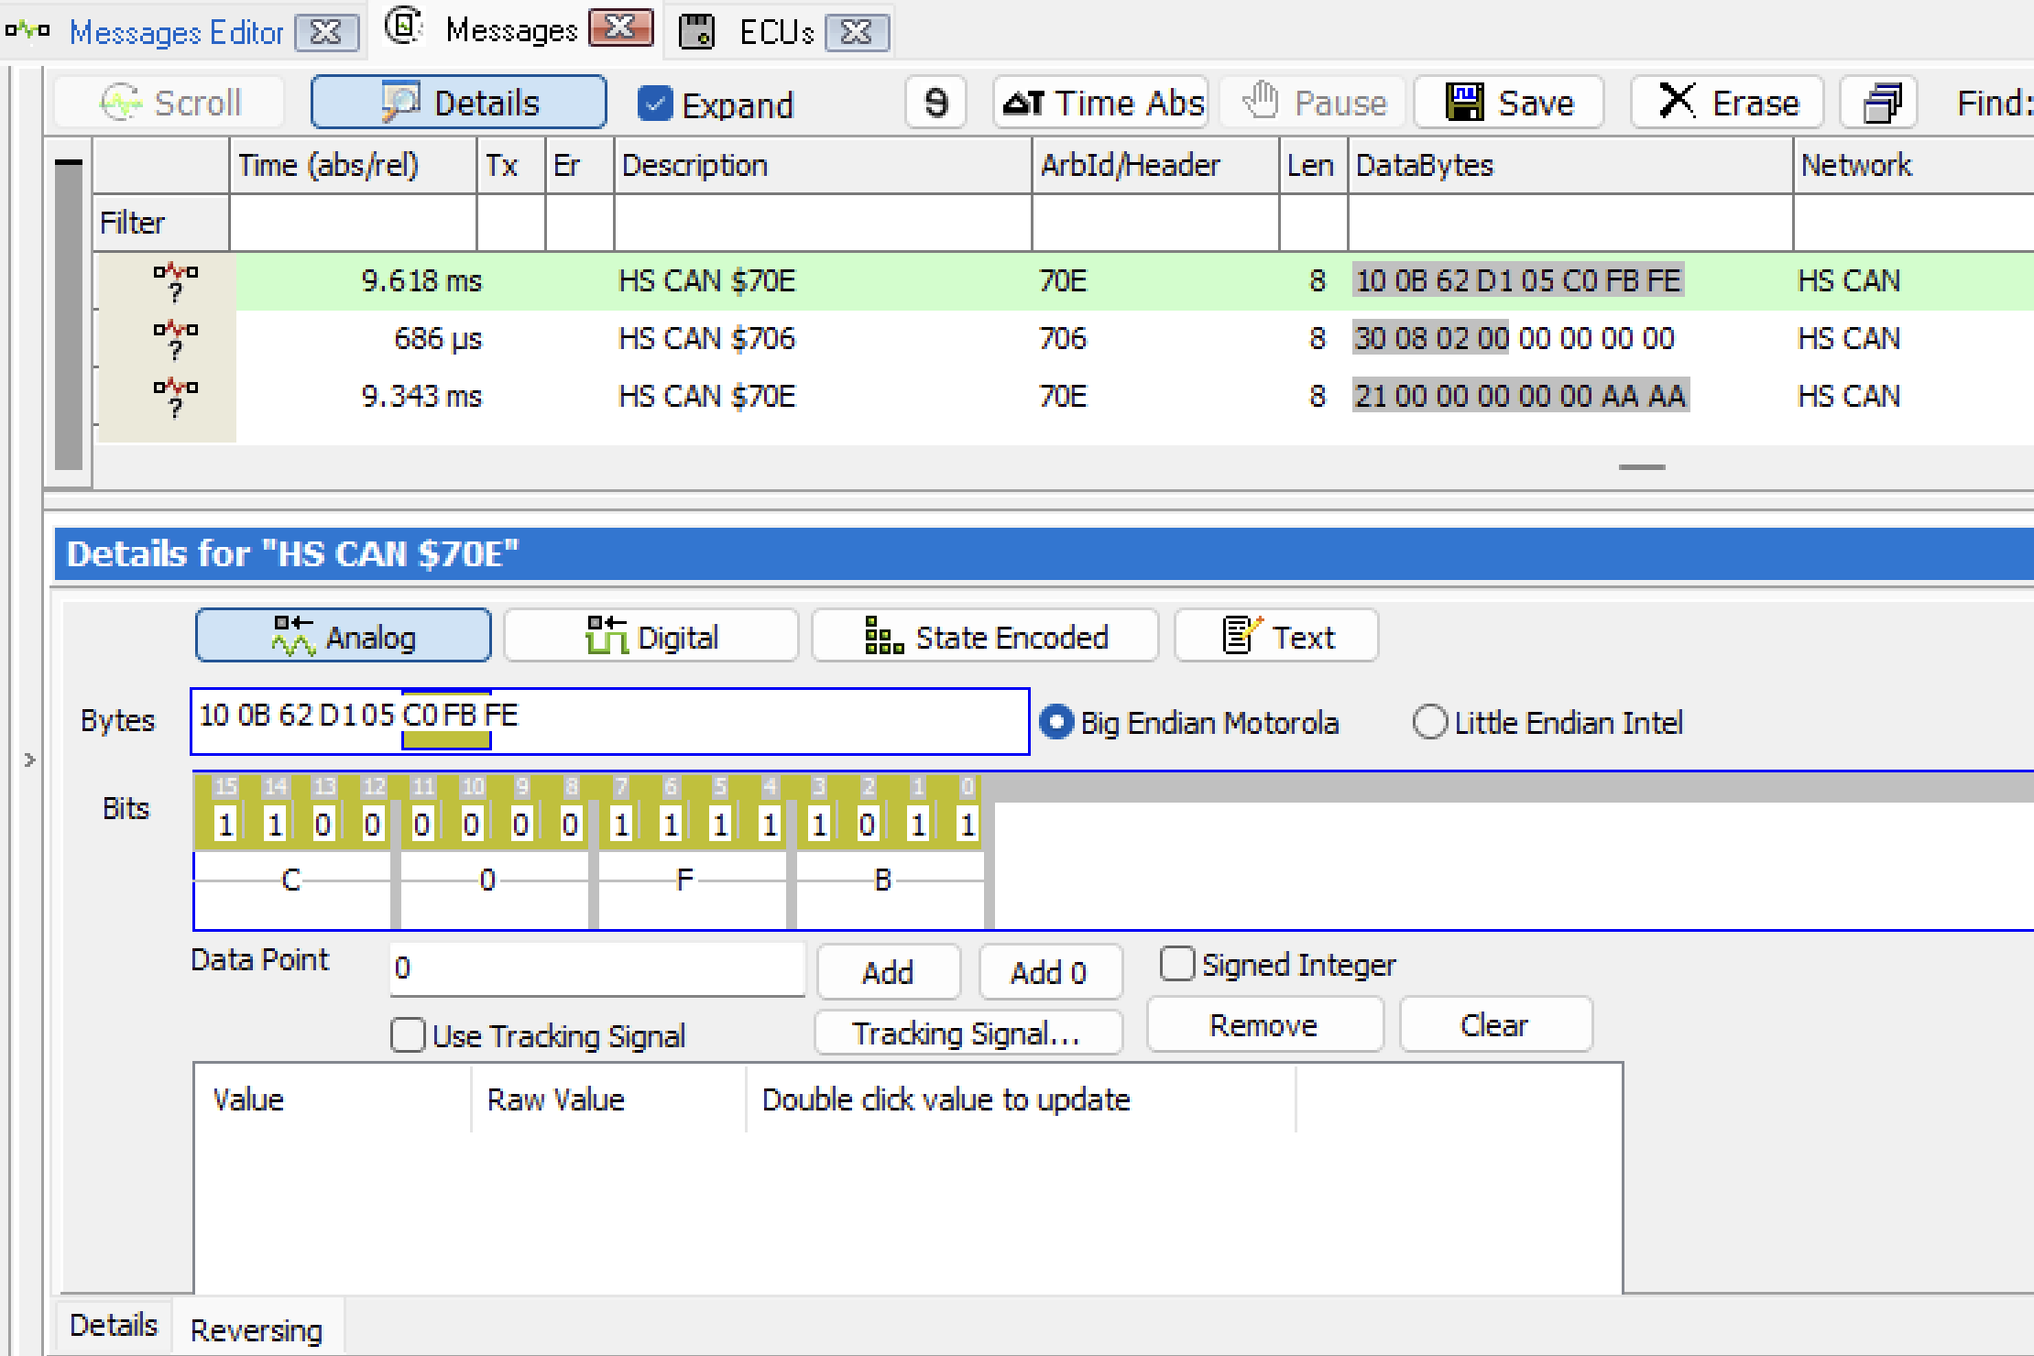

Tools
Publicly Available Tools:
  Vehicle Spy (Use daily) / neoVI
  Scantools
In-House Tools
  AutoAI
  VS3 Generator (Takes scantool capture)
  PID Reaper (Vehicle Simulator)

Slide 9
Methods
Basic Concept: Control the Input -> View log the output…
  Turn the Steering wheel to the right, then left, then right.
  Open/Close the door
Send Known Diagnostic Requests and find similar moving signals
Grab Scantool initialization for each module as a CAN Log for later use
Grab “Drive file” to for later applications of vehicle data and potential AI implications

Slide 10
Wrapping Up
Output of work

Slide 11
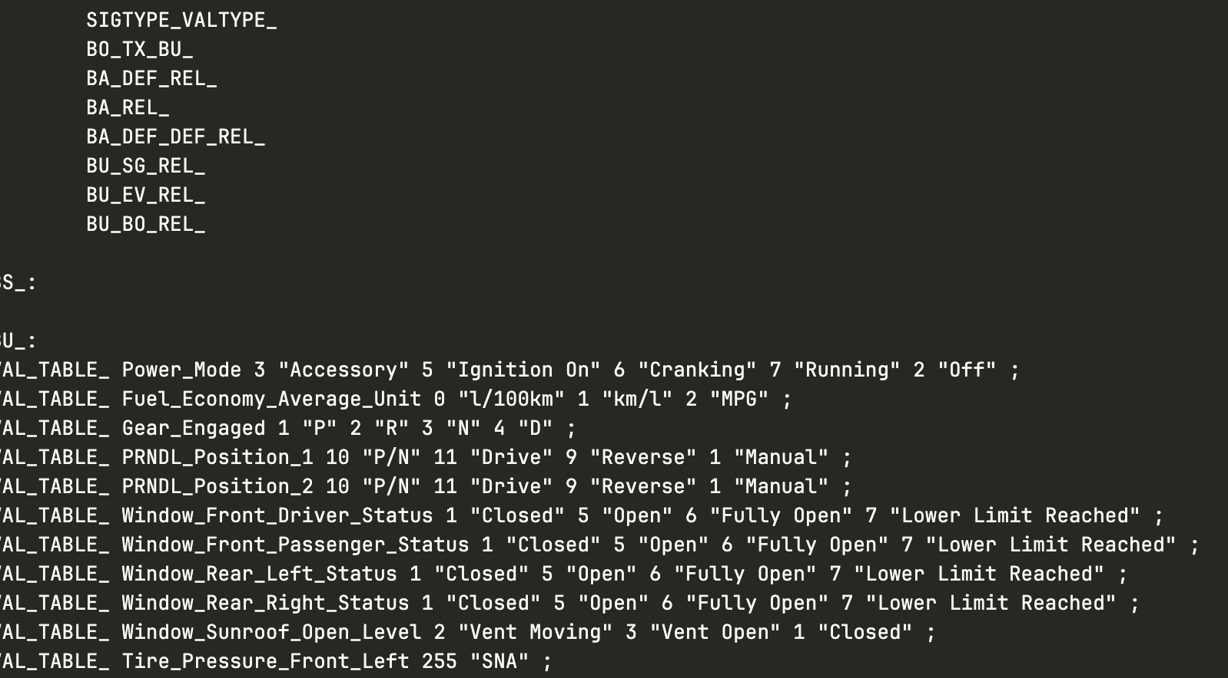
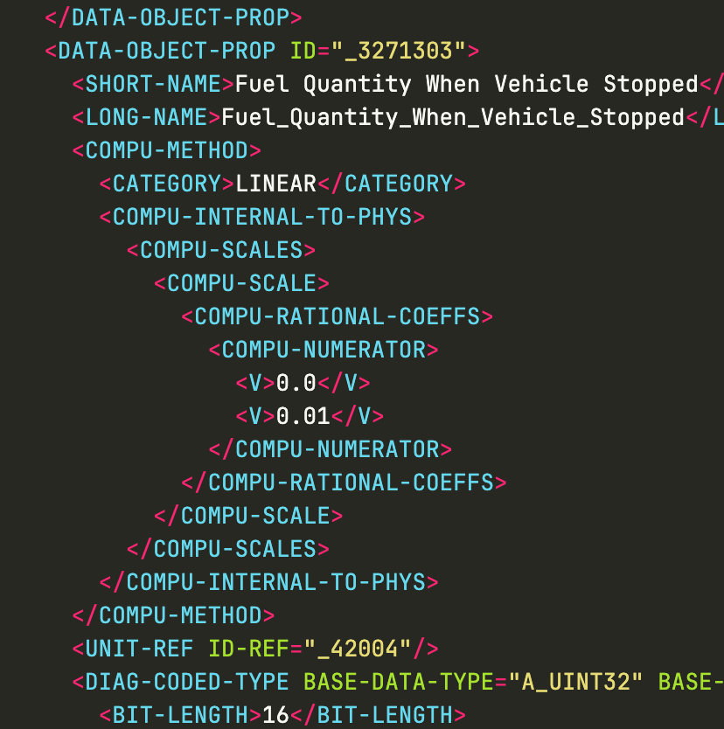
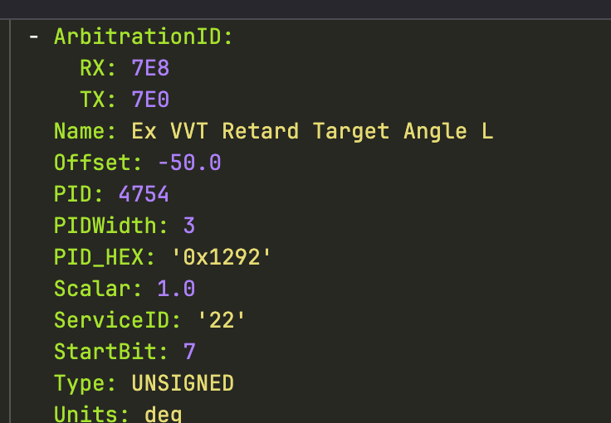
Deliverables
Normal Mode: dbc
Diagnostic Messages: yaml or odx
Report on what signals are where

Slide 12
Thank you and Questions?

