Slide 1
VISS and VISSR fleet usage
Ulf Bjorkengren, Ford Motor Company
2025-06-11

Slide 2
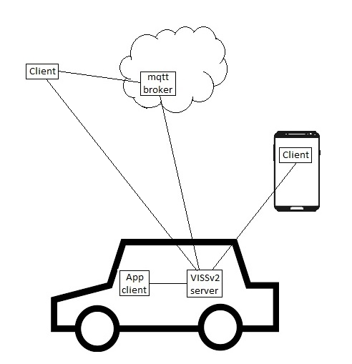
VISS support of deployment of VISS actors
Client deployment alternatives:
- Cloud
- Vehicle proximity
- In-vehicle (typically in app runtime)
Server deployment alternatives:
- In-vehicle (typically at the ”edge”)
- (Cloud)
Normative payload definitions:
- Client implementations at different deployments can (re)use the same requests also when using different transport protocols.

Slide 3
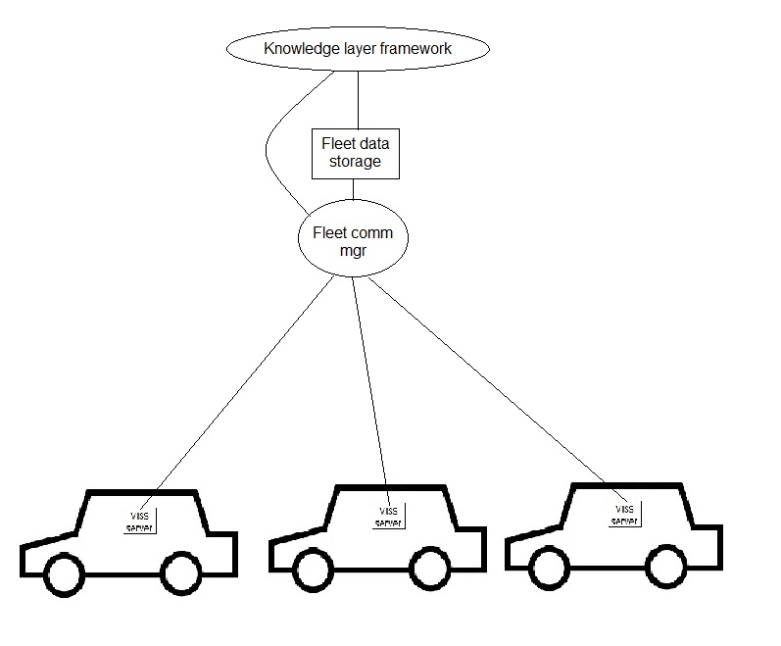
VISS fleet architecture model
Fleet communication manager implements one or more VISS clients that sets up bi-directional vehicle signal access.
KL-framework controls which signals to read from the fleet.
KL-framework can write data to vehicle(s).
Kl-framework have access to the stored fleet data in the fleet data storage.
Fleet data storage support storage of time series of vehicle data for multiple vehicles.

