Slide 1
Welcome
ALL MEMBER MEETING
APRIL 26-28, 2022

Slide 2



THANK YOU TO OUR SPONSORS

Slide 3
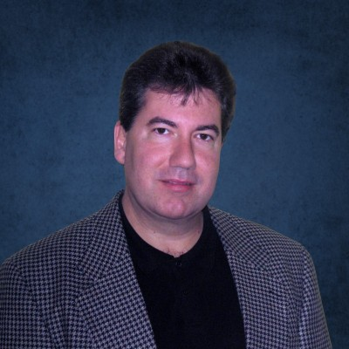
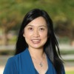
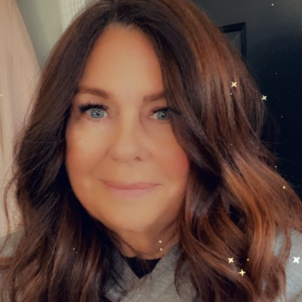
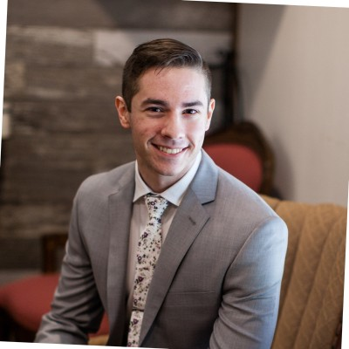
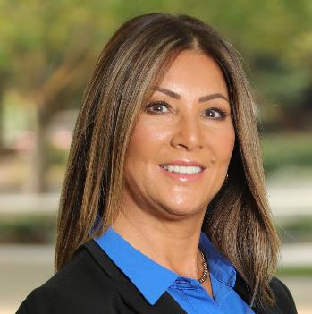
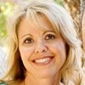
THANKS TO OUR TEAM!
Mike Nunnery – Biz Dev Manager
Fiano Han – Finance Coordinator
Karin Hanson – Sr. Events Manager
Nicholas Contino – IT Manager
Sue Schmidt – Helpdesk & Membership
Coordinator
Traci Renner – Branding &
Social Media
Karin, Paul, Nicholas, Fiano, Sue

Slide 4

New to the Team!
Paul Boyes – Community Director

Slide 5

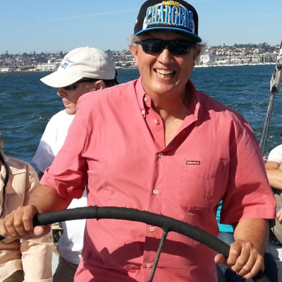
Most Value Contributors
Philippe Robin

Slide 6

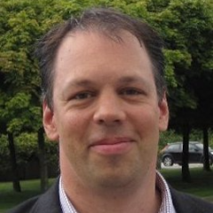
Most Value Contributors (2)
Gunnar Andersson

Slide 7
Overview of the Week
Event Program

Slide 8




Member

Slide 9
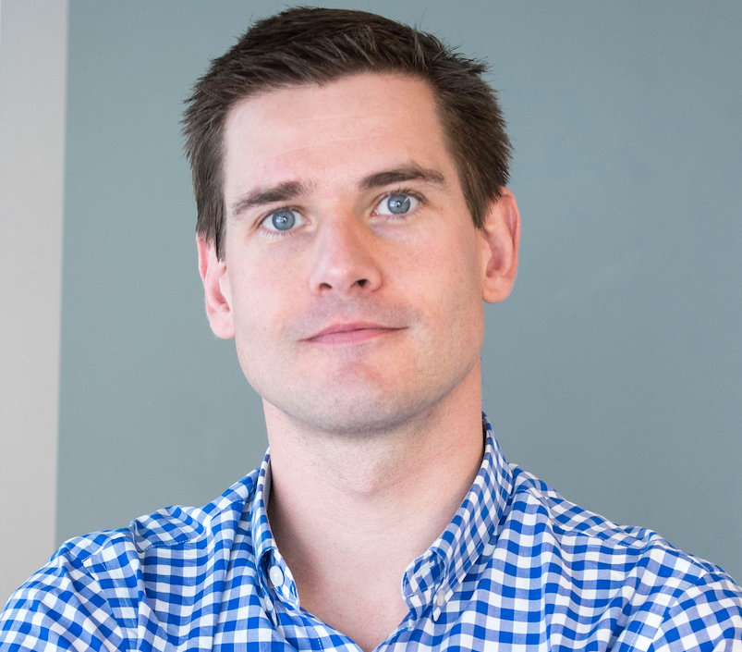
Matt Jones
Chairman & President, GENIVI Alliance
26 April 2022
| 3
Notes:
Steve Introduces Matt
Matt - We are investing in the organization’s future. We are an evolved organization with a fresh brand, a clear scope, some excellent work to pivot from, and a new value proposition to the industry.
Reinforce thank you to members.
it’s time to take it a step further – we’re not the same alliance from 2009 and we continue to evolve.
Play video

