Slide 1
OEMs Discuss the Future of Connected Vehicles
ALL MEMBER MEETING
APRIL 26-28, 2022

Slide 2
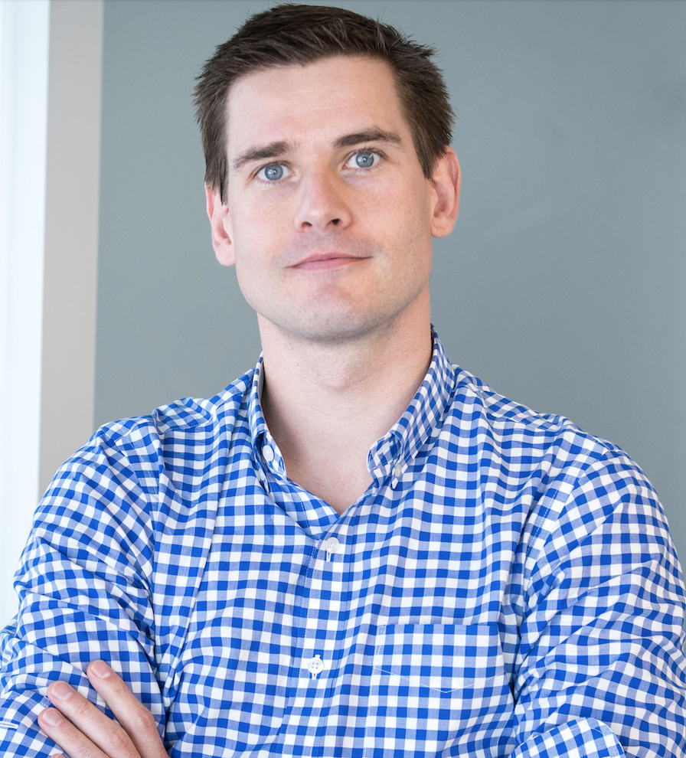
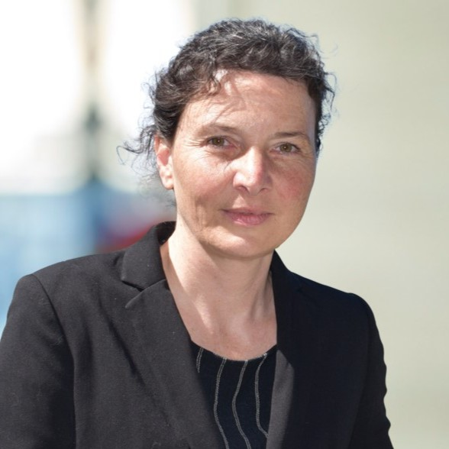
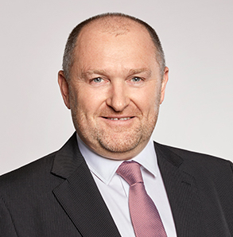
Matt Jones
Ford Motor Company
Katrin Matthes
Renault Group
Graham Smethurst
BMW Group

Slide 3

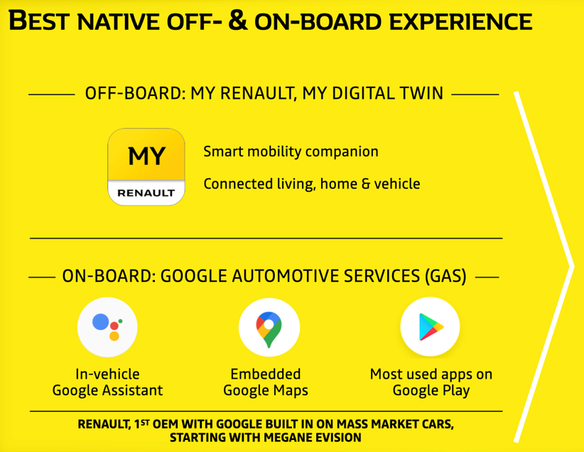
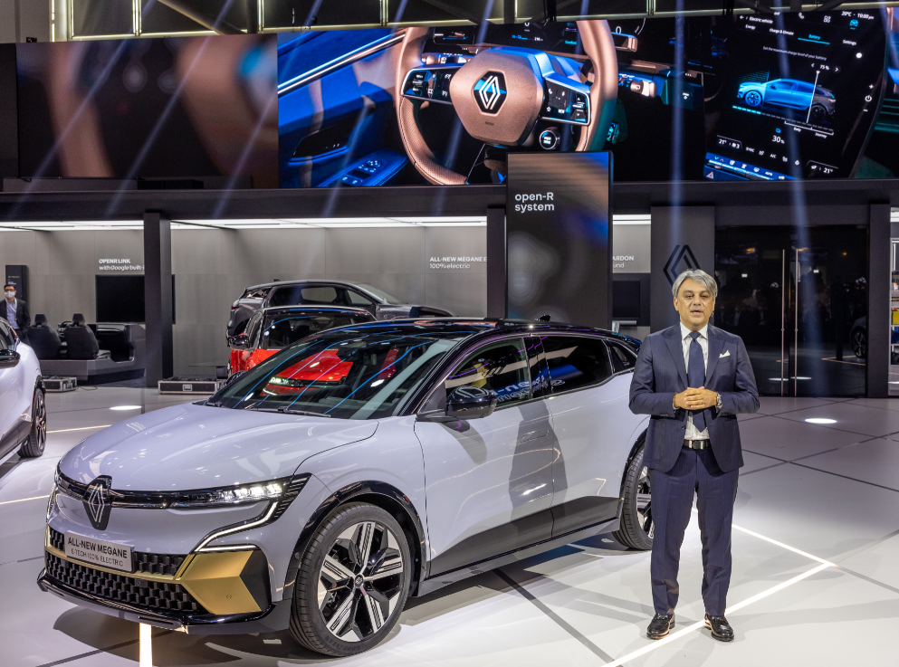
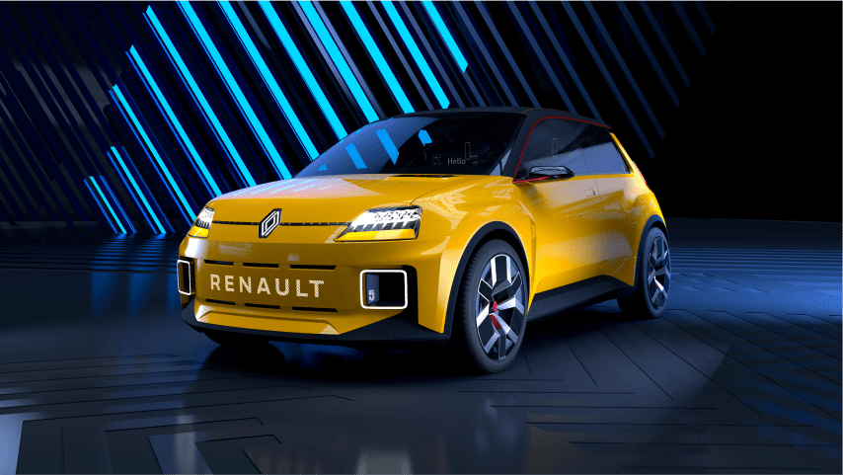
Connected Car Today: “Car Comes to Cloud”
Enhanced User Experience in the car
Digital Life Continuum
Connected Services
Leverage cloud as “extension to vehicle functions”

Slide 4

Connected Car Tomorrow: “Cloud Comes to Car”
Software Defined Vehicle (SDV)
Centralized Architecture –
High Performance Compute (HPC)
Virtualization
Containers & Orchestrators
Hybrid Services (onboard & offboard) with dynamic load management

Slide 5
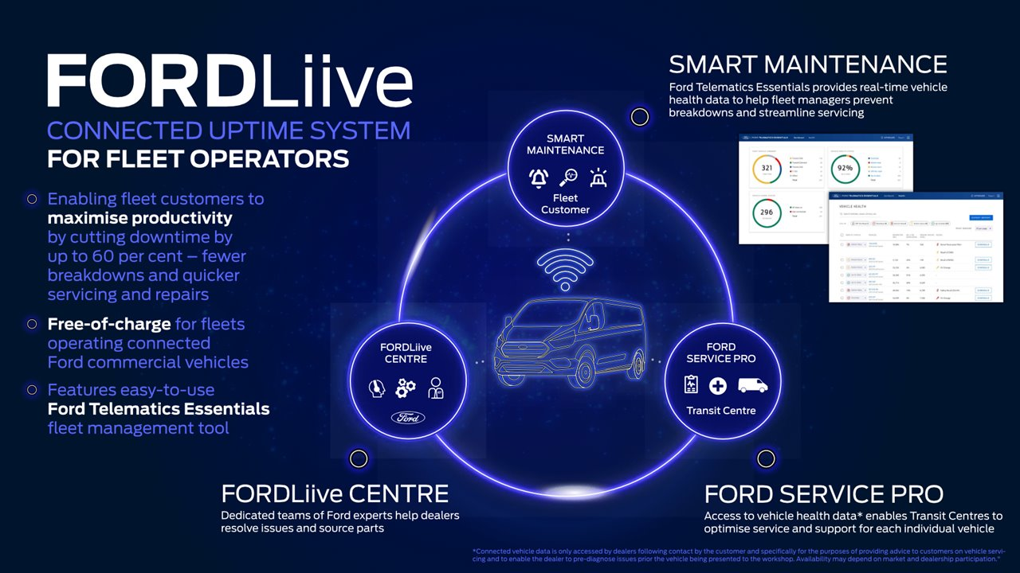

Slide 6

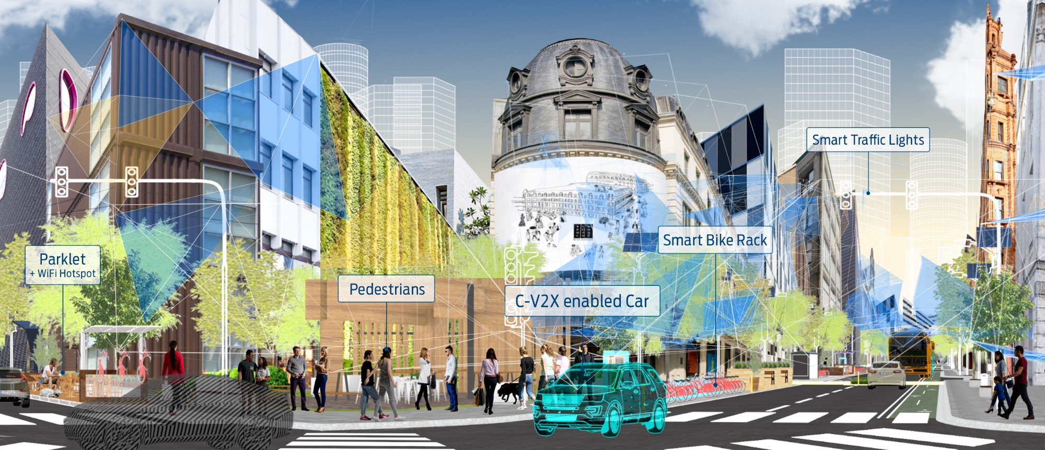
Products – Created by People

Slide 7
Questions & Answers

