Slide 1
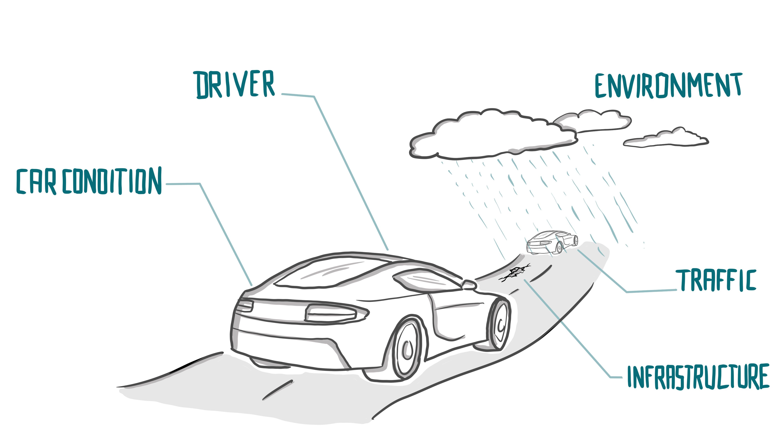

digital.auto unplugged | Show me the money!

Slide 2
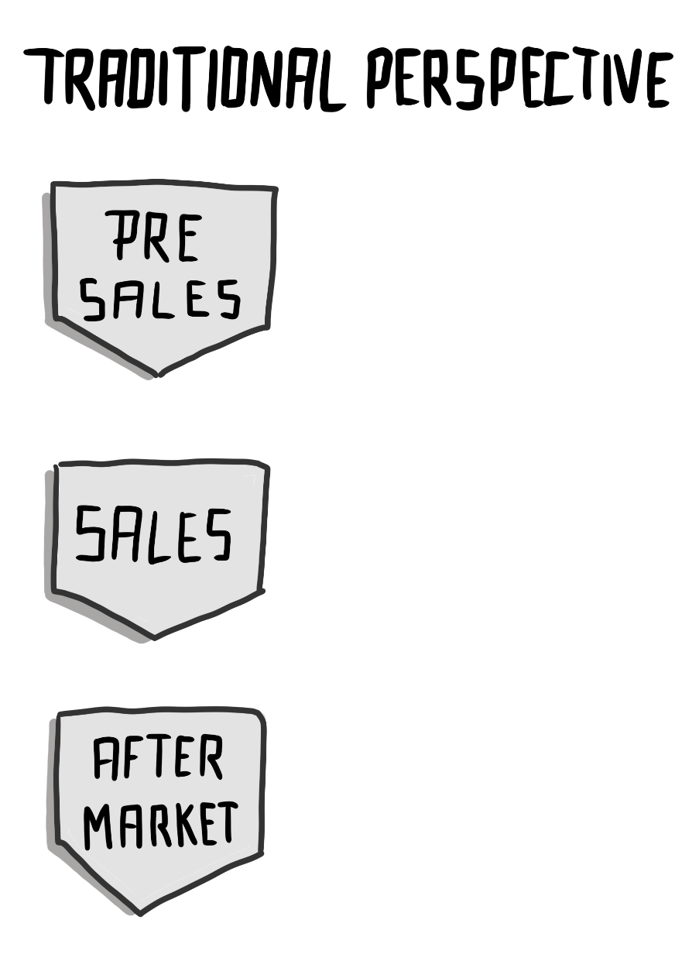
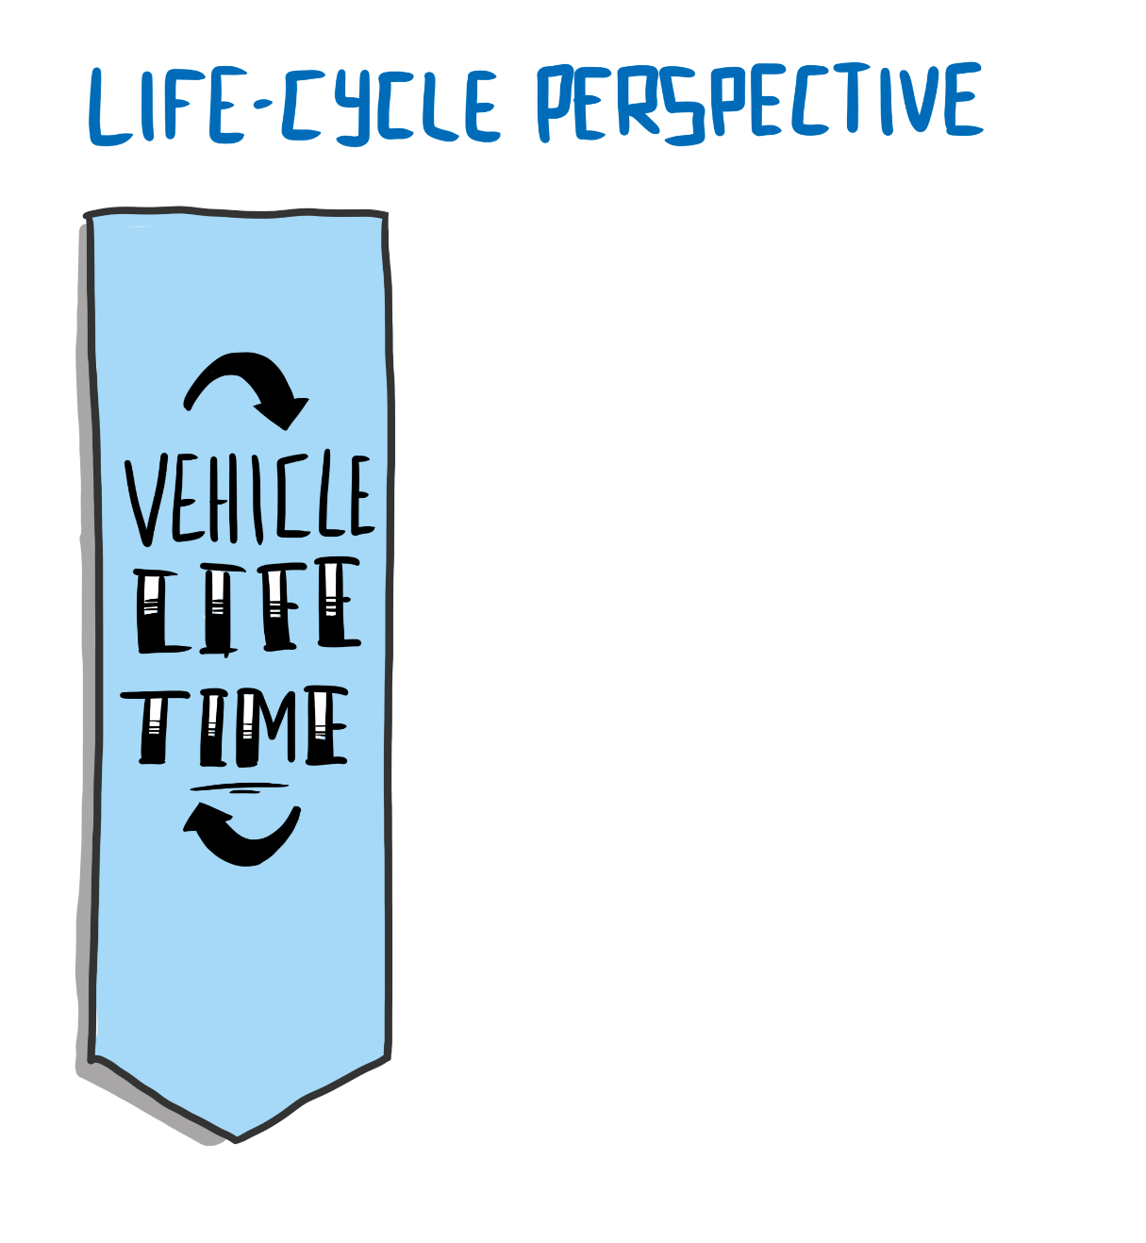
Stop focusing on selling hardware. Be open to selling digital products and services.
Every Moment counts
Convince the customer to opt
for additional features
(e.g., bigger sound system)
Onboard services
Vehicle features over the air
Enhancing safety and comfort
Entertaining passengers
Remote diagnostics and repair
Moment of Truth
Revenue is many / solely driven
by purchase price or leasing rate
Offboard services
Insurances
Car as mean of payment
Charging and fueling services
Services for fleet operators
Tie customers to own workshop
network (maintenance, repairs)

Slide 3
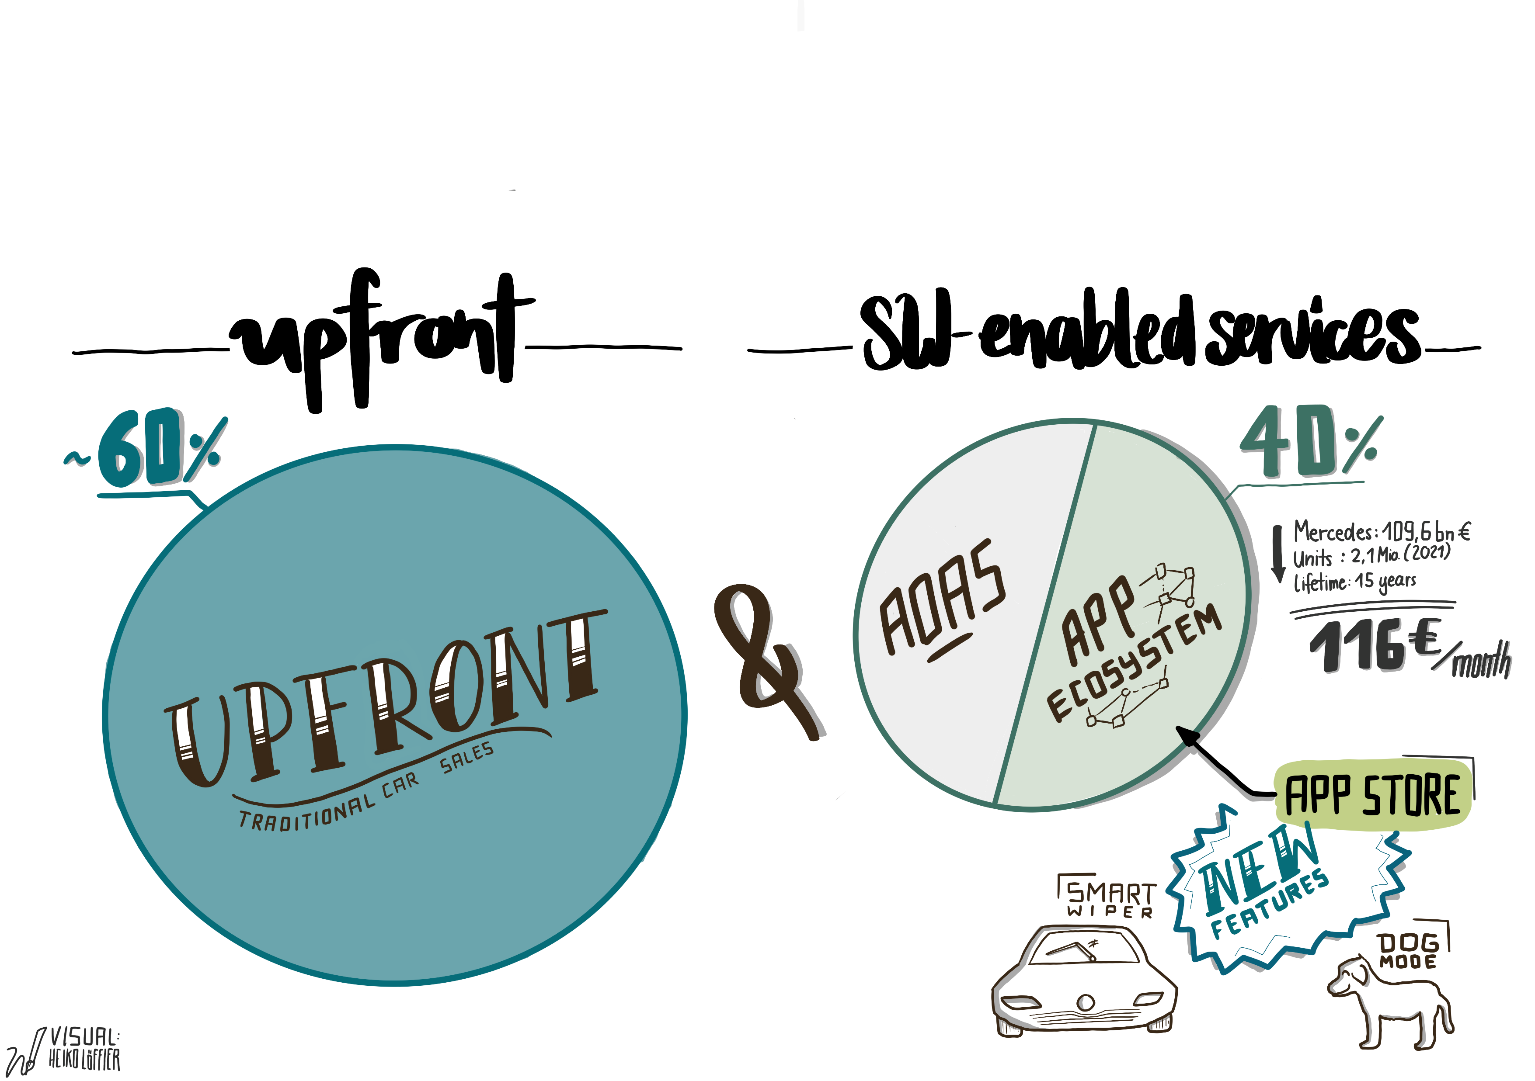
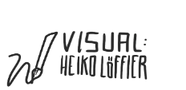
Revenues in the automotive market are increasingly realized along the life cycle through software enabled services!
Assumption: based on a revenue split of 3/5 upfront and 2/5 service-based for the year 2030
(based on a forecast by VW AG)

Slide 4
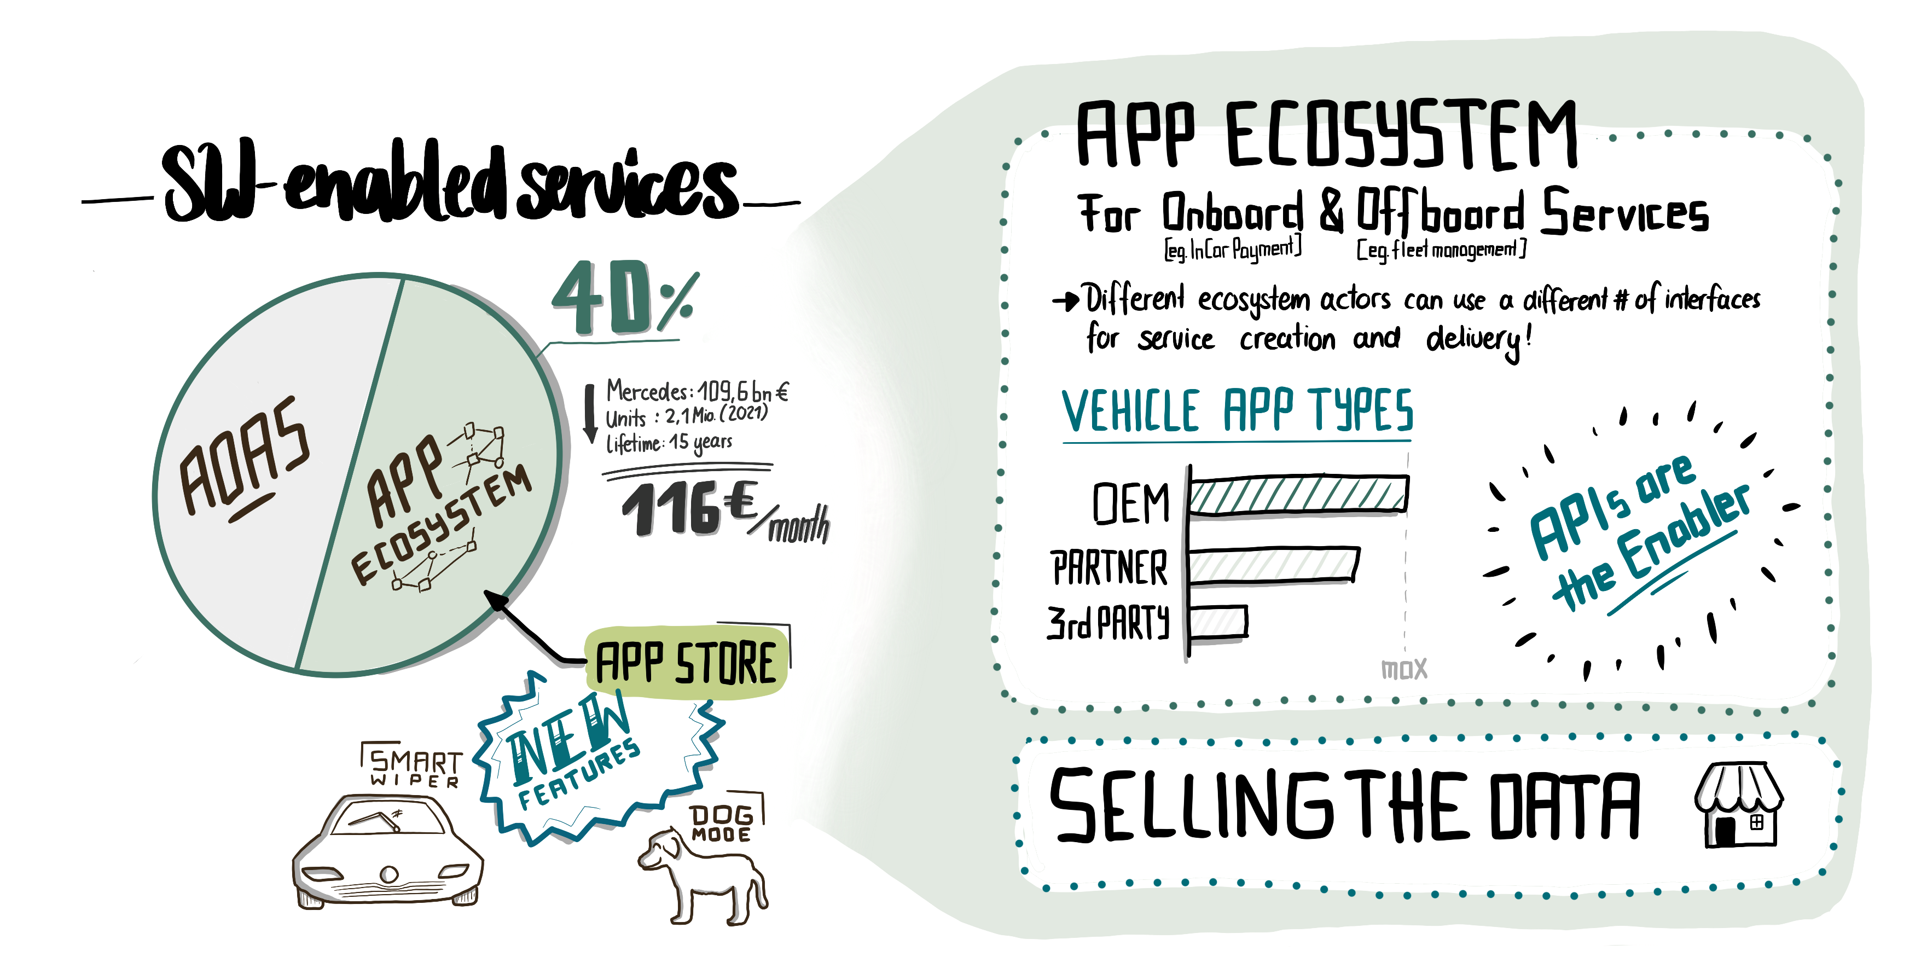
digital.auto enabled services, based on standardized interfaces, can unlock the digital value stream!

Slide 5

Along the customer journey there is a lot of data which can be used for the development of services!

Slide 6
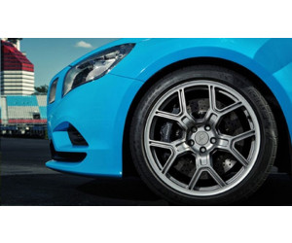

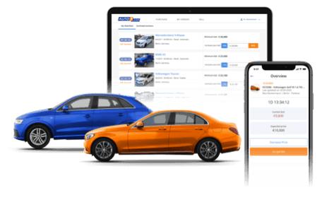

Vehicle manufacturers must ease the access to their services and products and integrate connected vehicle data.
Desired behavior
Motivation
Ability
Trigger
Customer wants to purchase 19 OE sports wheels with 245/35 W performance tires, breaks etc.
Customer wants to be able to drive faster
Customer wants to take advantage of limited promo-discount
Customer confirms 1 of 3 pre-booked appointments (pre-packaged specific offer for customer’s car)
Vehicle data reported frequent wheelspin or slippery
Promo-discount is only available for 100 hundred customers
Connected vehicle data

Slide 7
Use connected vehicle data to understand your customers.
Vehicle data | Driver profile | Offer
Many back-and-forth movements before ignition off Many different parking locations | Low parking ability Complex parking situation | Retrofit parking sensors Parking cameras 360-degree camera Adjustable mirror
Long-trip times | Long-distance driver | Fatigue detection Orthopedic seat
High average/max/corner speeds Many fast acceleration & harsh breakings | Sportive driver | Sport wheels & tires, breaks Radar-warning Distance warning High performance oil Driver training Race event Sports jacket
Below average speeds, accelerations, breaks | Cautious driver Eco-friendly driver | Fuel-safe tires Eco-route nav upgrade Lane warning/keeping Collision assist dashcam
Long low-speed driving in circles before ignition off | Long parking search time | Partner deal with parking garage Pre-loaded/discounted parking app Parking prediction services

