Slide 1
EVFleetSim – proposal to Ford

Slide 2
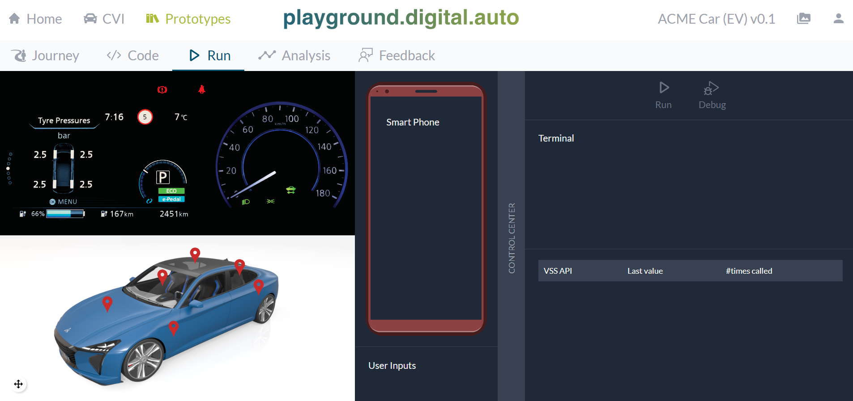


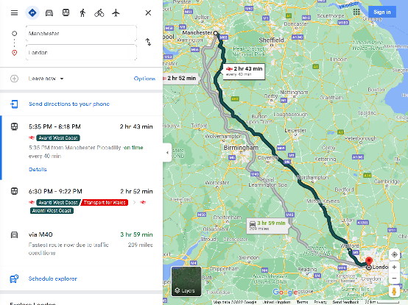
EV FleetSim Server for Playground
EV FleetSim Server
SimLoop
EV
plug-in
playground.digital.auto
REST API
Google Maps

Slide 3
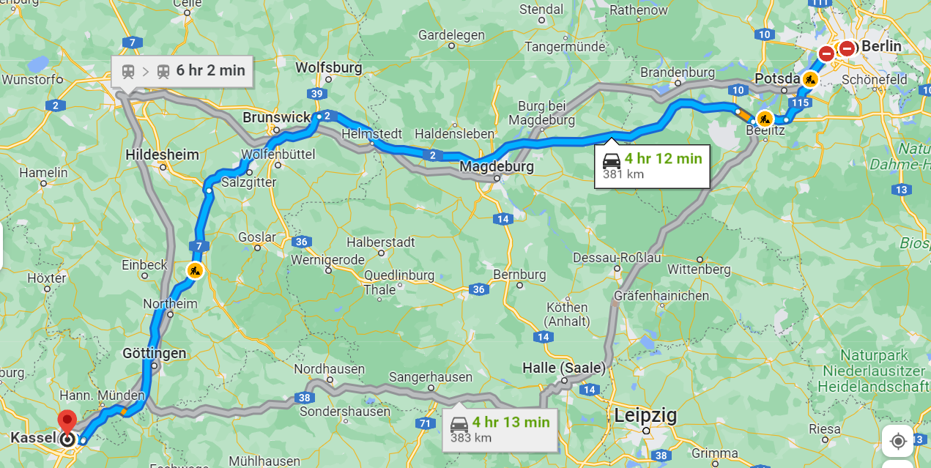


MVP: 3 FleetSim Plug-Ins for Playground
End
Next Chargestation
Chargestation | Current Value
ID | 4711
MaxCurrent | 32A
MaxVoltage | 208V
Average Power | 7.68kW
Next Chargestation
Long: …
Lat: …
Start
Vehicle
Long: …
Lat: …
VSS Data Point | Current Value
Vehicle.VehicleIdentification.VIN | 4Y1SL65848Z411439
Vehicle.Speed | 80 km/h
Vehicle.Powertrain.TractionBattery.StateOfCharge.Current | 56%
Vehicle.Powertrain.TractionBattery.NetCapacity | 80 kWh
Vehicle.Powertrain.TractionBattery..Charging. TimeToComplete | 9112s
Vehicle.Powertrain.TractionBattery.Charging.ChargeLimit | 80%
Vehicle.Powertrain.TractionBattery.Range | 123km
VSS Data Points
Status: Not connected
Distance: 98km
ETA: 1h12m

Slide 4
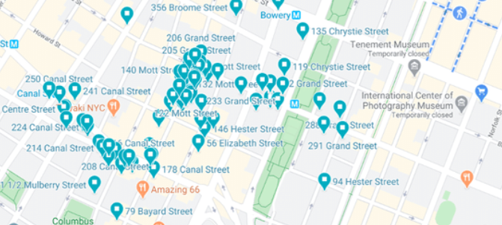
V1.2: Vehicle Selection
Next Chargestation
Chargestation | Current Value
ID | 4711
MaxCurrent | 32A
MaxVoltage | 208V
Average Power | 7.68kW
Next Chargestation
Long: …
Lat: …
Vehicle
Long: …
Lat: …
VSS Data Points
Pop-up to select a different vehicle. World is displayed as simple grid. Details of selected cell in grid are shown on map. Selection of vehicle in the map will set this vehicle as new vehicle for the main UI. Structure of grid chosen so that each cell has in average ~10 vehicles.
SimGrid
VSS Element | Current Value
Vehicle.VehicleIdentification.VIN | 4Y1SL65848Z411439
Vehicle.Speed | 80 km/h
Vehicle.Powertrain.TractionBattery.StateOfCharge.Current | 56%
Vehicle.Powertrain.TractionBattery.NetCapacity | 80 kWh
Vehicle.Powertrain.TractionBattery..Charging. TimeToComplete | 9112s
Vehicle.Powertrain.TractionBattery.Charging.ChargeLimit | 80%
Status: Not connected
Distance: 98km
ETA: 1h12m
Vehicles and Chargestations in selected grid element

Slide 5
Populating the SimGrid
SimGrid
  The is a rectangular area representing a part of the real world on GoogleMaps
SimGrid::Vehicles
  Vehicles are created by the simulation and logically mapped onto a real map
  The SimGrid contains totalNumberOfVehicles
  The number of cells should be defined so that each cell will contain on average 10 vehicles
  The cells structure is not so important for the simulation, but more for the visualization of the entire fleet in the UI
  Each vehicle on the SimGrid has a currentRoute, which includes startingPoint, endPoint, and nextChargepoint.
  Naturally, currentPosition must be on currentRoute
  vehicleState can be: Driving | Charging | Parking
SimGrid::Chargestations
  The chargestations on the SimGrid should be takend from GoogleMaps
  This should at least includes the Long/Lat, and potentially also the technical spec of the charge station
  In the initial version of the simulation, we will not track whether a chargestation is currently occupied. Each station will accept an unlimited number of concurrently charging vehicles.
SimGrid

Slide 6

Thank You!
digital.auto is an open collaboration platform, hosted by Ferdinand-Steinbeis-Institut (FSTI) as a neutral facilitator.
A privacy notice according to GDPR (how FSTI processes personal data and how it applies data protection principles) can be viewed here: https://ferdinand-steinbeis-institut.de

