Slide 1
Connected Vehicle Software Development
Automated Testing, a Collaborative Approach for the Industry
Stephen Lawrence (Renesas), GENIVI BIT Lead | May 2020

Slide 2

Agenda
Shared upstream testing with a focus on development
  How it complements existing in-house testing and can accelerate development
How Genivi is contributing
  Update on the Genivi Automated Testing Board Farm
  The road ahead
Q&A and discussion
Notes:
Japanese proverb:さるもきからおちる (Saru mo ki kara ochiru)
Even monkeys fall out of trees

Slide 3

Shared testing upstream

Slide 4
Shared testing upstream
Shared testing of important software
  Successful example is Kernel CI
    Community based open source distributed test automation system focused on upstream Linux kernel development.
    Goals
      Build every configuration for each architecture.
      Boot these configurations.
      Execute tests on these configurations.
Automated Testing Summit to increase collaboration and reuse
  Test cases – separate test cases from more abstract tooling such as scheduling
  Interoperability – results (pass/fail, logs), components
  Mechanisms – such as feature specific tooling, e.g. board control.
Notes:
Wanted to pick out two examples
Firstly a large testing project in Kernel CI
Secondly recent summits on the shared aspects of tooling
Kernel ci helps answer Qs like:
If I enable encryption will it build?
I use 4.14 kernel. What is the state of 5.4 kernel on my SoC?

Slide 5
Automotive needs
Companies have advanced internal testing setups
  proprietary s/w which can’t be shared and
  OSS s/w which is <– here shared testing is possible
OSS included in company-internal testing anyway so why share?
  Pooling resources creates ability to test wider variation of versions and configuration than is normally done in a production or internal platform project (remember Kernel CI)
  In a complex stack trying to cover everything internally is very difficult
  Development of test tools and test cases is time consuming and costly.
  We use component Foo v4. Should we take v5?
    v5 may not be tested internally (yet), but in wider community it might be
  Investigating upstream components for integration
Conclusion: ability to look upstream for test results is a stronger basis for development

Slide 6
GENIVI Contribution

Slide 7
Recap of what’s already in place
Distributed CI of “systems” using GENIVI GoCD instance
  Builds GDP and Baseline
  Central server, with remote build agents
GENIVI CI Policy encourages use of GitHub-integrated tools such as Travis-CI where teams select their own tooling for components
GENIVI source hosted in GitHub
  Integrated with GoCD to sanity build test pull requests for GDP and baseline
Yocto Baseline (meta-ivi)
  Meta-ivi-test image contains component unit tests
Components
  Mix of testing in individual companies and in the open, e.g. DLT
New automated test initiative
  Discussed at last AMM and now a reality
  GENIVI LAVA Board Farm
  Android and Linux testing

Slide 8
GENIVI s/w scope has expanded
Multi-OS strategy
  Domain Interaction evolving into Multi-OS
  Android SiG, Cloud and Connected Services Project etc.
  Meaning multiple dev environments
  Test infrastructure needs to be flexible
Collective opportunity
  Possibility to collaborate and integrate with existing testing infrastructures for supported development platforms such as Apertis, WebOS, Adaptive Autosar and Android.
  Favour working together towards greater combined solutions, over repetition
  Open test instances enhance shared development of tooling, test cases and learning
  Open dialog and flexibility
Notes:
Multi-OS strategy means multiple dev environments which requires a flexible test infrastructure
Linux, Android.. Functional safety OS
Opportunities:
Multi-OS means the possibility to collaborate with existing testing infrastructures.
Do I rebuild all that functional safety stack or take their image?
Favour working together towards greater combined solutions, over repetition
Consider early in the project what can be shared and what is unique to me?
Open test instances facilitate shared development (tooling and test cases) and learning
More useful than it may initially sound.

Slide 9
Automated test initiative: launch recap
Announced at last AMM
Working mode: make a start, be flexible and open to collaboration with other orgs
LAVA based test system to be connected to Genivi GoCD CI (and other CI as needed)
  Distributed system in wide use.
  Strong support for complex deployment use cases on embedded hardware.
  Proven to scale to large deployments.
Genivi instance will start one control server and one lab containing QEMU and automotive hardware
Will use it for CIAT test of future GENIVI code emerging from Multi-OS
Notes:
Working mode: make a start, be flexible and open to collaboration with other orgs

Slide 10
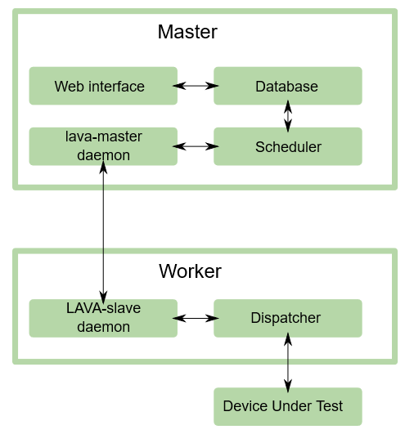
Automated test initiative: LAVA
What is LAVA?
  LAVA is the Linaro Automation and Validation Architecture
  System for deploying OSs onto physical and virtual h/w to run tests.
  Designed to automate validation during development
  Wide device support
  Extensive feature list
  See Overview in LAVA documentation for full details
Architecture
  A LAVA instance consists of two primary components
    LAVA Master (control server)
    LAVA Worker (execute tests on boards) for QEMU and automotive hardware
  YAML based test job descriptions
Notes:
What is LAVA?
System for deploying OSs onto physical and virtual h/w for running tests.
Designed for automated validation during development
Features
Automated: Automation the create, submit and process results of test jobs to validate the development process.
Parallel scheduling
Hardware sharing – expensive h/w possibly

Slide 11
Automated test initiative: Genivi instance status
Has been live and stable for some time now.
Genivi LAVA Master (server)
Genivi LAVA Worker (slave)
  Renesas are hosting a lab currently containing the following DUTs:
    QEMU
    R-Car M3 Starter Kit
    R-Car H3 Starter Kit with Kingfisher expansion board fitted
  More Workers/labs wanted..
Configuration
  Running in Docker containers created using lava-docker from Kernel CI project
  Leveraged work occurring in embedded industrial Civil Infrastructure Platform (CiP) (LAVA instance)
  Worker is currently running recent LAVA release v2020.02.
    Enables new support for handing Android host tools in Docker containers
    Plan to update to v2020.04

Slide 12
Automated test initiative: Genivi instance status
Flexible approach to inputs
  Allows input from different CI
  Test artifacts can come from Genivi CI or be downloaded
Linux
  Linux based boot tests have been running stably for some months
  Have proven running of meta-ivi-test unit test suite using LAVA
  GoCD pipeline in place to execute tests. Now completing integration so meta-ivi pull requests are sanity tested against meta-ivi-test unit tests.
Android
  Android builds have been containerised
  Using new features introduced in LAVA v2020.02 to handle Android host tools in Docker container
  Have successful flashing of Android binaries using LAVA
  Now moving to test execution.
Notes:
OS Job examples
Meta-ivi-test: https://lava.genivi.org/scheduler/job/492
Android: https://lava.genivi.org/scheduler/job/815

Slide 13
How can we all contribute? Q&A and discussion
The LAVA instance has been stable for some time. Now its time to make use of it.
Contribute test cases or help with integration
Contribute LAVA Workers
Android test expertise
Integrate your next GENIVI collaboration into the GENIVI CIAT
  Easier done from the start, than later of course
Propose other integration opportunities with existing testing infrastructure
  Internal - what can be shared upstream?
  Related alliances
The board farm exists. Let's put it work and expand it.
Q&A and discussion
Notes:
Gunnar and I have incubated the project into life. Now its time to make use of it.

Slide 14
LAVA Master Web-UI

Slide 15
Thank you!
Visit GENIVI:
http://www.genivi.org
http://projects.genivi.org
Contact us:
help@genivi.org

