Slide 1


Hands-On
May 10, 2017 | ALSA Routing Adapter Plugin
Jens Lorenz
Staff Engineer, ADIT GmbH, GENIVI Alliance

Slide 2
Why ALSA Routing Adapter?

Slide 3
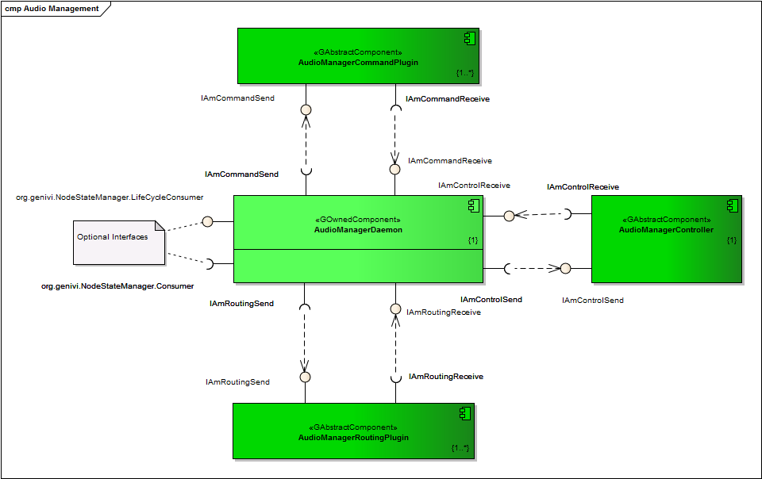
Overview
Existing Infrastructure
  Daemon
  Plugins
    CommonAPI
    DBus
    Generic Controller

Slide 4
Motivation
Reduce learning curve
  Playground to understand domain concept
  Playground to understand static vs. dynamic IDs
Playground independent of audio server
  AM works as a single daemon
  ALSA plugins for processing only i.e. mixing
Works with Generic Controller
Usable for real products
  Used in platforms with Hands-Free (ECNR) systems

Slide 5
What does it?

Slide 6
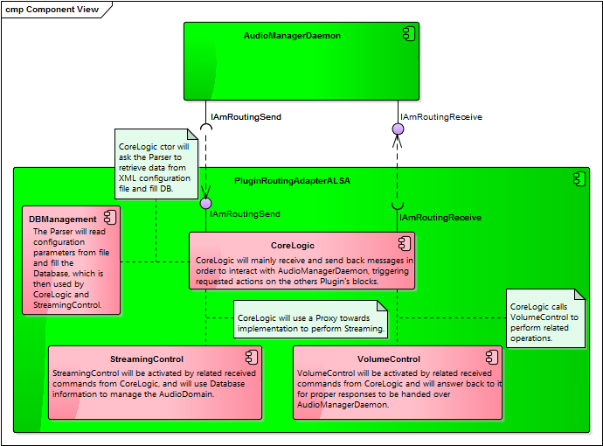
Design
Domain Database
  Filled on construction
  Registered on startup
Streaming Control
  Creates Proxies on demand
  Proxies can be replaced
Volume Control
  Works with SoftVol
ALSA Control
  On SoundProperty Request

Slide 7
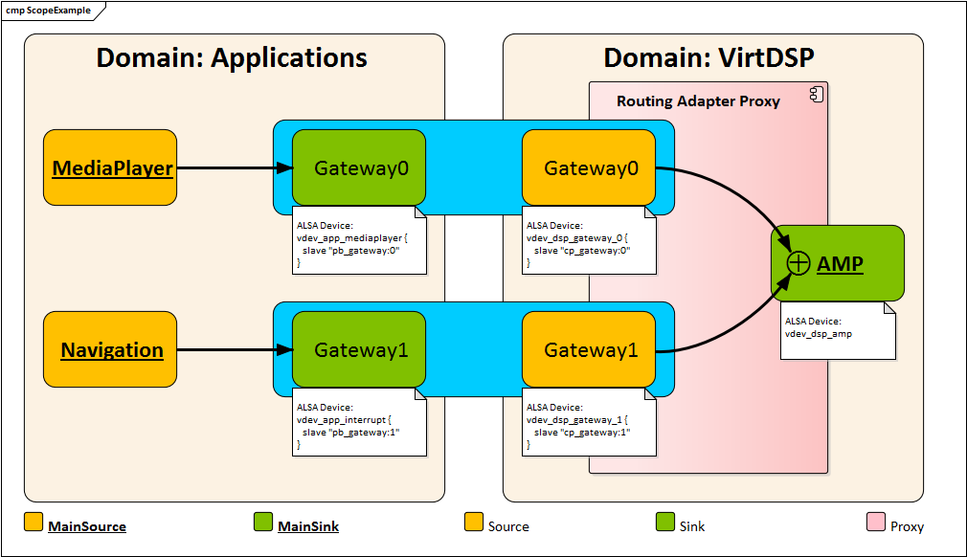
Proxy in Audio

Slide 8
Proxy Interface
class IAmRoutingAdapterALSAProxy
{
  IAmRoutingAdapterALSAProxy(const ra_Proxy_s & proxy);
  virtual ~IAmRoutingAdapterALSAProxy();
  virtual am_timeSync_t getDelay() const = 0;
  virtual am_Error_e openStreaming() = 0;
  virtual am_Error_e startStreaming() = 0;
  virtual am_Error_e stopStreaming() = 0;
  virtual am_Error_e closeStreaming() = 0;
}

Slide 9
Example Needed?

Slide 10
Domain Configuration with Gateway
<amra_alsa>
<tDOMAIN domNam = "Applications" nodNam = "Cpu">
<tSOURCE srcNam = "MediaPlayer" srcID = "1" srcClsNam = "BASE" />
<tSINK sinkNam = "GatewayIn" visible = "0“ />
</tDOMAIN>
<tDOMAIN domNam = "VirtDSP" nodNam = "Cpu">
<tSOURCE srcNam = "GatewayOut" srcClsNam = "BASE" visible = "0">
<tGATEWAY gatewayNam = "Gateway" sinkNam = "GatewayIn" sinkDomNam = “Applications"
lstSrcFrmt = "2" lstSinkFrmt = "2" convertionMatrix = "1"> </tGATEWAY>
</tSOURCE>
<tSINK sinkNam = "AMP" sinkID = "1“ />
</tDOMAIN>
</amra_alsa>

Slide 11
Volume Configuration
<tDOMAIN domNam = "Applications" nodNam = "Cpu">
<tSOURCE srcNam = "MediaPlayer" srcClsNam = "BASE"
pcmNam = "vdev_app_mediaplayer" volNam = "vol_mediaplayer" />
<tSINK sinkNam = "Gateway" visible = "0" />
</tDOMAIN>
ALSA configuration:
pcm.vdev_app_mediaplayer {
type plug
slave.pcm vdev_mpsv
}
pcm.vdev_mpsv {
type softvol
slave.pcm “hw:Loopback,0"
control.name vol_mediaplayer
control.card 0
}

Slide 12
Proxy Configuration
<tDOMAIN domNam = "VirtDSP" nodNam = "Cpu">
<tSOURCE srcNam = "Gateway" srcClsNam = "BASE" visible = "0“ />
<tSINK sinkNam = "AMP" sinkID = "1“ />
<tPROXY srcNam = "Gateway" sinkNam = "AMP“
pcmSrc = "vdev_dsp_gateway“ pcmSink = "vdev_dsp_amp“
lstRates = "48000" msBuffersize = "8"
CPUSchedulingPolicy = "1" CPUSchedulingPriority = "80" />
</tDOMAIN>
ALSA configuration:
pcm.vdev_dsp_gateway {
type hw
slave.card “Loopback”
slave.device 0
}
pcm.vdev_dsp_amp {
type dmix
slave.pcm “hw:0”
slave.rate 48000
slave.channels 2
}

Slide 13
Sound Properties
<tDOMAIN domNam = "VirtDSP" nodNam = "Cpu">
<tSOURCE srcNam = "Gateway" srcClsNam = "BASE" pcmNam = "vdev_app_mediaplayer" />
<tPROPERTY type = "1">
<tPROPSPEC value = "1"
namsVals = "vol_mediaplayer, 50; ADC High-Pass Filter, High Pass;" />
<tPROPSPEC value = "2"
namsVals = "vol_mediaplayer, 200; ADC High-Pass Filter, None;" />
</tPROPERTY>
</tSOURCE>
</tDOMAIN>

Slide 14
Next?

Slide 15
Open Topics
Generic Controller works with fix topology
  Policy shall work even without fixed configured topology
USB sound card detection support
  Sound cards will be registered to AudioManager / HMI
  Proxy can be used to integrate new detected devices

Slide 16
Questions?
genivi-audio-manager@lists.genivi.org
jlorenz@de.adit-jv.com
References
https://github.com/GENIVI/AudioManager
https://github.com/GENIVI/AudioManagerPlugins

Slide 17
Thank You!
Visit GENIVI at http://www.genivi.org or http://projects.genivi.org
Contact us: help@genivi.org
This work is licensed under a Creative Commons Attribution-Share Alike 4.0 (CC BY-SA 4.0)
GENIVI is a registered trademark of the GENIVI Alliance in the USA and other countries.
Copyright © GENIVI Alliance 2017.

