Slide 1
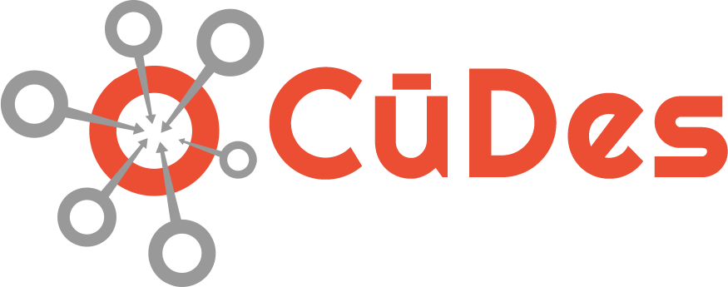
Network Micro-Segmentation Cloaking Technology for Connected Vehicles
Will Hill, Technology Broker @ CuDes.biz
Greg Shields, Director @ NetFoundry.io
6 May 2021

Slide 2
Table of Contents
What is zero-trust network access?
What is network micro-segmentation?
What has this got to do with connected & autonomous vehicles?
Question & Answer

Slide 3
What is Zero-Trust Network Access (ZTNA)?
No one can see that the end-point exists
A piece of software, a device, a user, cannot exist in the system until authenticated.
The firewall incoming ports are all turned off.

Slide 4
What is network micro-segmentation?

Slide 5
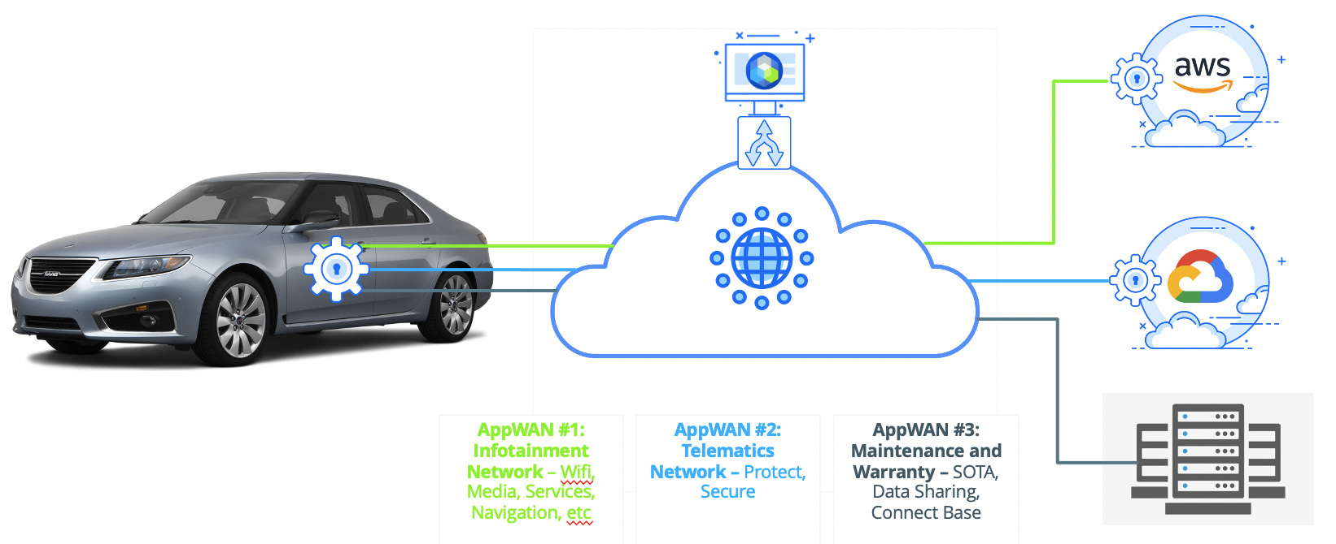
What has this got to do with connected & autonomous vehicles?

Slide 6





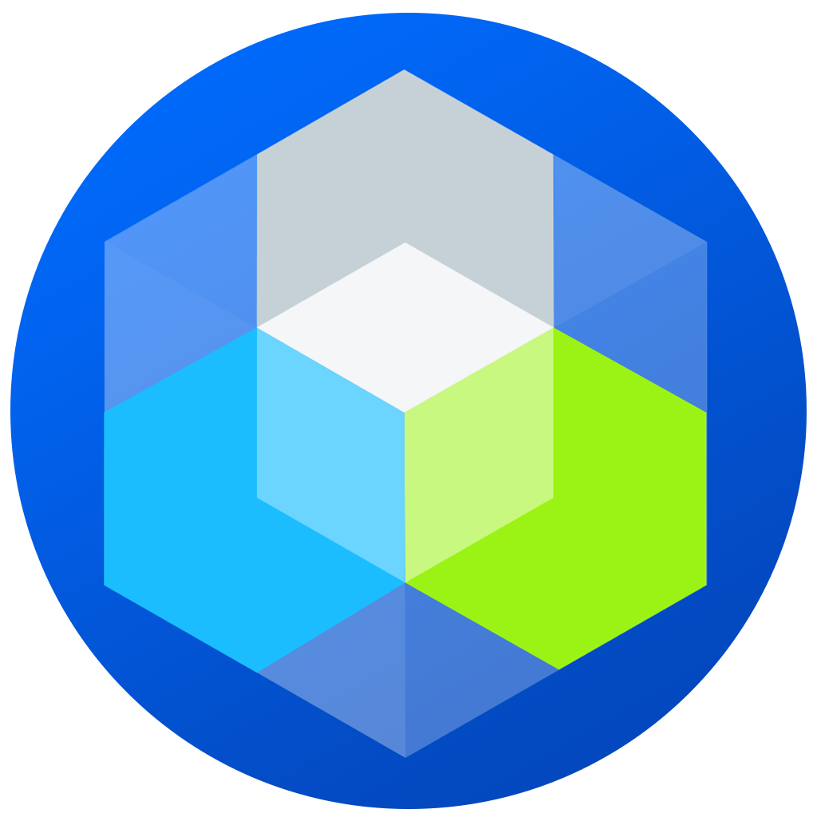
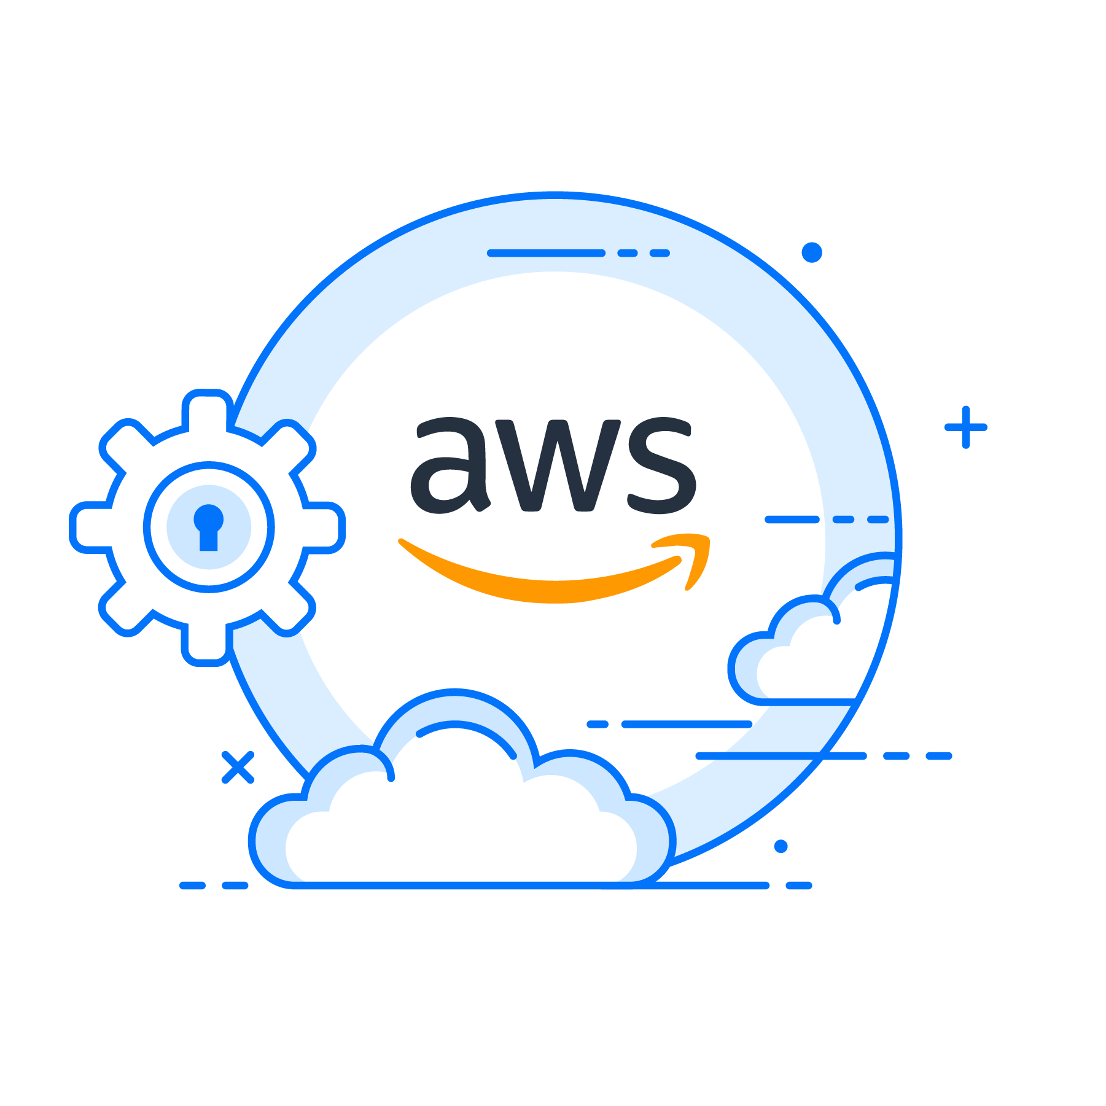

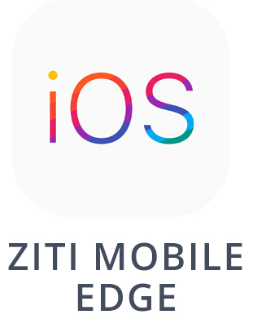
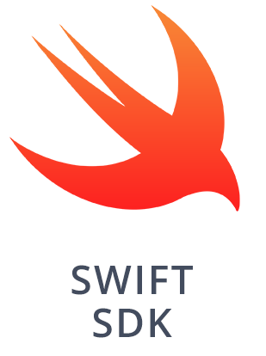
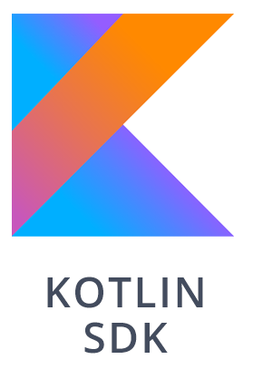
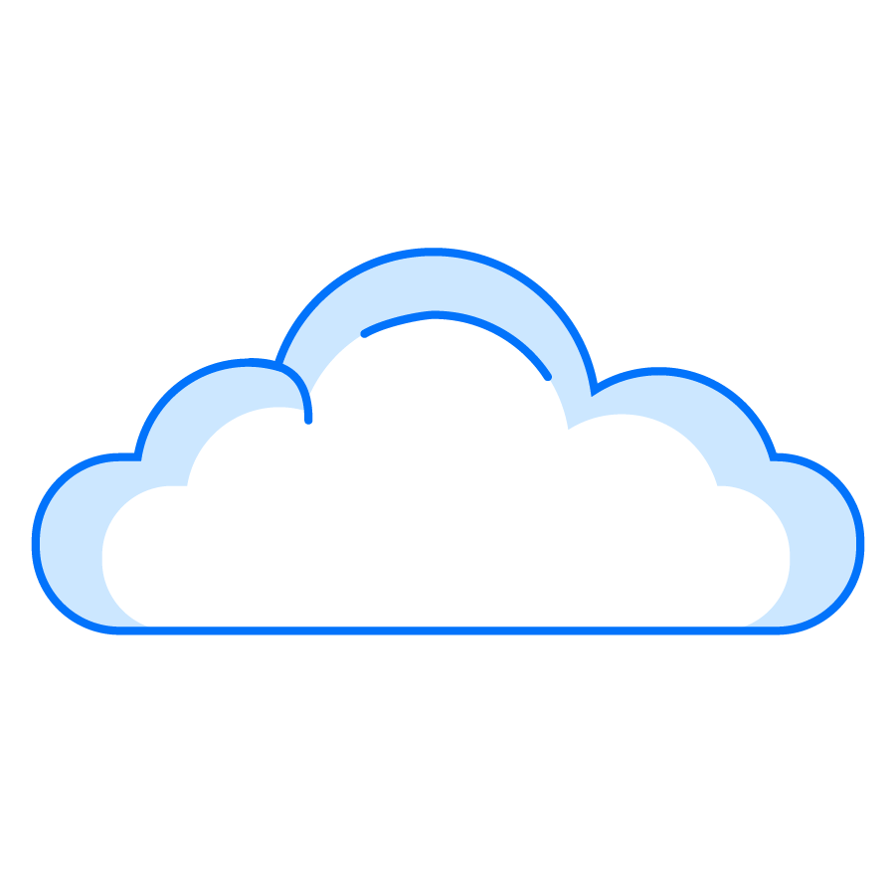
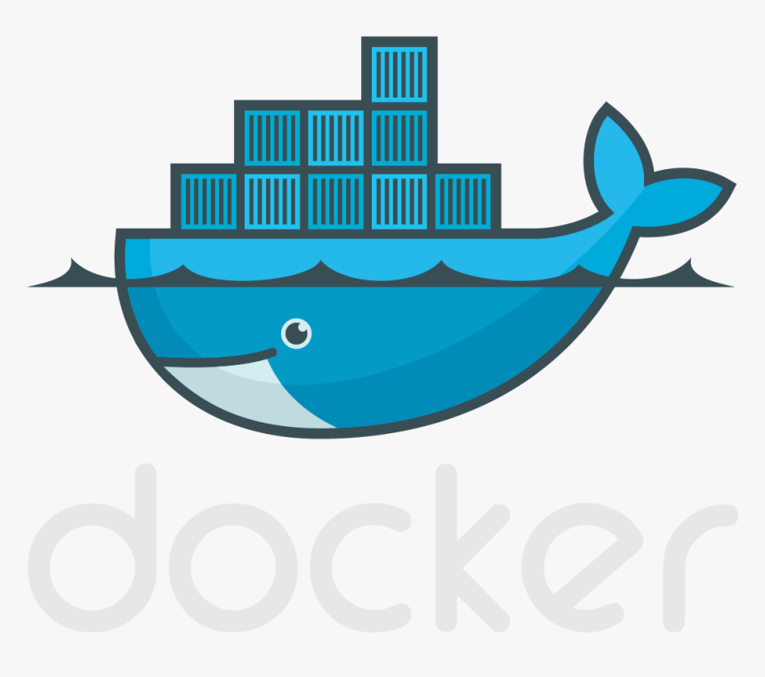
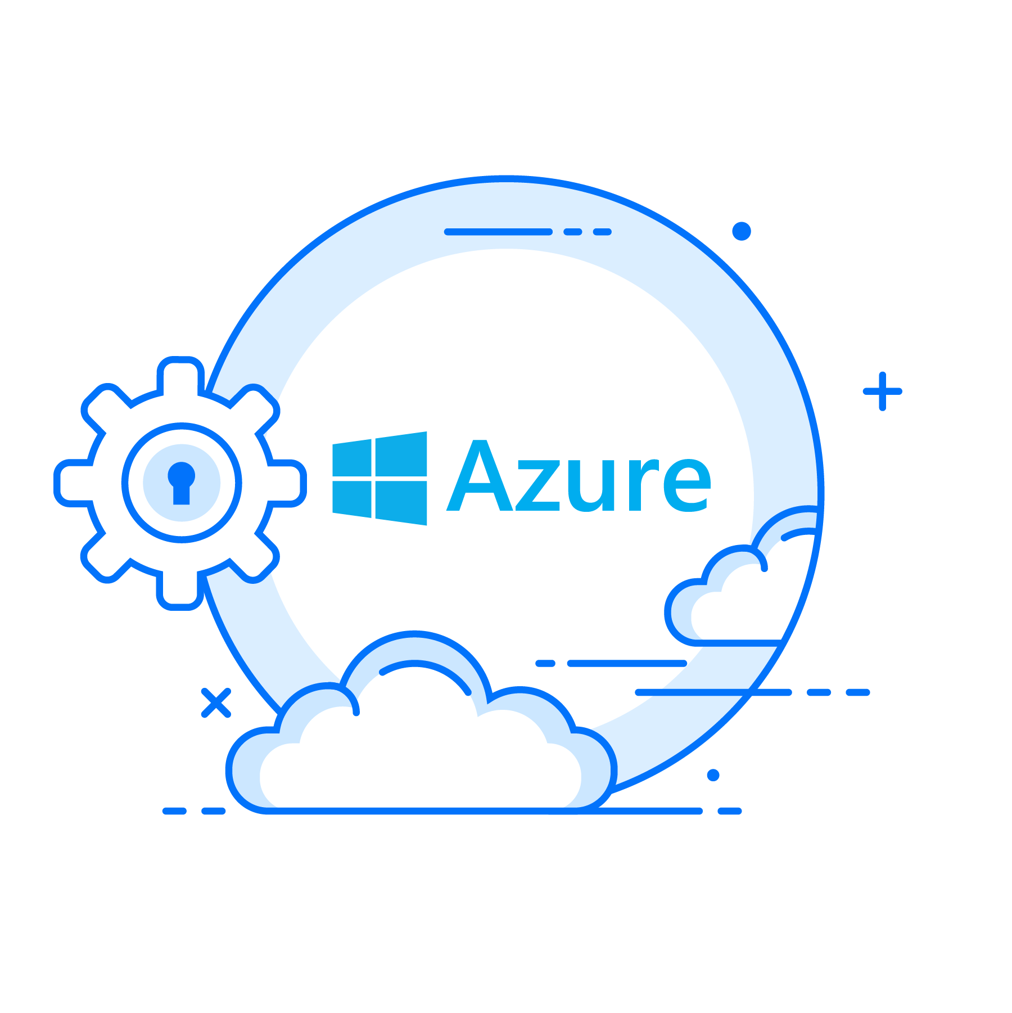
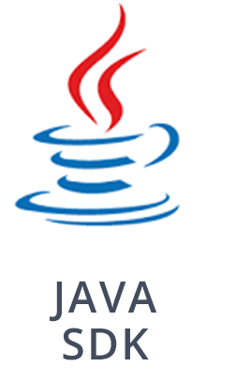
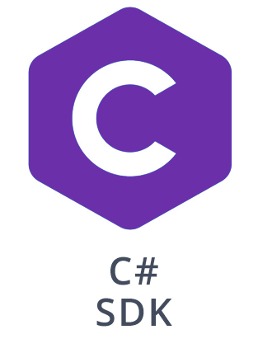

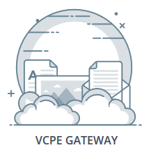
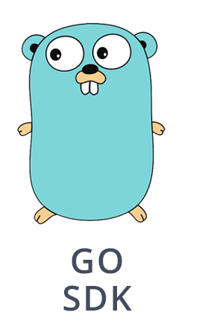

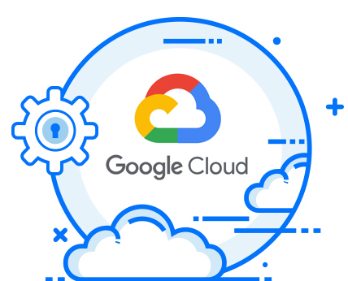
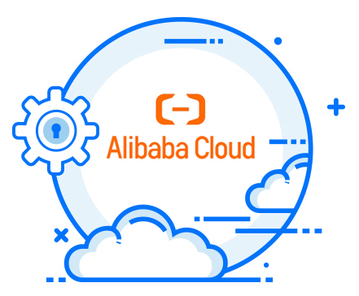
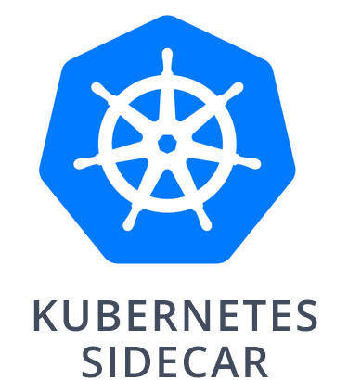
Global Automotive: extend private network to anywhere
Zero Trust, Enhanced Internet, Programmable, Embeddable, Everywhere in minutes
Secure Vehicle
Secure Remote Access
Any TCU, Gateway or in App
Any app or device via SDK or thin client
Secure Driver
Secure 3rd Party
Private, dedicated
Zero Trust SDN
Any Mobile or App
Any 3rd party Device or System
Secure Data Centre
Secure Edge – Factory/Lab
Any Cloud, any VM, container or App
Users and admins with least privileged access
Any IoT Device, System or Branch
Gartner names NetFoundry as one of 8 vendors to provide "enhanced Internet“; 30% of cloud connect market to be "enhanced Internet" instead of MPLS/ExpressRoute/Direct Connect by 2023
Gartner names NetFoundry as a Zero Trust Network Access provider in June 2020

Slide 7
Question & Answer
Please submit your questions into the chat.

Slide 8

For more information contact
Will Hill
+1 336-500-3332 will.hill@cudes.biz
https://www.linkedin.com/in/will-hill-a19a253/

Slide 9
APPENDIX

Slide 10
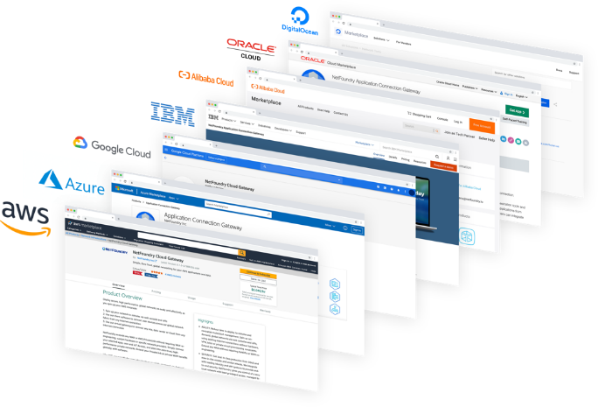
Agile: extend private network to any cloud
Optimized endpoints for all major clouds enables new cloud networks to be spun up in minutes
Gartner designated NetFoundry as 1 of 8 providers which optimize cloud connectivity over the Internet, and NetFoundry was the only one of the 8 included in Gartner's zero trust report

Slide 11
NetFoundry AppWAN Vs VPN or SD-WAN
Feature | VPN or SD-WAN | NetFoundry | Value
Security model | Perimeter, site based security | Zero Trust / Dark Network | Stronger security, from anywhere to anywhere. Least privileged access.
Deployment model | Deploy hardware | NaaS | Simple, agile, on-demand
Performance optimization over managed global Fabric | No | Yes | Improved productivity. Throughput commonly 2x to 10x compared to VPN
Reliability over Internet | Dependent on best effort BGP | Dynamic routing algorithms across NetFoundry Fabric | Better latency, packet loss and jitter
Cloud native endpoints | No | Yes, in every major cloud marketplace | Instant cloud migrations, multi-cloud and hybrid cloud
Management model | Manage local configurations | Cloud orchestrated | Manage as an air traffic controller rather than managing individual VPN tunnels
Use cases | Site to site | IoT, multi-cloud, app-specific, third party vendor access, edge compute, mobile, remote access, SaaS optimization, etc. | NetFoundry provides a platform across all use cases, rather than unique bespoke solutions for each

Slide 12
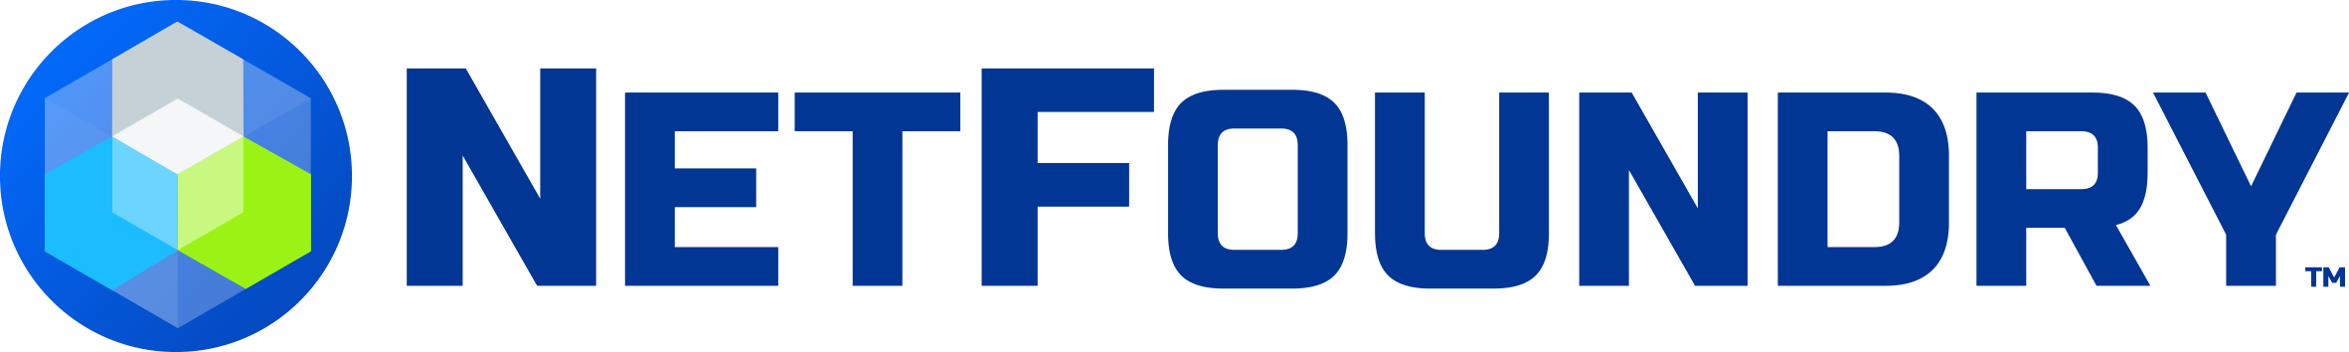
NetFoundry
https://netfoundry.io/
NetFoundry offers a cloud-native, Network as a Service (NaaS) platform which prevents the remote access to any software app by hiding the internet connection to this app and whoever this app is communicating with. Because a hidden-, cloaked-, dark-connection is used, the attack hackers cannot find what does not exist. A user can also implement micro-segmentation such that one software app can only talk to one other software app. The software app can be in the cloud or one app of many apps running on any device with an application processor. Simply put, any app which calls to the internet will be completely hidden from remote access. This is all orchestrated from the cloud as a 100% software solution.

Slide 13
Why work with CuDes vs supplier’s direct salesperson?
Integrity = the direct salesperson may do things, not in your best interest, due to fear of losing their job
Escalating at the supplier = CuDes works directly with the owners of the supplier
CuDes gives you instant access to hundreds of brains from many suppliers vs. one supplier’s group of brains

Slide 14

Blossom Family Life Practice
www.blossomfamilylifepractice.com
Blossom Family Life Practice offers Family Life Coaching to parents with children prenatal to 10 years old. For family planning we offer a pregnancy class and a birth class. These are 3 innovative employee benefits which organizations can make available to increase health. We also offer Real Colors™ personality type education as a 1-day workshop for groups of 16 – 24 people. This class improves interpersonal communication because you now have a common language to discuss each of our diverse personality types… and how to communicate with someone with a different personality type. This common language improves life at work and at home. All services delivered via live video conference; so anyone can have access.

Slide 15
Zenmid
https://zenmid.com
Zenmid offers small to medium sized businesses with over 100 employees IT Security & Compliance services. Customers are able to ensure they will have business continuity when a cybersecurity breach happens to their infrastructure. The attack hackers are targeting all business who can pay a ransom and who can be shut down remotely by getting employees to click on links. All of us, eventually, click on the link. Many organizations have IT security regulations to comply with via a certification process. We offer the service of generating the materials necessary for the submission to the regulators in order to receive the certificate. Our portfolio also includes managed security solutions to look out for threats to your brand, customers, and employees from sources like social media and mobile apps.

