Slide 1
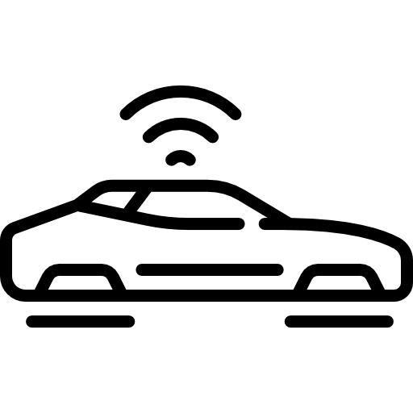



COVESA Scope
Vehicle 2 traffic infrastructure
Vehicle 2 Vehicle
Mobile device
Charging point
VSS
Cloud
E-Call
Hosted
OS
AI
…
…
OBD
Common consistent BASIS across several touch-points.
Car icons created by Freepik ©2022

Slide 2
Scope of COVESA / AUTOSAR Collaboration
In-vehicle browser
Smart Device (e.g. BT)
Draft
VISS
Android
…
…
Cloud
VHAL
Hosted OS
???
MQTT
…
SomeIP adapter
VSomeIP Adapter
SommR Adapter
COVESA / AUTOSAR collaboration
VSS
(data model)
Adaptive Autosar
(Gateway)
Classic Autosar
COVESA Touchpoint
Legacy vehicle networks
Open source License
Proprietary AUTOSAR license
Classic Autosar

Slide 3

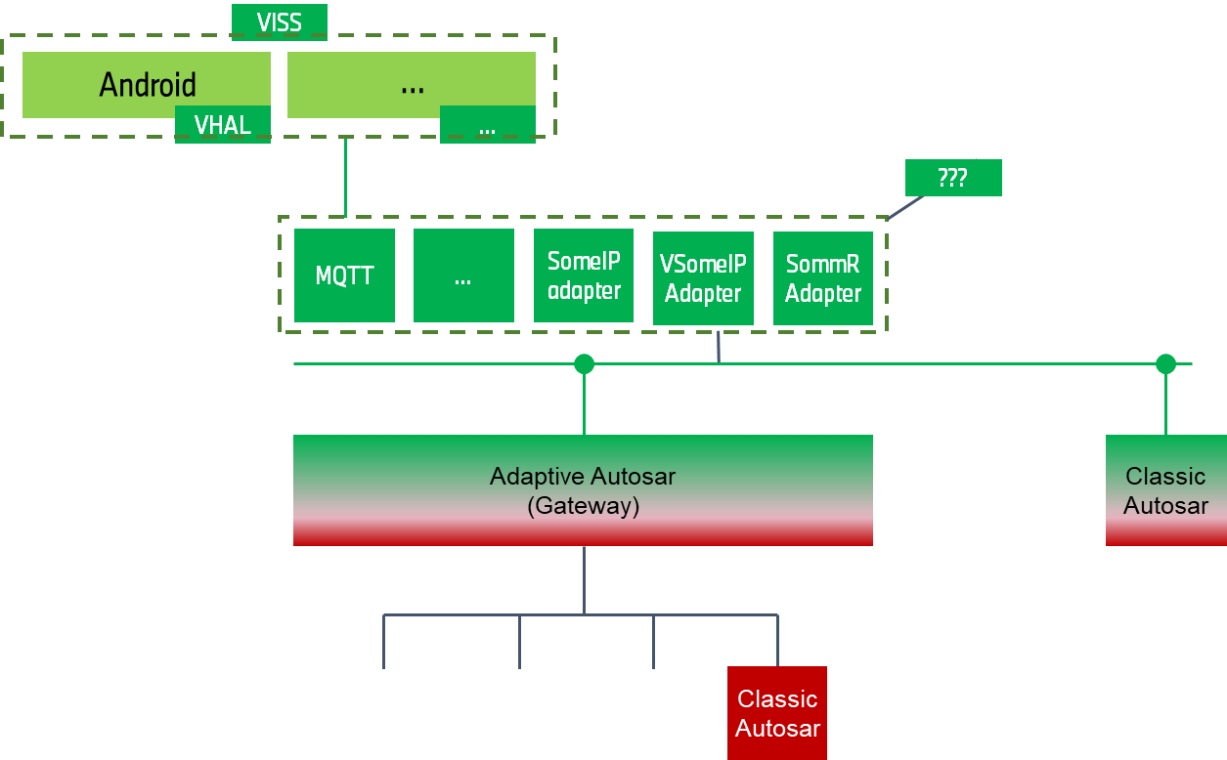
Scope of COVESA / Autosar Collaboration
Draft
Common consistent BASIS across several touch-points.
Smart Device (e.g. BT)
In-vehicle browser
Cloud
Hosted OS
COVESA Touchpoint
Legacy vehicle networks
VSS
(data model)
Open source license
Proprietary Autosar license
Car icons created by Freepik ©2022

