Slide 1
Action items for meeting on 10th july.
To-Do @all: Providing e-mail address to Paul Boyes (COVESA) if you want to participate in virtual meeting
To-Do @all: Deciding for a license models (https://www.covesa.global/sites/default/files/COVESA-Public-Policy-for-Open-Source-Licensing.pdf)
@Sven Eckoldt (Cariad): To clarify with Harman if they are willing to contribute to COVESA app developer documentation
@Thijs van Herkhuizen (Faurecia Aptoide): Map best practices structure with Faurecia documentation
Identify right whitespots: Compile the cross-OEM incompatibility issues that app developers are facing
→ @Thijs van Herkhuizen (Faurecia Aptoide): First overview of deviations from App Store Provider perspective
To Do @all: Overview of timeline/ milestones for identified priorities; what do we need to achieve to claim it a success (reference implementation vs. sample code), who takes the lead:
  Cross-OEM emulator (including automotive host)
  Camera API
  Push notifications
  Issues to bring mobile versions of Video Apps to Automotive
  → To Do @all: Overview what is necessary to benefit from working group
@Melina Mascolo (BMW): Clarifying with COVESA how Best Practices for App Developers could be published

Slide 2
Action items for meeting on 17th july.
Having “trusted team” of app developers validating scope and work results of expert group
→ To Do @all: Getting first ideas which app developers could be interested
→ Goal: Depending on the defined work streams, involving relevant app publishers early in the process to discuss solutions for the problem being addressed
@Juhani Lehtimäki (Snapp Automotive): Providing overview to expert group what Snapp emulator already provides
→ Exploring how Snapp and Remotive Labs product could interact
@Emil Dautovic (Remotive Labs): Providing overview what Remotive Labs is offering regarding Cross-OEM emulator
@Sven Eckoldt (Cariad): Overview of issues seen when bringing mobile video app to automotive (e.g. DRM, HCP, button size, immersive mode, etc.)

Slide 3
Identified workstreams.
Cross-OEM emulator (including Automotive Host)
Camera API
Best Practices
Push notifications
Video Apps @ Automotive
Tbd.: Developer Communication via COVESA

Slide 4
Automotive AOSP App
Framework Standardization
Expert Group
22.06.2023

Slide 5
WELCOME
Graham Smethurst, COVESA/ BMW

Slide 6
Antitrust Note Well
Before we begin, we would like to make clear that COVESA is committed to compliance with the antitrust laws in all of its activities, and that it expects all participants to similarly comply with the antitrust laws. We will not engage in--and members must refrain from--any discussion of, or understandings regarding competitively sensitive topics. If you have any doubts regarding whether a matter is appropriate for discussion, please consult with your antitrust counsel.

Slide 7
BMW STARTUP GARAGE
The Venture Client Unit for Startup Enabled Innovations.

Slide 8






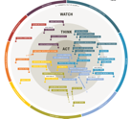




Our Business Model: MATCHMAKING New (Technology-) Solutions and beyond.
UNDERSTANDING Future
MATCHMAKING New Technology SOLUTIONS and beyond
Mobility-/Tech TRENDS
Innovation POTENTIAL
Innovation NEED
CROSS INDUSTRY TECHNOLOGIES
THINK TANK: Future Mobility
Tech-Trend Radar
STARTUPS
Business Units / Product Lines
INNOVATION CROWDS,
EXPERTS, …
B2C
B2B
(B2G, 3rd)
White Paper
Reports
INTRAPRENEURS
Building Knowledge, Enabling Decisions
PROOF of CONCEPT Projects => Sustainable Transfers

Slide 9
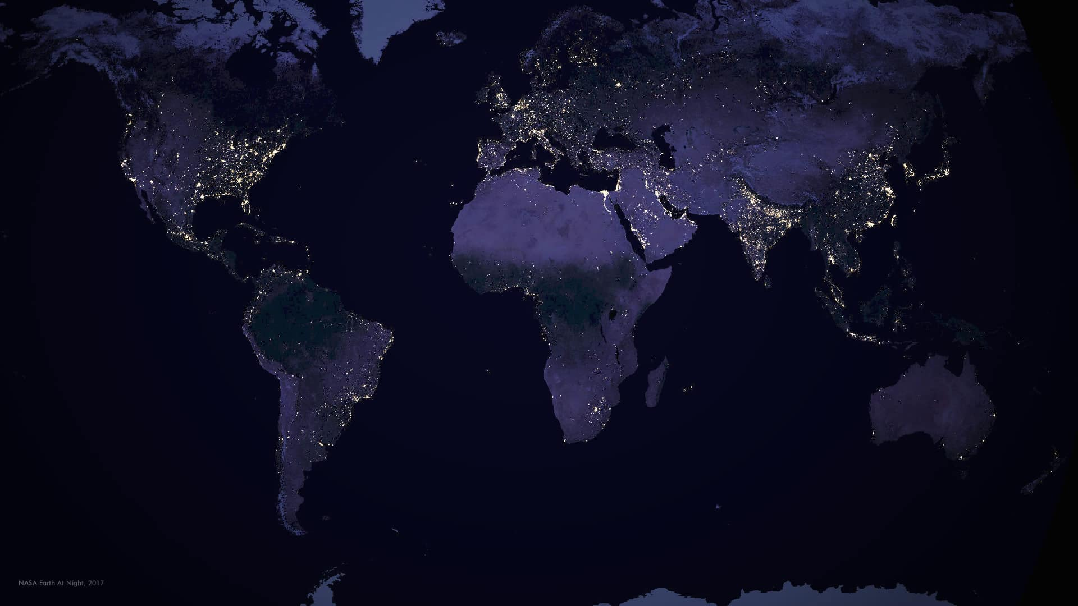
BMW TECHNOLOGY OFFICES.
Seoul
Technology Office South Korea
Munich
Technology Office Munich
Tokyo
Technology Office Japan
Mountain View
Technology Office
USA
Tel Aviv
Technology Office Israel
Shanghai
Technology Office China
Notes:
TOKYO / SEOUL / SHANGHAI / TEL AVIV / MUNICH / SILICON VALLY
CROSS INDUSTRY EXPERTS, UNIVERSITIES, INVENTORS Latest tech trends, bring them to Munich
Outpost für OPEN INNOVATION FORMATE, already established: BMW startup garage

Slide 10
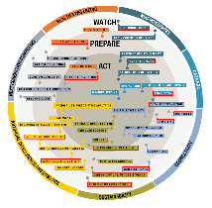



WHY?
OPEN INNOVATION.
Fast emerging cross-industry tech trends
New innovation drivers / ecosystems
Changing competition landscape
Drivers
OPEN Innovation
Innovation Leadership
Contribute to
Searching BEYOND the obvious
Unlocking UNCONVENTIONAL innovation sources
Delivering FAST results
Notes:
> Wesentlicher Innovationstreiber sind Startups

Slide 11

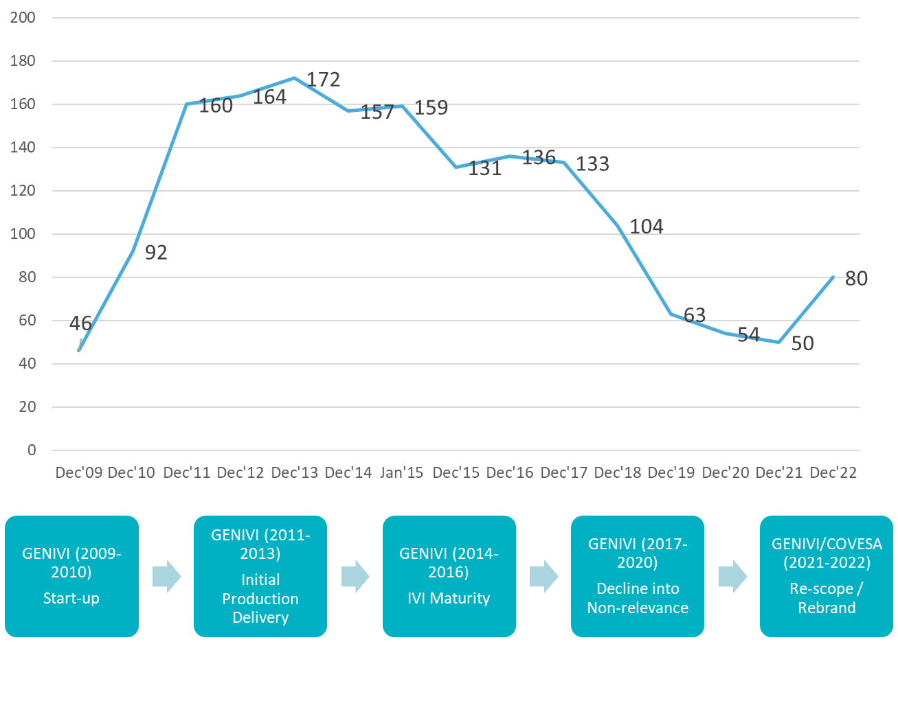
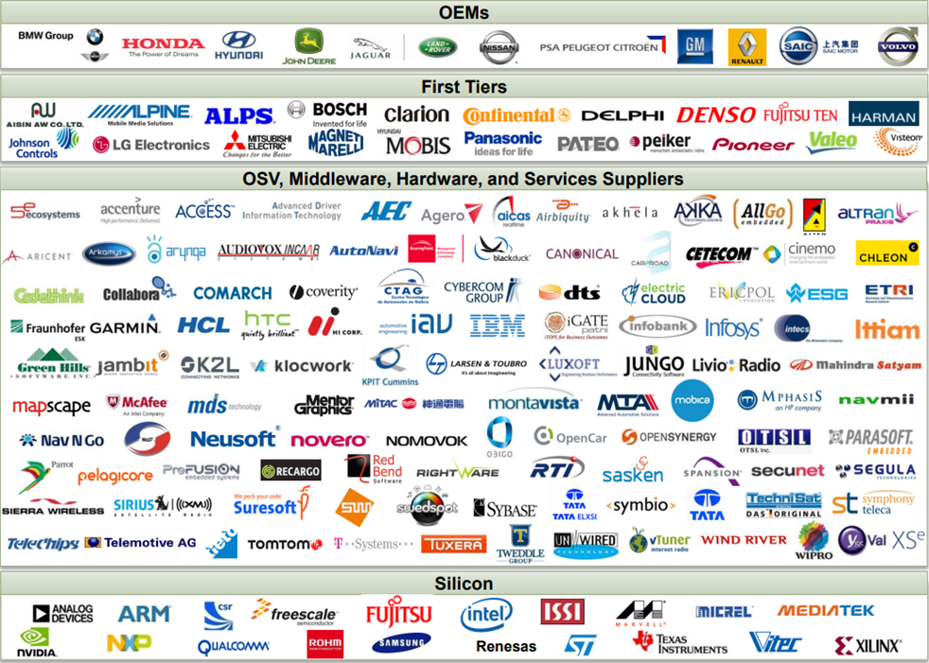


GENIVI Alliance 2009 - 2021
GENIVI Membership EOY 2013 172
Members
Infotainment
Connected
EN-51

Slide 12

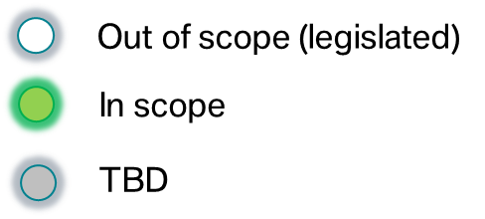


COVESA Scope
Key
…
Mobile device
Charging point
Cloud
AI
Native OS
Hosted
OS
Legacy networks
Common consistent data BASIS across multiple touch-points.
https://www.covesa.global/
Car icons created by Freepik ©2022

Slide 13

COVESA Data Expert Group – Organization
Board of Directors
Technical Steering Team
Data Expert Group
Electric Vehicle Charging Expert Group
Android Automotive SIG
AOSP App Framework Standardization
Expert Group
...
In-Vehicle Payment Special Interest Group
Expert Group
...
Vehicle Charge Event Data Aggregation Project
VSS to VHAL
Project
...
Project
...
Project
...
In-Scope Touchpoints
Charging Point
Hosted OS
Mobile Device
Native OS
Groups Not Dependent on Data Expert Group
Cloud
AI
Data Expert Group Pillars
Best Practices and Guidelines
Data Models /Ontologies
Data Architecture/
Infrastructure
Interface Definition

Slide 14
AGENDA

Slide 15
Agenda morning.
1
10:00 - 10:30: Election Co-Chairs
2
10:30 - 11:30: Meeting cadence & next steps
3
11:30 - 12:15: Critical success factors for Expert Group
12:15 – 13:45: LUNCH ☺

Slide 16
Agenda afternoon.
4
13:45 - 14:30: Reference implementation in-vehicle camera access
5
14:30 - 15:00: Best practices automotive AOSP app development
15:00 - 15:15: Short break
6
15:15 - 16:00: Android for Cars usage for AOSP based Systems
7
16:00 - 16:30: Planning further F2F events/ presentations
8
16:30 - 17:00: Meeting wrap-up
17:00 - 20:00: Evening Get-Together & light snacks

Slide 17
CO-Chairs
Steve Crumb, COVESA
22nd June 2023

Slide 18
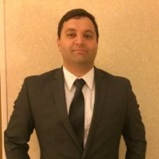


Elected chairs.
Chair Chair Chair
Richard Fernandes Melina Mascolo Camille Ghibaudo
General Motors BMW Faurecia Clarion Electronics
*Volvo also volunteered as chair, due to them not being official COVESA member yet, it was parked for later point of time

Slide 19
Meeting cadence
Steve Crumb, COVESA
22nd June 2023

Slide 20
Meeting cadence & next steps.
Weekly vs. biweekly virtual calls?
Which timezones do we need to cover?
How often do we want to meet in-person?
Protocol
Chosen virtual slot: Monday: 5-6pm CET*; Microsoft Teams
First meeting 10th July
@Melina Mascolo (BMW) to set up virtual call
To-Do @all: Providing e-mail address to Paul Boyes (COVESA) if you want to participate in virtual meeting
Quarterly in-person meetings, e.g. COVESA AMMs & CES
* Time slot could be adjusted in the future for some meetings, if there is interest from Asian partners to join as well

Slide 21
Open questions raised by COVESA for expert group.
Protocol
Preferred License model for working results of Expert Group
Overview license models: https://www.covesa.global/sites/default/files/COVESA-Public-Policy-for-Open-Source-Licensing.pdf
To-Do @all: Getting overview of license models
→ Decision which one to use: Virtual meeting 10th July

Slide 22
Critical success factors
Everyone ☺

Slide 23
Critical success factors.
Jointly collected
Protocol
Supporting E2E journey for app developers with unified documentation and guide how to develop / intergrate automotive app
Clear scope of expert group: AOSP
Finding way to prevent OEM specific fragmentation (e.g. with plugfests)
Avoidance to create sub-standards to already existing AAOS-standards
→ Clear focus on standards that are not available at all, or only available for OEMs using Google Services as part of AAOS
Involvement of application partners, to understand their friction points
→ On workstream basis vs. open meeting for all interested app providers
Avoiding too many loose ends that app developers experience on OEM-side leasing to hesitance to develop automotive app
Template that devs can leverage to develop cross OEMs
→ Navigation template
Getting clear scope for expert group what OEMs vs. app developers want to achieve
Having “trusted team” of app developers validating scope and work results of expert group
→ To Do @all: Getting first ideas which app developers could be interested
Frequently reviewing if AAOS standards have been extended
→ @José Freitas (Faurecia Aptoide): Providing update to Expert Group in case new standards came up
Step-by-step approach to include app developers
  1) Getting clear scope and workstream overview within expert group
  2) Involvement of first batch of app developers to proof-of-concept scope
  3) Involvement of larger audience of app developers

Slide 24
Critical success factors.
Jointly collected
Open topic: How to open-up a feeback loop to Google?
Explore way to contribute to AOSP with working results of expert group
Defining marketing model of COVESA: How to attract app developers for automotive in a scalable way
→ Goal: Activate developer community to engage with Automotive
Clarify interaction with data expert group and android abstraction within COVESA?
Providing reference implementations for developers, especially if deviating from AAOS templates
Identify right whitespots: Compile the cross-OEM incompatibility issues that app developers are facing
→ @Thijs van Herkhuizen (Faurecia Aptoide): First overview from App Store Provider perspective
Building compatibility test suite to get overview which OEMs are compatible
Overview of timeline/ milestones for deliveries:
→ To Do @all: Preparing this for meeting 10th July
Joint goal to provide broader content experience to OEM customers
Prodviding Cross-OEM Emulator to app developers to support development/ testing
→ Already frist emulators available (Snapp Automotive; Remotive Labs)
→ @Juhani Lehtimäki (Snapp Automotive): Providing overview to expert group what Snapp emulator already provides
→ Exploring how Snapp and Remotive Labs product could interact
Open topic how to keep up with changes, do we need some kind of version controlling for expert group implementations?

Slide 25
In-Vehicle camera access
Manuel Saraiva, BMW
22nd June 2023

Slide 26
motivation & Goal.
Presented
Work in progress
In-Vehicle Camera Access.
App Developers are requesting access to in-vehicle cameras, e.g. Communication Apps / Social Media Apps.
Access to in-vehicle cameras is automotive specific, beginning Android 13
Frequently asked questions from developers:
  Which cameras can/should be accessed? What is the default camera?
  Is compatibility ensured across OEMs?
  Should apps already prepare for Android 13 in order to stay compatible?
Goal: Providing a reference implementation via COVESA GitHub for App Developers
  Working across Android OS versions
  Granting access to inside- & outside-facing cameras
  Ensuring compatibility across OEMs using AOSP / GAS

Slide 27
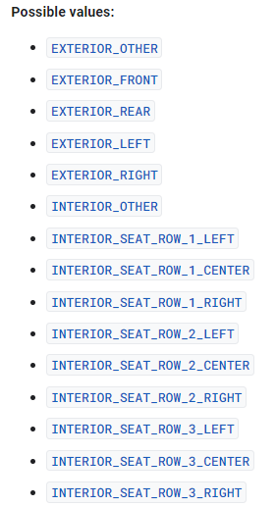
Clarifications oems.
Presented
Work in progress
In-Vehicle Camera Access.
Camera libraries and APIs in Android have a set of characteristics, one of them being the LENS_FACING.
This property informs 3rd-party developers which camera to select.
AAOS (Android 13 or higher):
    Introduction of AUTOMOTIVE_LENS_FACING, allowing to access variety of in-cabin cameras
    Precondition: FEATURE_AUTOMOTIVE system flag (PackageManager.hasSystemFeature API)
    Standardization:
        In-Cabin Camera: INTERIOR_SEAT_ROW_1_CENTER
      → Should this be the default or rather LEFT / RIGHT?
        Front-facing exterior Camera: EXTERIOR_FRONT
    LENS_FACING can be supported in addition to AUTOMOTIVE_LENS_FACING
Android or AAOS (up to Android 12):
    Standardization:
        In-Cabin Camera: LENS_FACING_FRONT
        Front-facing exterior Camera: LENS_FACING_BACK

Slide 28
Infos for developers.
Presented
Work in progress
In-Vehicle Camera Access.
Guidelines
AUTOMOTIVE_LENS_FACING only exists in Camera2, not CameraX
App targetSdk should be 33 where AUTOMOTIVE_LENS_FACING was introduced (Android 13)
App minSdk should be 24 because PackageManager hasSystemFeature API is required
Implementation logic
Obs: these are only for the default lens facing apps can expect in automotive, but they can still use Camera2 APIs to enumerate the different cameras and characteristics/metadata.
In-Cabin Camera
AUTOMOTIVE_LENS_FACING_INTERIOR_SEAT_ROW_1_CENTER
Check if system is AAOS
and API level >= 33
TRUE
Front Ext. Camera
AUTOMOTIVE_LENS_FACING_EXTERIOR_FRONT
FALLBACK
PackageManager.hasSystemFeature(FEATURE_AUTOMOTIVE)
FALSE
Android.os.Build.VERSION.SDK_INT >= ...
In-Cabin Camera
LENS_FACING_FRONT
Front Ext. Camera
LENS_FACING_BACK

Slide 29
Next steps in-vehicle camera access.
To Do @all: Checking if any disagreement with mapping of the first proposal (slide 27, implementation logic)
Tbd: Check with Google how Android for Cars is abstracting driver/passenger cameras and/or left/right-hand-driving cars
@Thijs van Herkhuizen (Faurecia Aptoide): To loop in app developers to get their perspective (and also contribute to the overall list of pain points)
Comment from Dutt, Yagya (Mercedes Benz): LENS_FACING values could be limited, need to extend? Backport from Android 13?
Insight from session: There is an API for camera characteristics allowing to determine where camera is located
→ Might be interesting to include this information in developer guide

Slide 30
Best practices: Automotive aosp app development
Melina Mascolo, BMW

Slide 31
Best practices: Automotive aosp app development.
Is there a joint interest to have COVESA as kind of developer community?
E.g. with FAQ, collection of learnings from App Stores/OEMs/Developers

Slide 32
Best practices: Automotive aosp app development.
Jointly collected
Collecting needed adaptions for journey how to bring mobile app to automotive
Structure / biggest identified pain points:
  Differences Android vs. Android Automotive
  Audiofocus
  Link handling (developers should not assume that OEMs provide browser for external link handling)
  Interaction with back button /home button
  Solving GMS dependencies, e.g. Firebase, Google Login, Google Play linking
  Payment
  → Already existing group regarding payment in COVESA (involving Stellantis, mavi.io)
  → @Vamsi Krishna (mavi.io): Providing update to Expert group about existing payment activities
  Login process
  Notifications
  Camera access
  Immersive mode: Interaction climate bar / full screen
  How to integrate/test app
  Prioritized at later point of time: Driver workload/ driver distraction
  → @Sven Eckoldt (Cariad): Check if you can provide your insights/ guidelines to expert group
  @Thijs van Herkhuizen (Faurecia Aptoide): Checking what Faurecia Aptoide can provide from their documentation already
@Sven Eckoldt (Cariad): To clarify with Harman if they are willing to contribute to COVESA app developer documentation
Longterm goal to have reference app everyone contributes to (displaying camera, playing sound, send notification, etc.)
→ There is potential to refer to Google reference applications or open source applications built for Android Automotive such as EVMap

Slide 33
AUTOMOTIVE AOSP ECOSYSTEM
AND RISKS OF FRAGMENTATION
José Freitas, Faurecia Aptoide

Slide 34
Agenda
Presented
Work in progress
Automotive AOSP vs Cars with Google Built-in (Ecosystem differences)
Android for Cars: Categories of Apps and Risks of Fragmentation
Cars App Library and Automotive App Host
Communication Apps
Key Takeaways
Android is a trademark of Google LLC.

Slide 35
Automotive AOSP vs Cars with Google Built-in (Ecosystem differences)
Presented
Work in progress

Slide 36

Automotive AOSP
Presented
Work in progress
Automotive AOSP (a.k.a. “Android Automotive”, or Android Automotive OS) is open source
“Android Automotive is Android”: “Android Automotive is not a fork or parallel development of Android.”
“Android Automotive extends Android”: to add “support for automotive-specific requirements, features, and technologies.”
Automotive AOSP does not include Google Automotive Services (GAS)
OEMs using Automotive AOSP need to provide or source solutions for:
  Maps
  Voice Assistant
  Apps distribution
  3rd party apps features dependent on GAS (e.g. Google Pay, Automotive App Host Maps rendering, etc.)
https://developers.google.com/cars/design/automotive-os
Android is a trademark of Google LLC.
https://source.android.com/docs/devices/automotive/start/what_automotive
https://developer.android.com/training/cars/google-services

Slide 37









Automotive AOSP vs Cars with Google Built-in
Presented
Work in progress
Maps
Google
Automotive
Services
App Store
Voice Assistant
3rd party apps
Ecosystem driven by OEMs and App store providers, following official Android documentation
Less focus on “templated” apps when compared to GAS systems → Risk of fragmentation/apps incompatibility
Ecosystem driven by Google together with OEMs
More focus on “templated” apps that can be deployed to Android Auto and Android Automotive OS
Android is a trademark of Google LLC.
Examples of some of the providers of the different types of apps/services

Slide 38
Android for Cars
Presented
Work in progress
Categories of Apps and risks of fragmentation
Android is a trademark of Google LLC.

Slide 39
Android for Cars Categories of Apps
Presented
Work in progress
Categories of Apps
  Media (audio)
  Messaging (*)
  Navigation
  Point of Interest (POI)
  Internet of Things (IOT)
  Weather (**)
  Video
  Games
“Bring your app to vehicles running either Android Auto or Android Automotive OS. Use one app architecture that works for both cases so every user can enjoy your app.”
https://developer.android.com/training/cars
https://android-developers.googleblog.com/2023/05/whats-new-with-android-for-cars.html
(*) Only Android Auto for now, Android Automotive expected soon
(**) “weather is in an early access program” (no public documentation yet)
https://developer.android.com/training/cars#supported-app-categories
Android is a trademark of Google LLC.

Slide 40
Typology of Apps
Presented
Work in progress
Apps Categories
Distraction Optimized
(a.k.a. “templated”)
Headless
(app has no UI)
App UI uses Cars App Library
Parked and passenger
Gaming
Video
App uses (or might use) Maps
Communication
Media (Audio)
Navigation
Points of Interest
Weather
Internet of Things
App doesn't use Maps
(Current) Risk of fragmentation/ incompatibility
Low
Medium
High
https://developer.android.com/training/cars#supported-app-categories
https://source.android.com/docs/automotive/driver_distraction/guidelines#do

Slide 41
The easy ones first: Media(Audio), Gaming, Video
Presented
Work in progress
Headless
(app has no UI)
Parked and passenger
Gaming
Video
Media (Audio)
Audio streaming apps are headless services (no UI)
UI is from IVI system Media Player (AOSP or OEM custom)
Interfaces are stable and understood by OEMs and Apps publishers
Gaming apps have their own UI (simple or no adaptation from mobile)
Risk of incompatibility only for in-app purchases
Theoretically no risk of incompatibility …
… however official documentation mentions a dependency to android-automotive-video library
https://developer.android.com/training/cars/parked/video
https://developer.android.com/training/cars/parked/games
https://developer.android.com/training/cars/media

Slide 42
Apps that Use Cars App Library
Presented
Work in progress
App uses (or might use) Maps
Communication
Navigation
Points of Interest
Weather
Internet of Things
App doesn't use Maps
Implications for Apps Publishers
  Build their apps using Cars App Library and its templated components
  Test their app in a representative environment (e.g. emulator)
Implications for OEMs
  Integration of Automotive App Host (but AOSP version doesn’t support maps)
  Customization of Car UI Library
https://source.android.com/docs/automotive/hmi/aosp_host
https://source.android.com/docs/automotive/hmi/car_ui/appendix_b

Slide 43
Car Apps Library and Automotive Host
Presented
Work in progress
For Navigation, POI, IOT and Weather Apps

Slide 44
Dependencies for Apps using Cars App Library
Presented
Work in progress
CarAppService is an abstract Service class that your app must implement and export to be discovered and managed by the host.
App relies on host
to be executed
3rd PARTY APP
AUTOMOTIVE APP HOST
https://developer.android.com/training/cars/apps
App built with Cars App library
CAR UI LIBRARY
OEM Skinning /
UI Customization
OEM CAR UI LIBRARY CUSTOMIZATION
PROVIDED BY
ANDROID
OEM
3RD PARTY
Android is a trademark of Google LLC.

Slide 45
Automotive Host for 3PAs that render maps
Presented
Work in progress
Map rendered by Host
Map rendered
by the App
App uses (or might use) Maps
Navigation
Points of Interest
Weather
Internet of Things
✓
✓
✓
✓
https://developer.android.com/training/cars/apps#supported-app-categories
https://developer.android.com/training/cars#supported-app-categories

Slide 46

Automotive Host for 3PAs that render maps
Presented
Work in progress
Map rendered by Host
App uses (or might use) Maps
Navigation
Points of Interest
Weather
Internet of Things
✓
Automotive App Host needs to be able (among other things) to render maps
✓
✓
https://developer.android.com/training/cars/apps#supported-app-categories
https://developer.android.com/training/cars#supported-app-categories

Slide 47
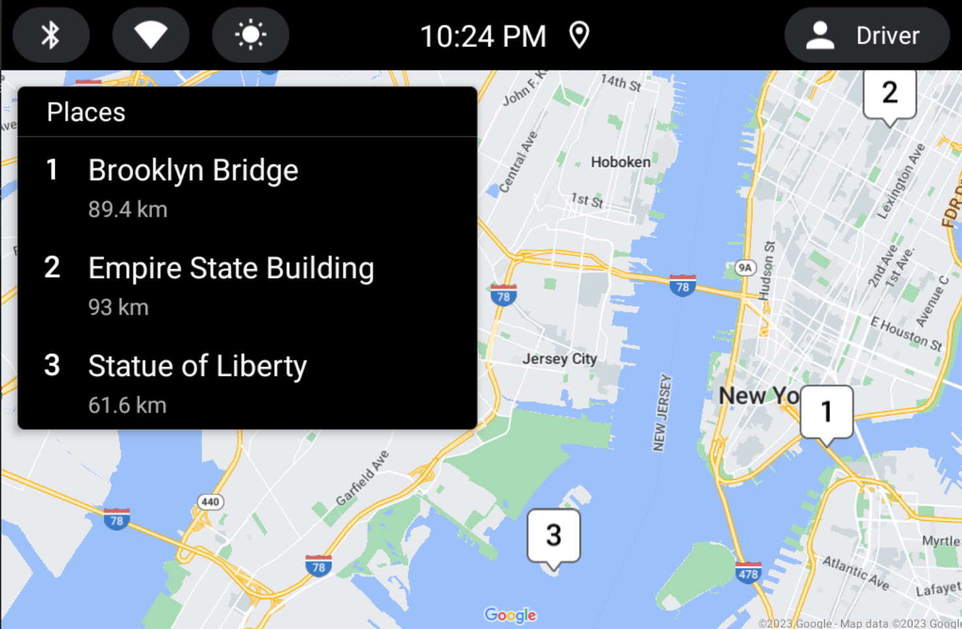
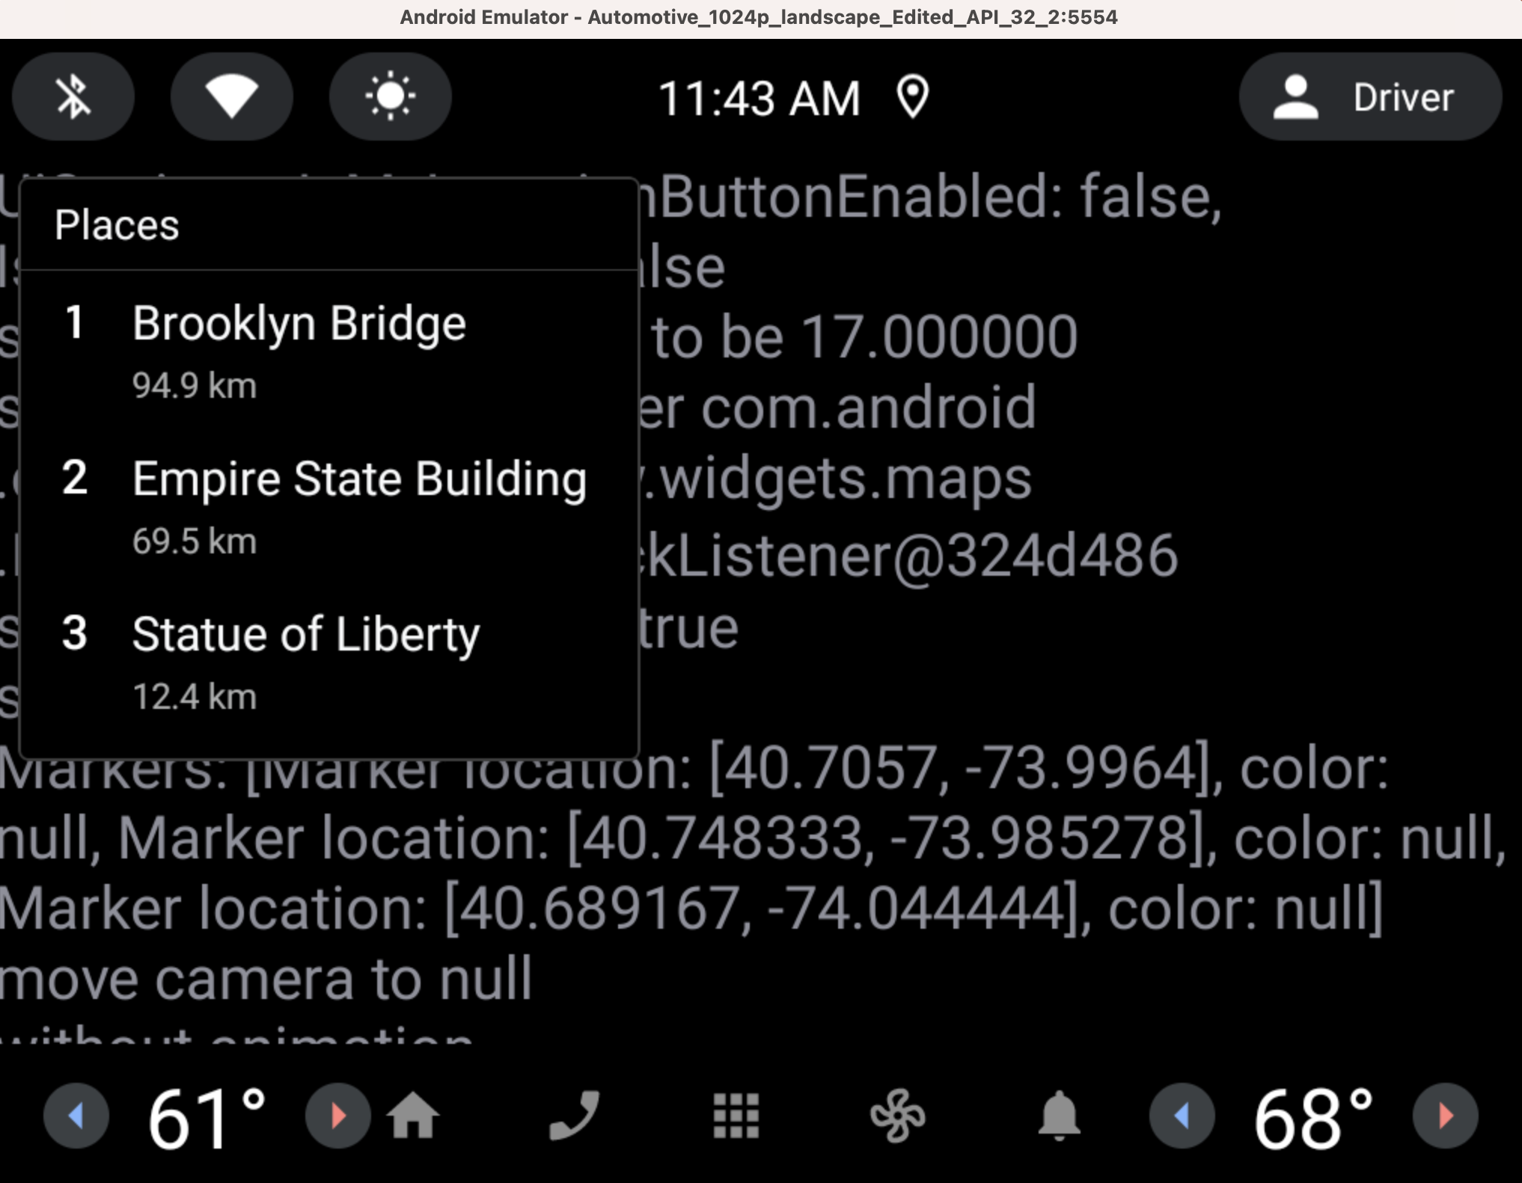
AOSP Automotive App Host
Presented
Work in progress
GAS Version ⁽¹⁾
AOSP Version ⁽²⁾
Screenshot from a GAS Emulator, using GAS Automotive Host (with Google Maps), displaying a POI example app
Screenshot from a non-GAS Emulator, using AOSP Automotive Host (without maps), displaying a POI example app
(1) https://play.google.com/store/apps/details?id=com.google.android.apps.automotive.templates.host
(2) https://android.googlesource.com/platform/packages/apps/Car/Templates/+/refs/heads/master/Host

Slide 48
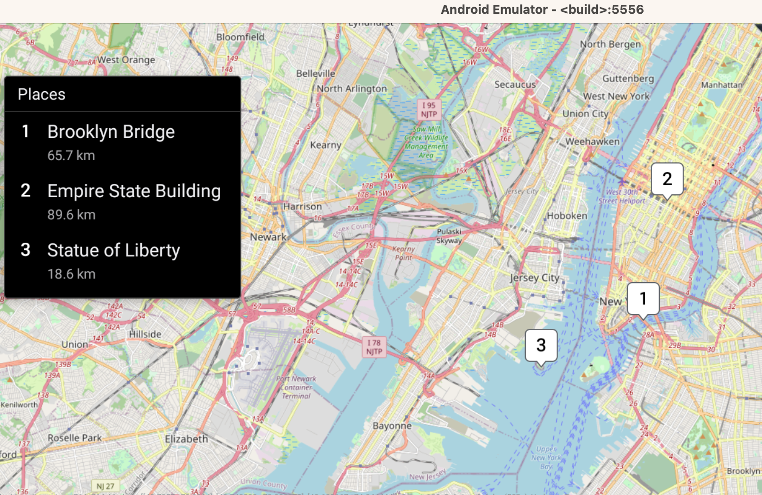

COVESA (?) Automotive App Host
Presented
Work in progress
COVESA Version (?)
Next steps:
  Potential COVESA contribution:
  Automotive App Host reference implementation using open source maps (e.g. Open Street Map)
  Use an Interface that Abstracts Maps Provider so that OEMs can easily plug their Maps
  Create a common interface for automotive intents (Multiple Waypoints, Electric Vehicles Trip Plans) based on Google Maps for Automotive Intents
  COVESA or AOSP repository?
Screenshot from a non-GAS Emulator, using Faurecia Aptoide Automotive Host (with OSM Maps), displaying a POI example app
https://developers.google.com/maps/documentation/urls/android-intents-automotive

Slide 49
Communication Apps
Presented
Work in progress
Rely on Cars App library, Push Notifications and Camera interface

Slide 50
What about Communication Apps?
Presented
Work in progress
Communication
App doesn't use Maps
Communication/Messaging not yet a category on Android Automotive, likely in the future (Zoom, Microsoft Teams, and Webex by Cisco (*) )
Probably based on Cars App Library
Depend on:
  Push Notifications for incoming calls/messages
  Camera interface for video Conferencing
Android Push Notifications rely on Google Mobile Services (GMS). A priority to be tackled by COVESA.
(*) https://android-developers.googleblog.com/2023/05/whats-new-with-android-for-cars.html
Android is a trademark of Google LLC.

Slide 51
Key Takeaways
Presented
Work in progress
For Automotive AOSP App Framework Standardization WG

Slide 52
Key Takeaways for COVESA Automotive AOSP App WG
Presented
Work in progress
Top priority: avoid fragmentation and ensure compatibility (to the possible extent)
  Make sure Apps publishers can Create Once Publish Everywhere
  Provide the tools for Apps Publishers to validate their apps
Specific topics to tackle:
  Non-GAS Emulators → Tools for Apps publishers to validate their apps
  Automotive App Host able to render maps (available also on the emulator) → for Apps publishers and also for OEMs
  Push Notifications → to enable new features needed by Communication apps
  Camera2 reference implementation → feasibility of Camera2 API for use cases such as video conferencing

Slide 53
FURTHER F2F EVENTS
Paul Boyes, COVESA

Slide 54
Further F2F Meetings for expert group.
All Members Meeting (AMM) 2x year
→ 1x Europe
→ 1x US
Option to combine longer working session of expert group with presentations at AMM
→ To-Do @all: Check possibility of attendence AMM in Detroit 10th-12th October
→ GM confirmed attendance already
COVESA Event @ CES: 1x year (next one 09.01.2024, begin afternoon)
→ To-Do @OEMs/App Store Provider: Check if joint event 2024 is possible (e.g. joint discussion round/showcasing same apps in different vehicles)
Further independently organized events
→ To-Do @all: Who would be open to host the next onsite event?

Slide 55
MEETING WRAP UP
Melina Mascolo, BMW

Slide 56
Participants.
Participants Onsite:
BMW
Cariad
Mercedes
General Motors
Faurecia Aptoide
Elektrobit
Ansys
Bosch
L&T Technologies
Virtual Participants:
Volvo Cars
Hyundai Mobis
General Motors
Mbition
BMW
RemotiveLabs
Luxoft
COVESA
Blackberry
Jimmy Technologies
Grapeup
Mavi.io
LGE

