Slide 1
VSS in-vehicle
Deployment Options and Security Architecture
Sebastian Schildt, ETAS GmbH,
COVESA AMM, April 27th 2023

Slide 2


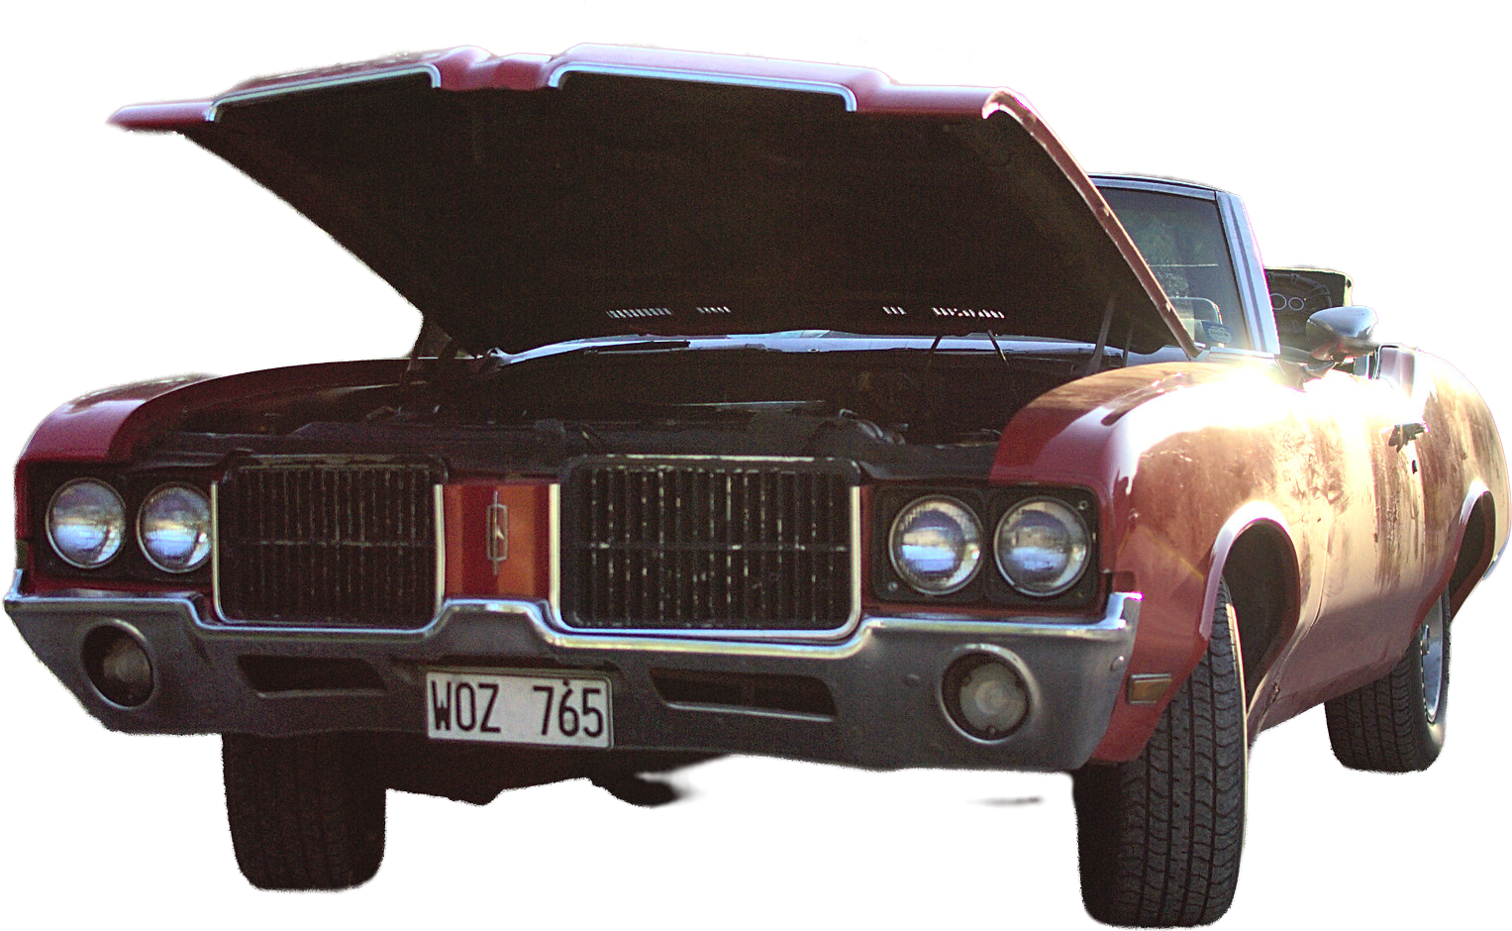
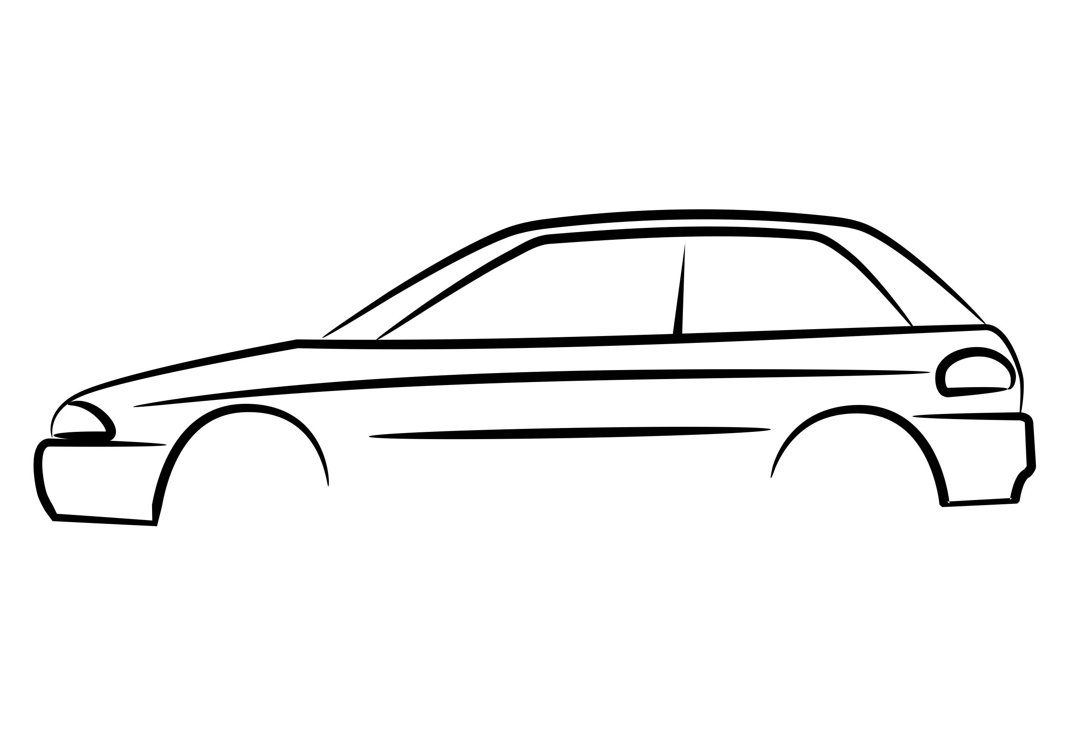

Leveraging VSS in-vehicle
Backend
Aggregating data of many vehicles
Link data to other domains
Good for VSS: Systems already in production
Searching for
the sweet spot
SDV: Vehicle Computer Layer
Can afford the cost of abstraction
Decouple Soft- and hardware
Save time and money with more generic in-vehicle software
Perfect: Modern Vehicle/SDV require abstraction
Deeply-Embedded Layer
Small µCs
CAN/LIN
Very proprietary
Very limited compute resources
Not a happy place for VSS
https://fosdem.org/2023/schedule/event/kuksa/

Slide 3
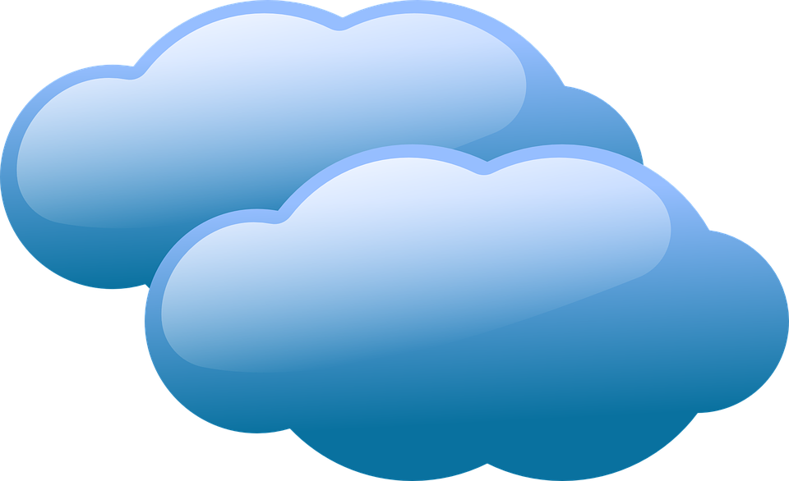
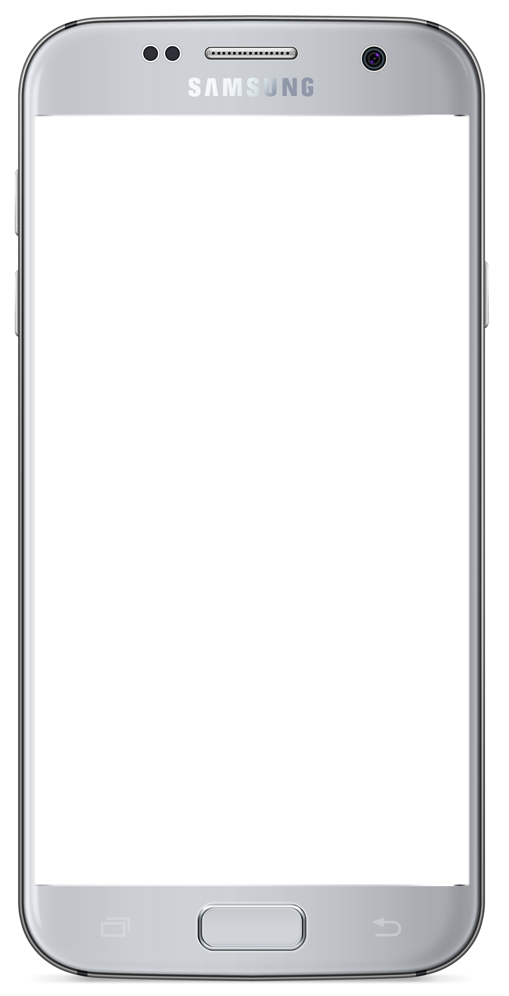

Convert and use VSS in a Vehicle Computer
Here you can afford the costs of abstraction
This is the place, where the industry is working on decoupling hard- from software (SDV!)
Here you save money & effort with more generic/portable software (SDV!)
Off-board
* Something with a processor and a full blown (POSIX) OS
App
App
SwC
Vehicle Computer
Implications on System Design?
Deeply Embedded

Slide 4
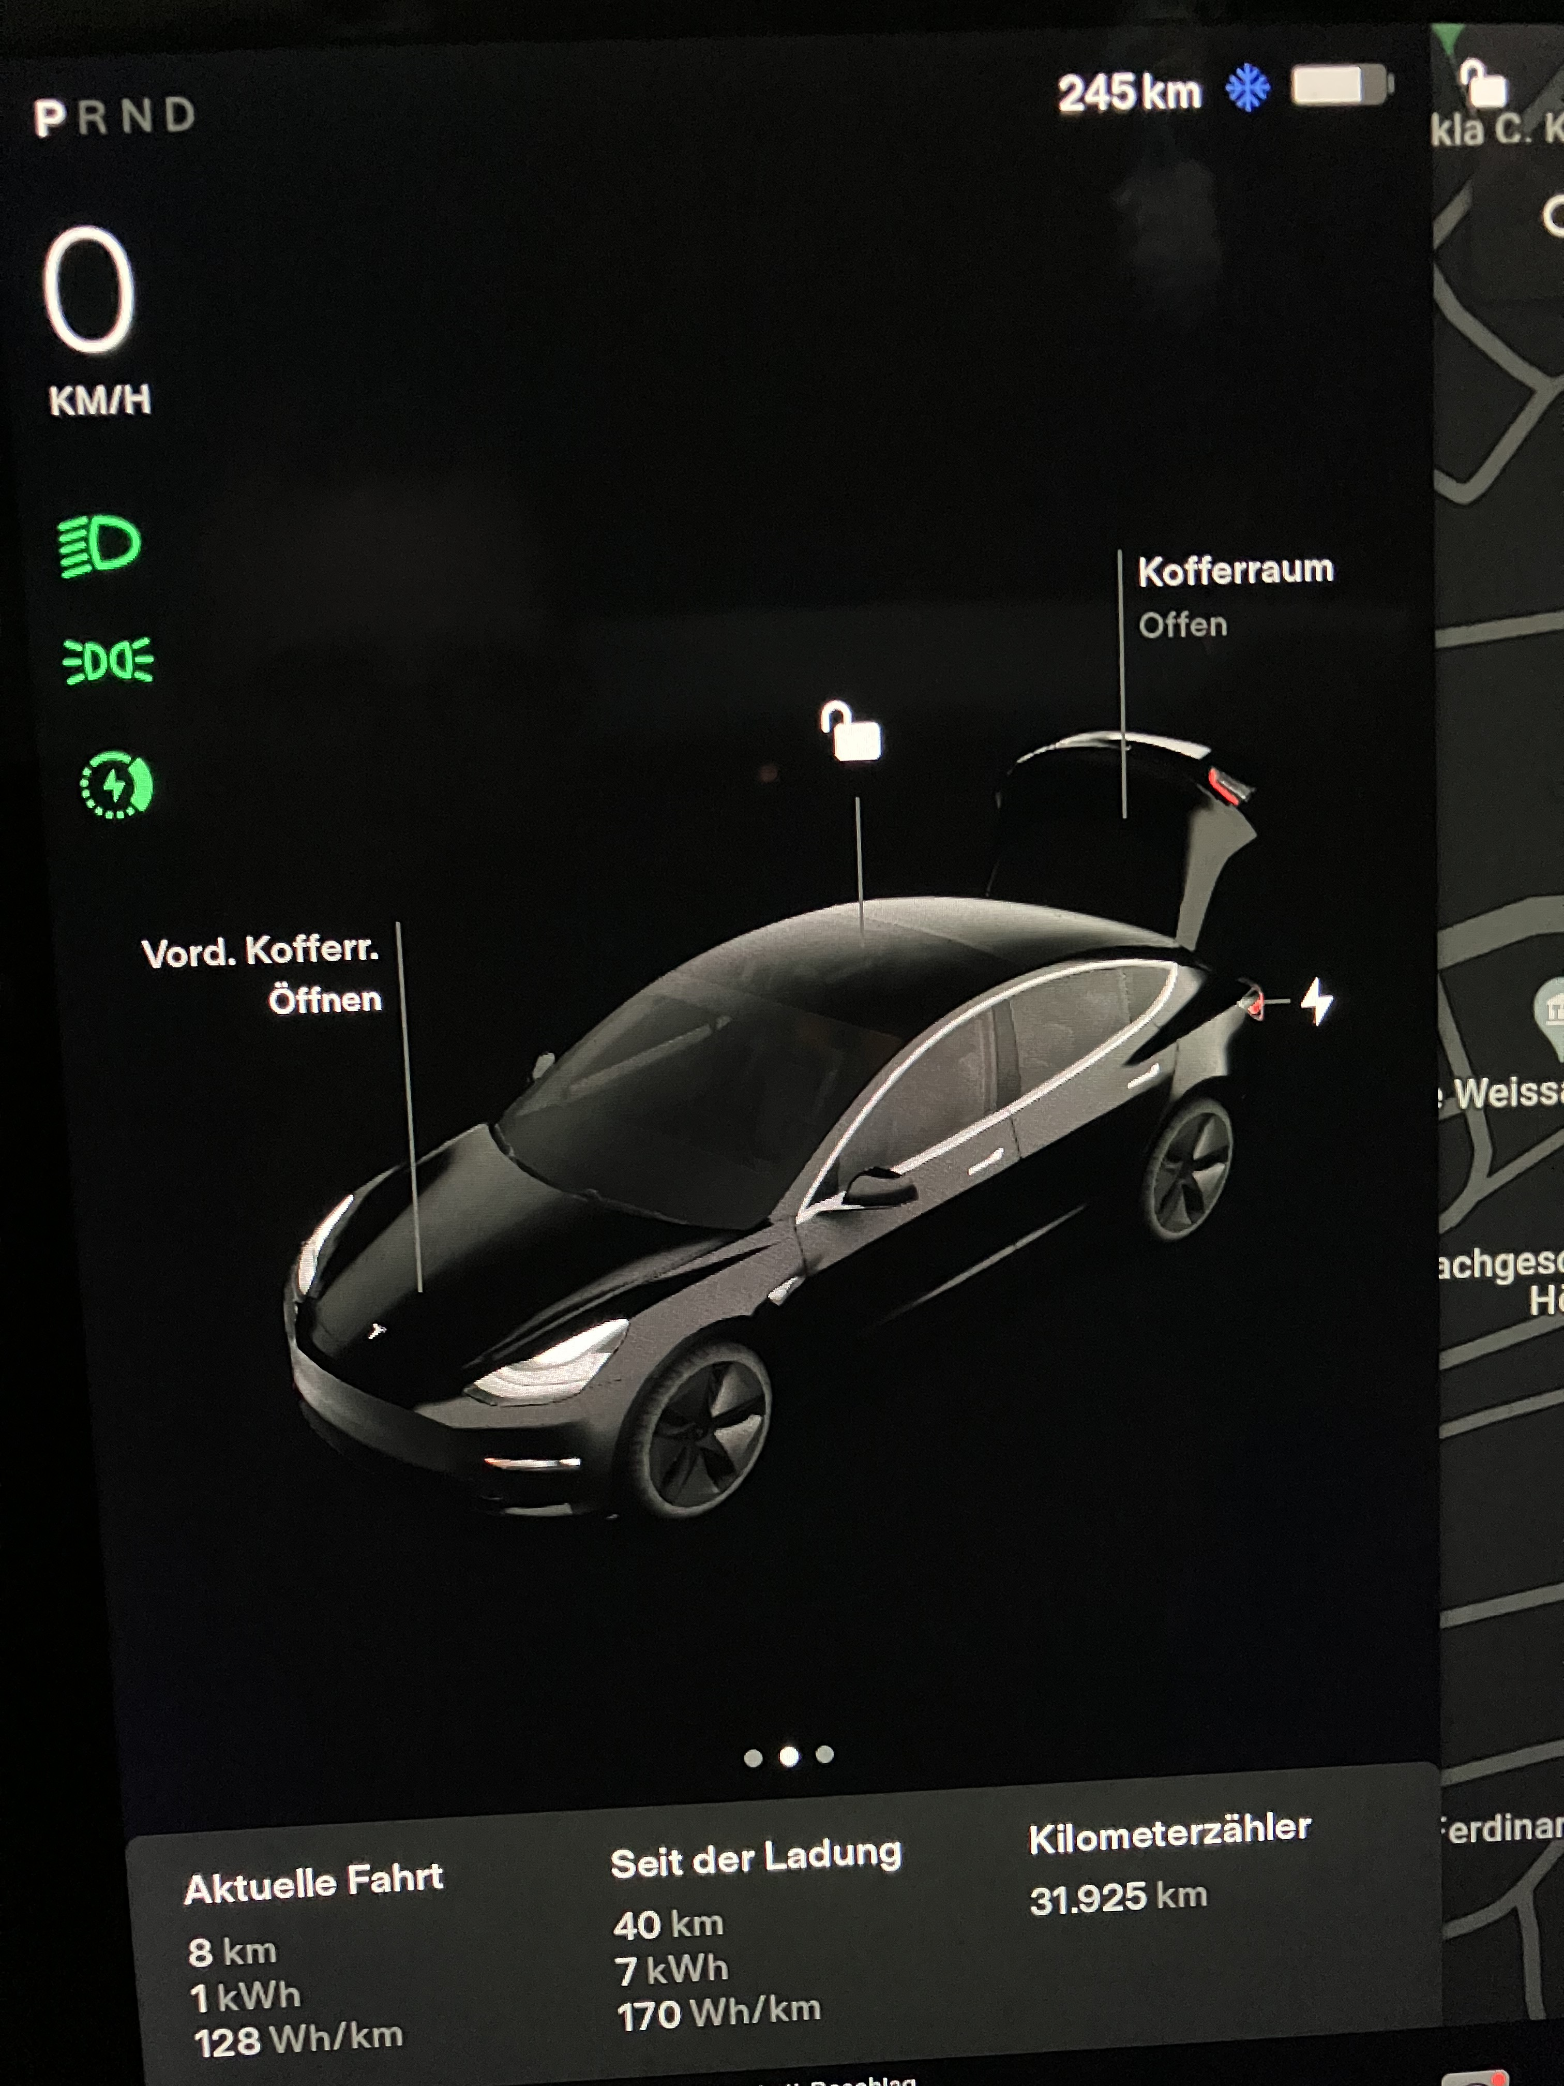
A simple in-vehicle use case
Subscribe
Vehicle.Body.Trunk.Rear.IsOpen
Set target:
Vehicle.Body.Trunk.Rear.IsOpen
Subscribe target
Vehicle.Body.Trunk.Rear.IsOpen
VSS Server
Set
Vehicle.Body.Trunk.Rear.IsOpen
Application
VSS Data Provider
VSS Actuation Provider
E/E network (CAN, SOME/IP, LIN, DDS, etc.) or Autosar (adaptive) platform

Slide 5
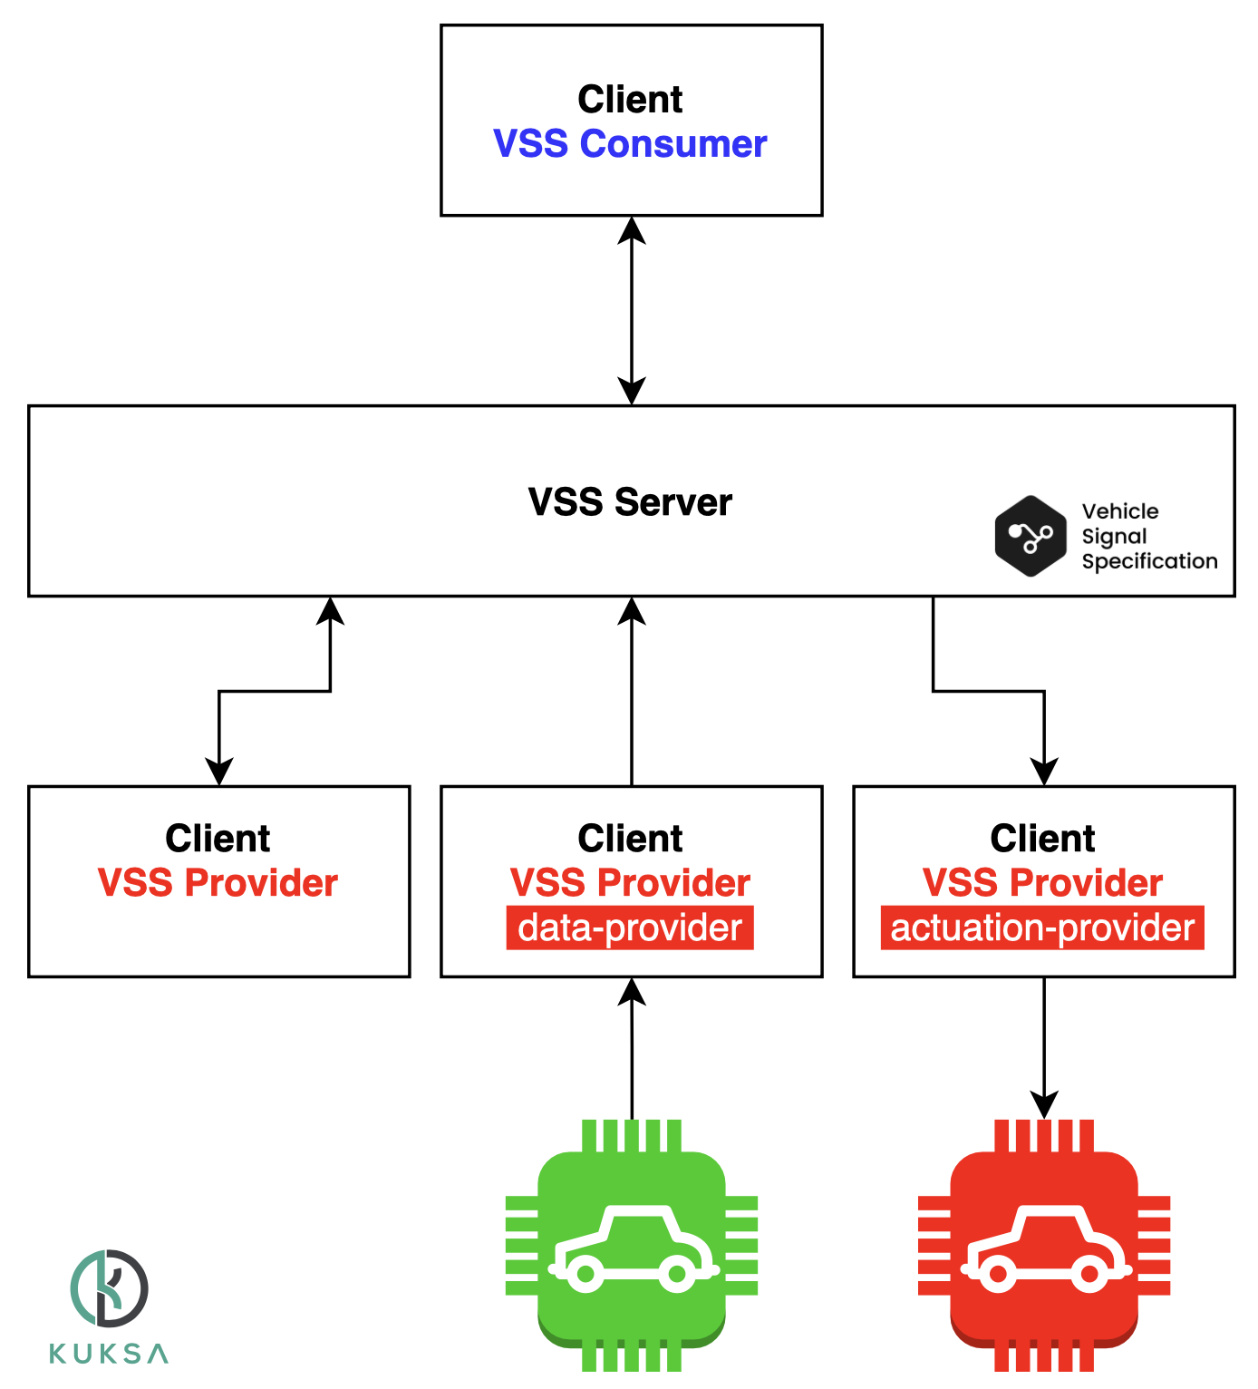
Taxonomy of in-vehicle VSS components
Interacts with Vehicle represented by the VSS model
  Vehicle Computer function
  IVI App
  External consumer device
Holds current vehicle state in VSS format
Provides an API to interact with VSS signals
VSS provider syncs of the vehicle with VSS model of the server
  data-provider: makes sure that the actual state of a vehicle is represented in VSS (historically known as “feeder”)
  actuation-provider: makes ensure that the target value of a VSS actuator is reflected by the actual state of a vehicle
https://github.com/eclipse/kuksa.val/blob/master/doc/terminology.md

Slide 6
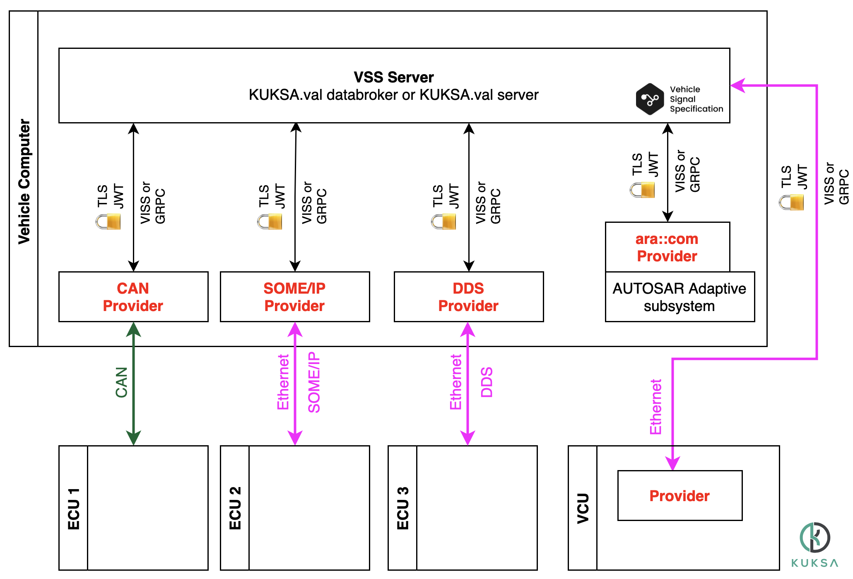
A Zoo of providers
A vehicle will likely several different providers, many data providers
some actuation providers, some combined
Providers may run on the the same ECU/VCU as the VSS server or on a remote system
https://github.com/eclipse/kuksa.val/blob/master/doc/system-architecture.md

Slide 7
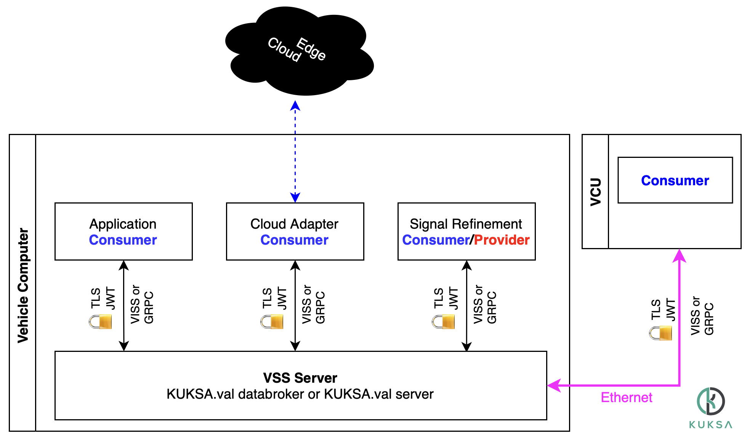
A Zoo of Consumers
This is what we ant to enable with VSS
A number portable of applications & functions consuming VSS data
Running on the same hardware as the VSS server or remotely on a different ECU/VCU/consumer device
A consumer might be a provider as well
https://github.com/eclipse/kuksa.val/blob/master/doc/system-architecture.md

Slide 8



Safety and Security Control Points
App
Another
App
Where Safety and Security come into play depends largely on on your application.
It is safe to assume, they will play a role.
KUKSA.val architecture and seperation of concerns gives you several control points.
QM Domain
KUKSA.val databroker
data-provider
actuation-provider
Vehicle Bus /
Hypervisor Border /
Bus Gateways
Some ECU/VCU
data-provider
actuation-provider
Safety Domain
Some ECU

Slide 9
How to do Security
Building blocks to limit access

Slide 10

Requirements
Not every API user should have access to all VSS signals
You can not rely on a vehicle being connected all the time
Complexity for in-vehicle software should be reasonably low
Need to integrate with many different software systems and ecosystems
Need to tackle a wide range of different use cases, while being simple, extensible and not relying on external infrastructure during runtime

Slide 11
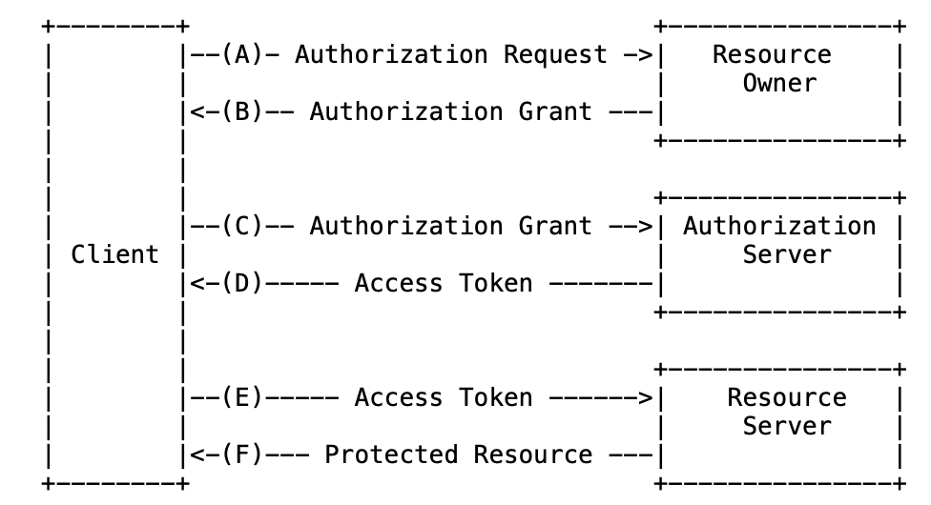
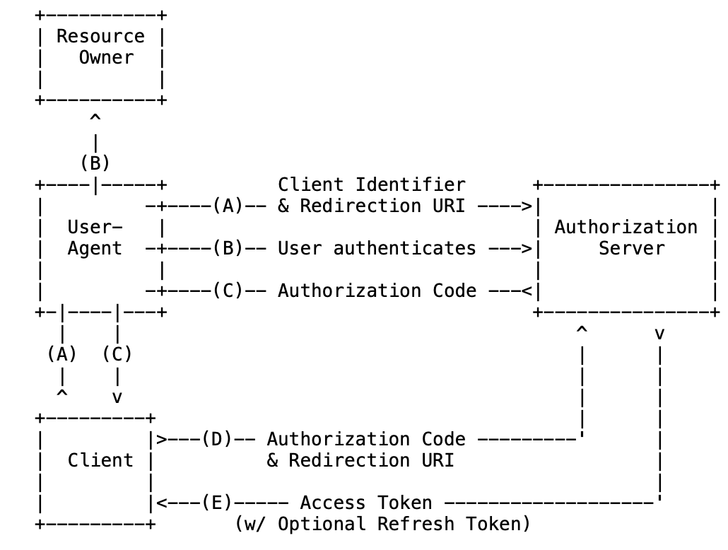


Meet the elephant in the room: OAuth2
Taxonomy and System architecture for authorization
Rich ecosystem: Tools/libraries
OAUTH2
VSS Server in-vehicle is a Resource Server
Only needs to deal with Access Tokens
https://oauth.net/2/

Slide 12
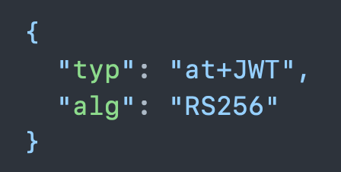
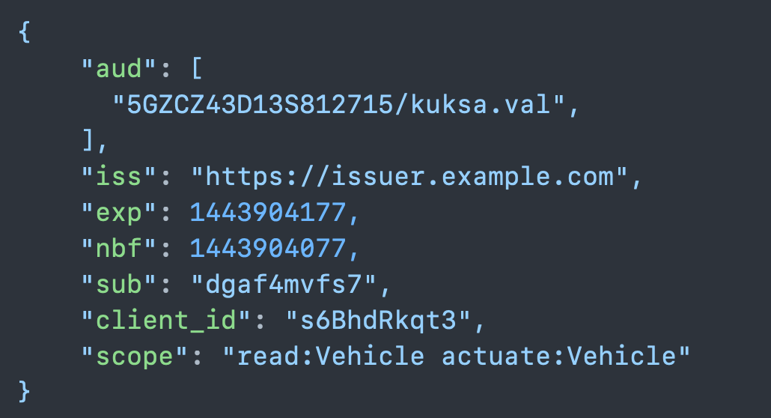

Tokens
JSON Webtoken (RFC 7519)
  “signed JSON snippet spelling out your rights”
OAUTH2 compliant access token (RFC 9068)
  A “profile” for a JWT defined by OAuth
How a client comes into possession of a valid AT is
  Not necessarily easy
  Dependent on your ecosystem/deployment
  Out of scope for the in-vehicle VSS server
What a VSS Server need to do
  Verify the signature
  Understand the contents (mainly scope)
https://www.rfc-editor.org/rfc/rfc7519
https://www.rfc-editor.org/rfc/rfc9068
.val

Slide 13
JWT OAUTH2 AT ingredients
Iss – Issuer | Identify the issuer of this token
aud – Audience | Limit access to a specific instance of a VSS server, a subset/ group
exp - Expiration | When does this AT expire
nbf - Not before | Do not accept AT before this time
sub - Subject | Who does this token represent
client_id | Which client requested this token
scope | What permissions does this token give its bearer
Vehicle side as a minimum we need to verify, whether a token is signed correctly then interpret the aud and scope claims
https://www.rfc-editor.org/rfc/rfc7519
https://datatracker.ietf.org/doc/html/rfc9068

Slide 14
Scopes for (in-vehicle) VSS access
scope: <ACTION>[:SUB_ACTION][:<PATH>]
Action
read | Allow client to read matching signals (and metadata)
actuate | Allow client to actuate matching signals (includes read)
provide | Allow client to provide matching signals (includes read)
create | Allow client to create a VSS entry (under a certain path). If a VSS entry already exists
Provide-subaction
provide:data | Allow client to provide data (but not respond to actuation requests) for matching signals. (includes read)
provide:actuation | Allow client to respond to actuation requests (but not provide the value) for matching signals. (includes read)

Slide 15
Example Scopes
Scope | Meaning
read | Allow client to read everything
read:Vehicle.Speed | Allow client to read Vehicle.Speed (including metadata)
read:Vehicle.ADAS | Allow client to read everything under Vehicle.ADAS (including metadata)
actuate:Vehicle.ADAS | Allow client to actuate all actuators under Vehicle.ADAS
provide:Vehicle.Width | Allow client to provide Vehicle.Width
provide:Vehicle.Cabin.Trunk.*.IsLocked | Providing IsLocked for all matching (e.g. Trunk.Front, Trunk.Rear) signals
An access token will usually include several space separated scopes
https://github.com/eclipse/kuksa.val/blob/master/doc/KUKSA.val_data_broker/authorization.md

Slide 16
Deployment Blueprints
So, how much security do I need? Scopes? Lifetime/rotations?
It depends!

Slide 17
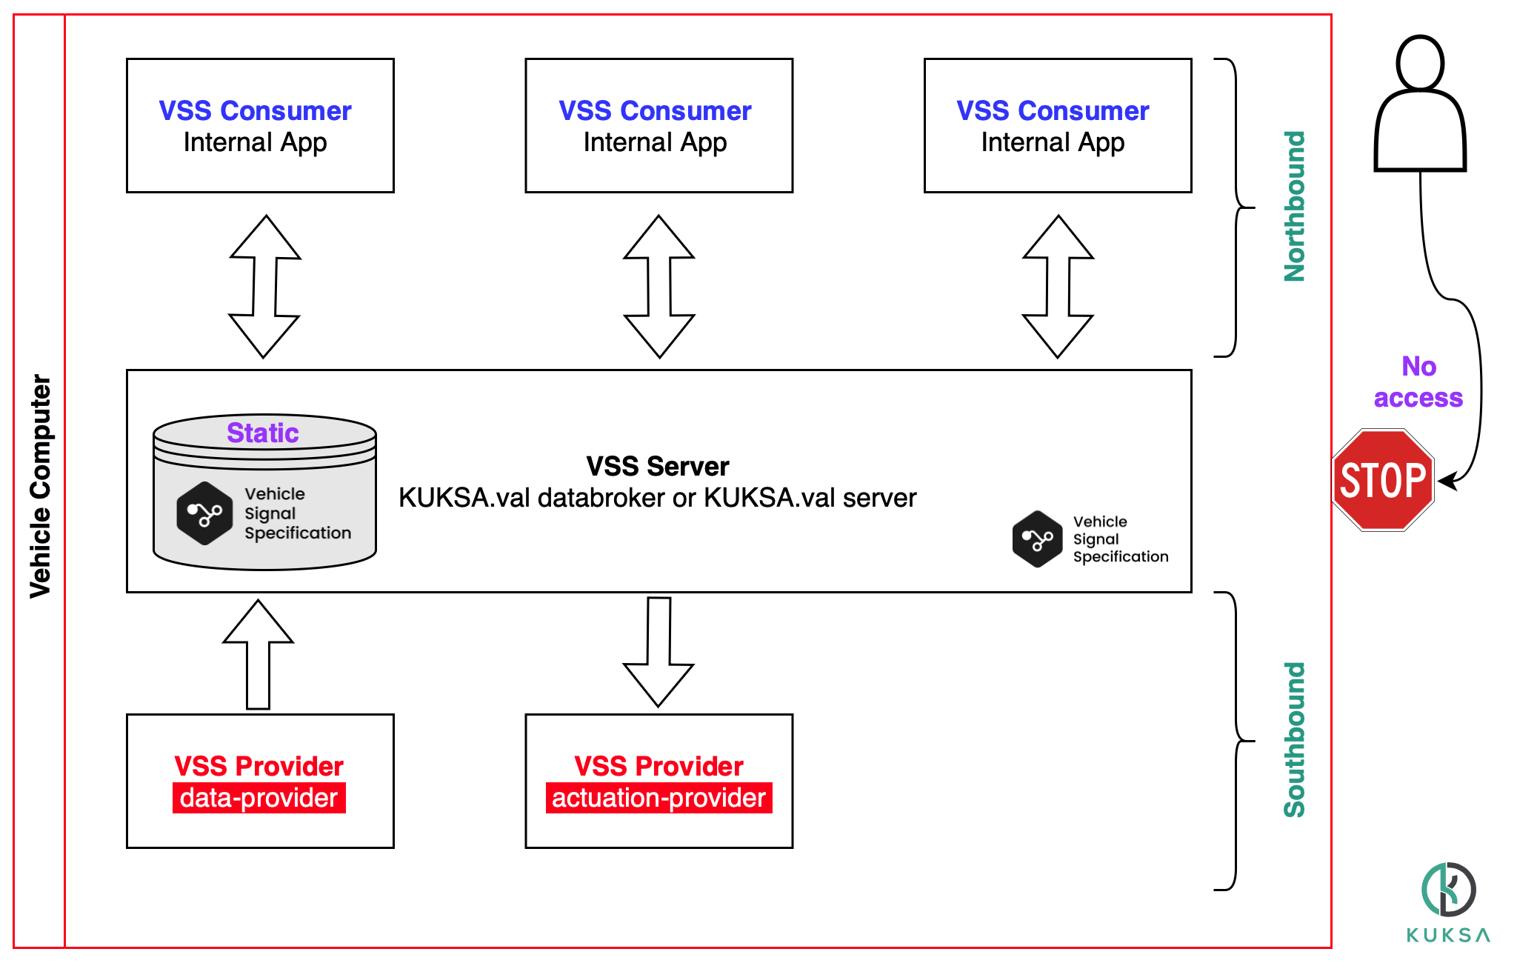

Blueprint 1: Internal API
VSS semantics make my internal APIs so much better
Users | You
System Updates | Complete
Security | None/Fixed
VSS model | Static
VSS server | Firmware

Slide 18
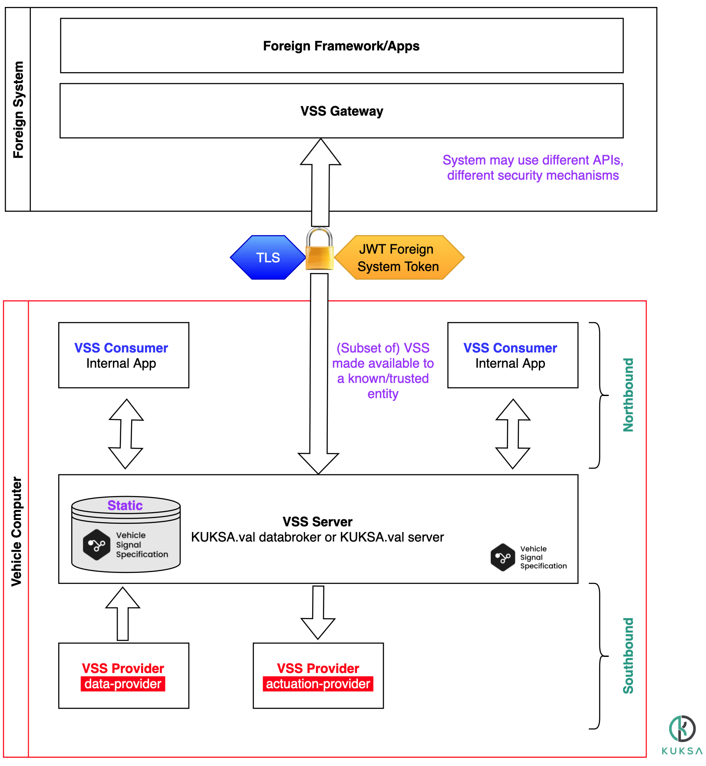

Blueprint 2: Exposing a subset of VSS to another system
I need vehicle data in my existing framework
Users | Other trusted platforms
System Updates | Firmware/complete on controlled system Unknown on 3rd party
Security | TLS+Foreign platform token
VSS model | Static
VSS server | Firmware or Software

Slide 19
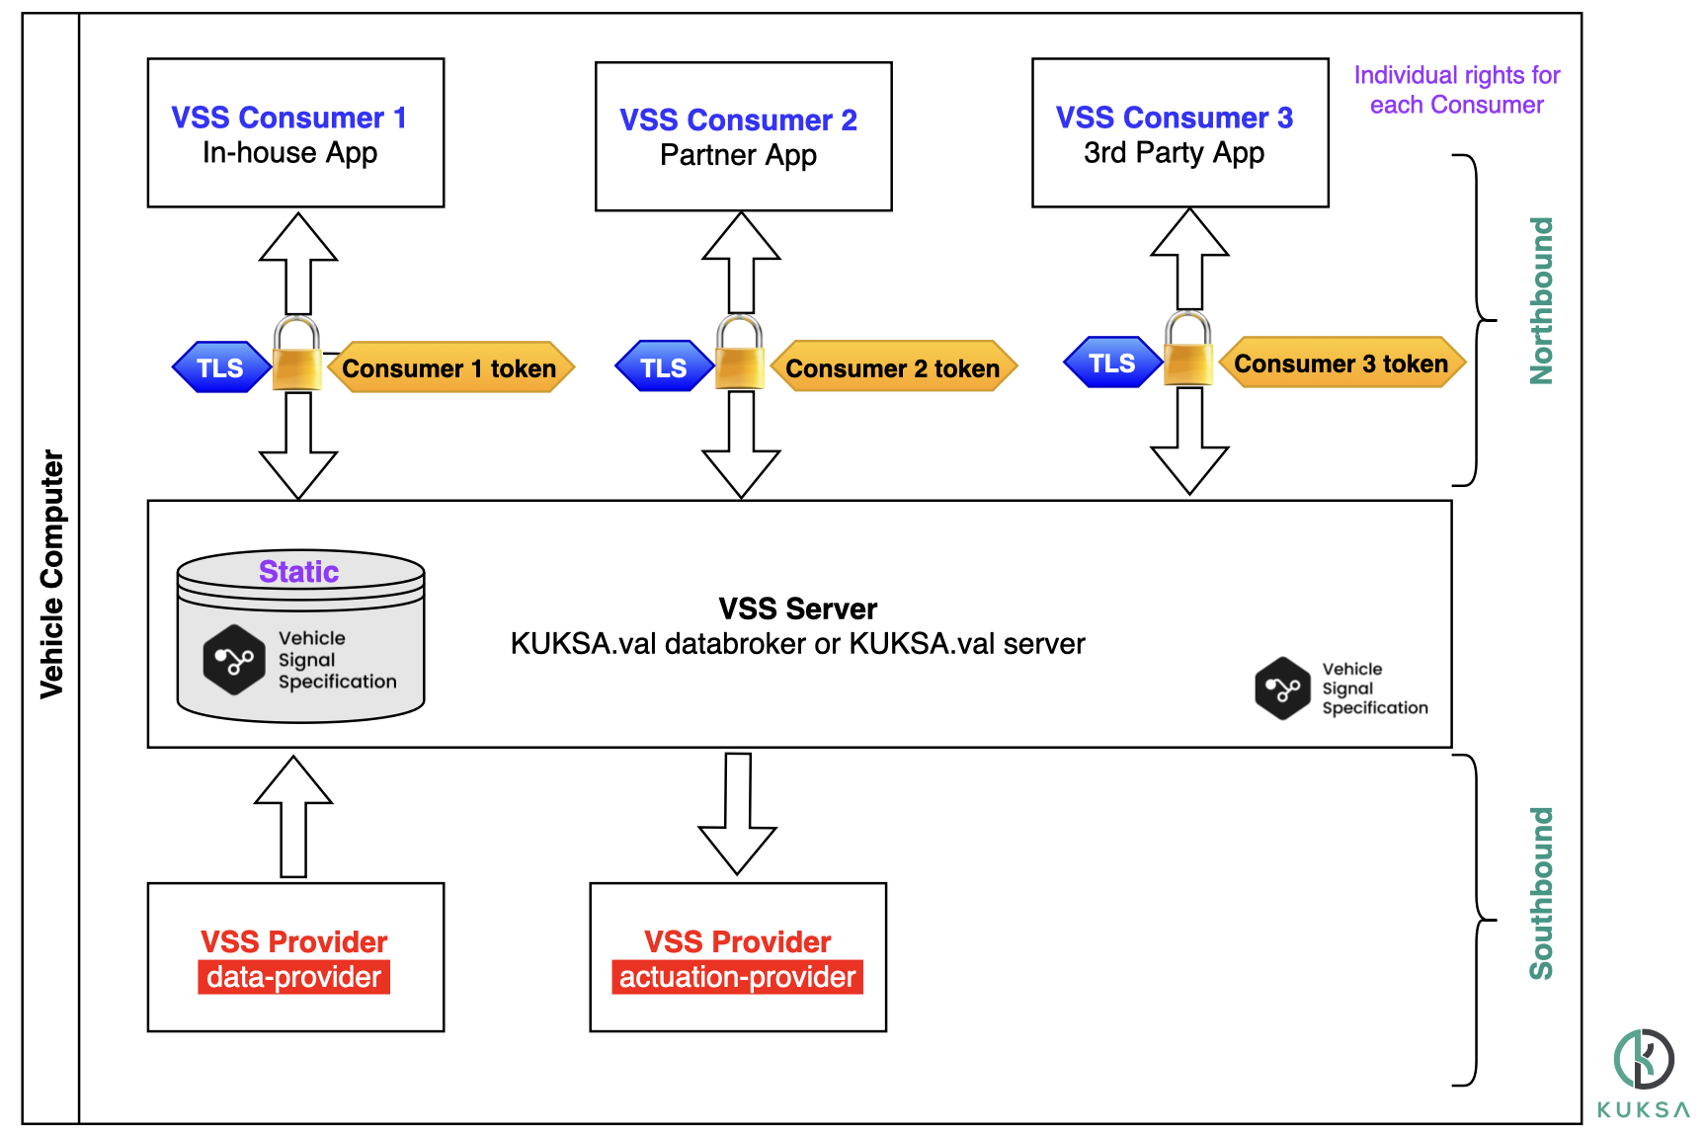

Blueprint 3: Individual Applications
Soo many apps and functions in my ecosystem!
Users | You+3rd parties
System Updates | App-level
Security | TLS+Individual Consumer tokens
VSS model | Static
VSS server | Software package

Slide 20
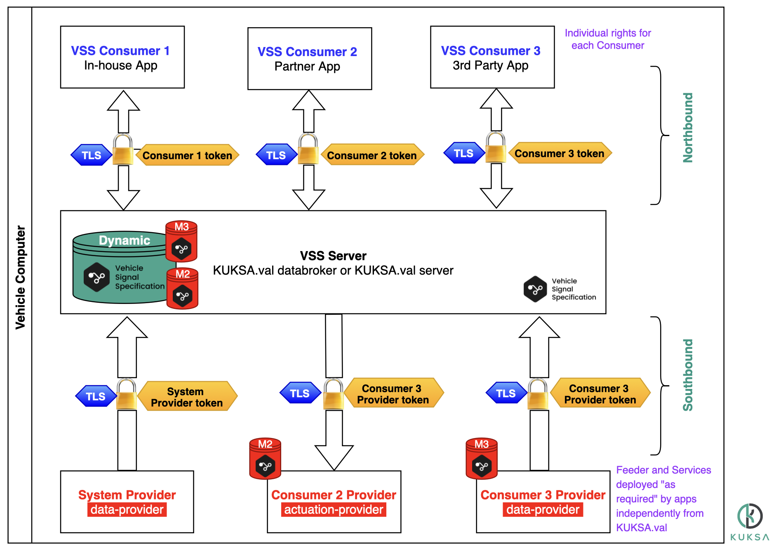

Blueprint 4: Apps with dynamic VSS extensions
Eureka! A truly dynamic SDV system!
Users | You+3rd parties
System Updates | App-level
Security | TLS+Individual app tokens
VSS model | Dynamic
VSS server | Software package

Slide 21



Thank You
Contact & Information
KUKSA https://eclipse.github.io/kuksa.website/
Me http://sdv.expert
Eclipse SDV https://sdv.eclipse.org
COVESA VSS https://covesa.github.io/vehicle_signal_specification/

