Slide 1
Automotive AI: Unleasing New Possibilities & Experiences
COVESA All Members Meeting – Gothenburg 2024
Automotive

Slide 2
Automotive AI

Slide 3
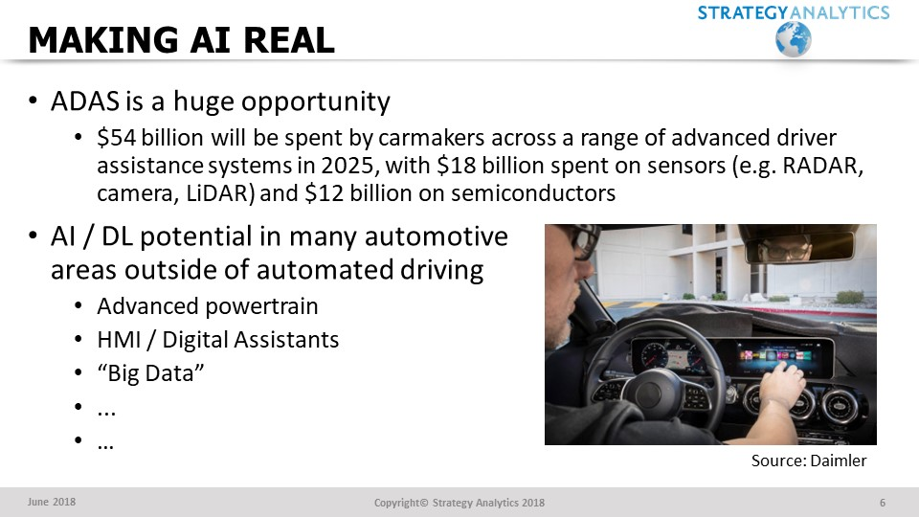
AI in Automotive is NOT new!
This was one of my “stock” slides from 2018
In an August 1998 report, SA noted that Breed/ Siemens was working on AI-based occupant classification
“Fuzzy logic” was the buzz-phrase back then!

Slide 4

Automotive Software Survey – AI
This question from TechInsights’ and Aurora Labs’ fourth annual Automotive Software Survey asked respondents where AI (generally, as opposed to generative AI specifically) will have the most influence in the automotive industry.
  Over half (54%) of respondents selected “automated driving” as their main response.
  In second place, at 28%, respondents selected “software development processes”
  In third place was “in-cabin experience” at 10%
Companies have been launching software development tools that use generative AI models, such as Microsoft’s GitHub CoPilot and Amazon’s CodeWhisperer. This is an area where AI will make a major difference in the near-term.
Copyright © 2023 TechInsights Inc. All rights reserved.

Slide 5
What About
Generative AI?

Slide 6
Generative AI – General Points
Generative AI is a “foundational” technology
  It can be broadly applied to many types of digital systems and applications.
  It turns natural language into a more direct interface with software.
  It can be used to perform tasks by interacting with many types of software in sequence, i.e., to enable “AI agents.”
  Its pattern recognition capabilities, combined with its ability to output text, enable it to rapidly search and summarize.
Currently, foundation models “hallucinate,” and text embedding models can be biased
  Generative AI models are not always accurate.
  Generative AI models regularly make up information.
  Their only “intent” is to maximize a reward function to predict the next “token” (i.e., text).
  Text embedding models, used for search, classification, recommendations, etc., can produce biased output due to biases in training data.
  This is (hopefully!) not news to any of you, but many people don’t understand this.
People are trying to break these systems
  The more flexible a system is, the more ways people will have to break it.
  Attempting to “jailbreak” generative AI models (particularly multi-modal models, i.e., models with LLM functionality) is a common
We are still in the early days of generative AI commercialization
  Despite the limitations noted, research is progressing rapidly to improve response accuracy
  AI safety and interpretability research is beginning to gain interest (and additional funding)
  Governments are already looking to implement regulations, and some have passed draft legislation (the European Union passed the draft of its AI Act)

Slide 7
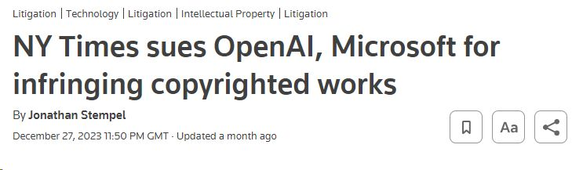
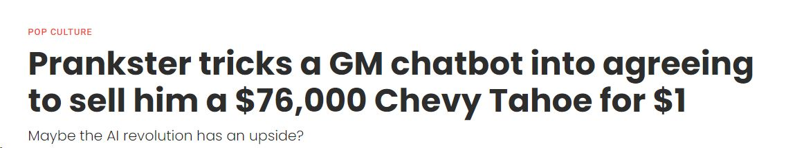
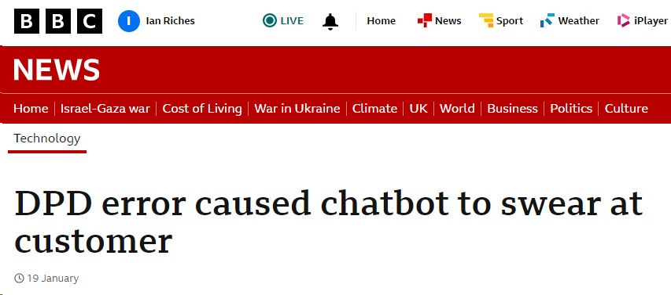
Generative AI Risks & Challenges
New Regulations: Several countries are either establishing rules for generative AI or are launching investigations. The Cyberspace Administration of China, for example, has published a draft policy to regulate generative AI. The EU passed the AI Act, which has provisions regulating generative AI.
Privacy: EU countries are investigating EU countries’ citizens’ personal information being included in training datasets, which would violate GDPR.
Copyright Issues: There are lawsuits pending over foundation models that include copyrighted text and images in their training datasets.
Ownership: It’s unclear whether companies using generative AI tools would legally own the output of these tools.
Information Security: Sharing information with enterprise AI tools could inadvertently provide company information (e.g., data, ideas, code) to competitors. Some companies enable users to opt-out of sharing information or provide other safeguards.
Reputational Risk: Chatbots going “rogue” may mean that services need to be withdrawn rapidly …
Source: Reuters.com
Source: Upworth.com
Source: BBC News

Slide 8
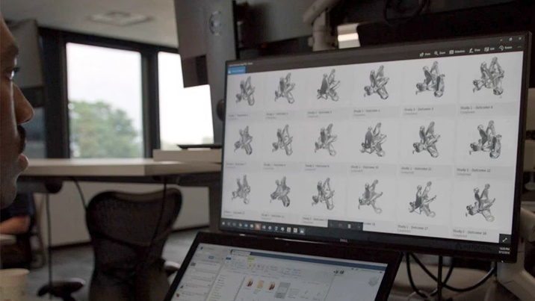


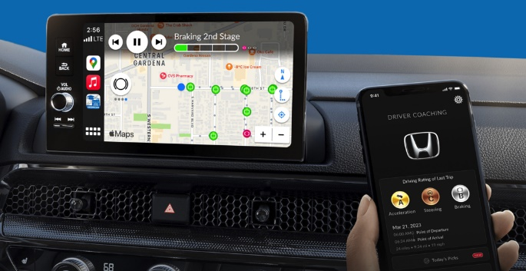
Automotive Generative AI Use Cases
In-vehicle Infotainment: Digital assistants and “co-pilots” for drivers and passengers
Automated Driving: Still largely at an academic research stage – but LLMs are being investigated to see if they can help automated driving systems better understand the driving environment – although many remain sceptical…
Automotive Retail: Customer-facing and operational use cases, at the OEM and dealership level, sales forecasting and analysis
Design, Development and Manufacturing: Vehicle and component design and development, software engineering assistance, quality assurance, and back-office operations (document management, compliance, etc.), trend analysis
Automotive Marketing: Assist marketing professionals with tasks and to more rapidly generate marketing materials and campaign ideas (i.e., ideation)
Source: Autodesk
Source: Microsoft Stock Image
Source: General Motors
Source: Honda

Slide 9
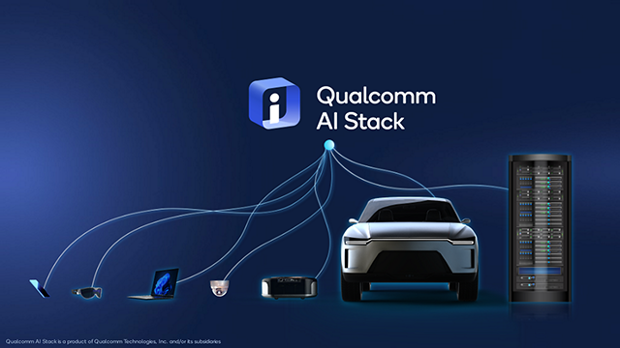
Running Generative AI Models In-Vehicle
Some semiconductor companies are now developing products that will enable LLMs to run on edge devices.
For example, Qualcomm’s CEO Cristiano Amon, at the Bernstein Conference, said he expects to be able to run 60B parameter LLMs on upcoming automotive-specific chips.
Techniques, such as quantization (converting a model’s 32-bit float parameters to 8-bit integers), can reduce the computational and memory requirements of running AI models.
These capabilities will only improve over the next 5 – 10 years as semiconductor companies focus on enabling AI workloads across their product lineups.
Source: Qualcomm
TechInsights believes that locally-running LLMs will be required to fully unlock the value of enabled features and avoid offline/online functionality disparities

Slide 10
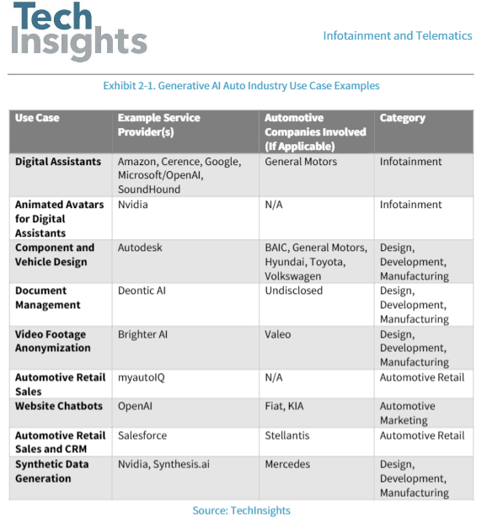
Generative AI – Use Case Examples

Slide 11
AI = Connected

Slide 12
The Software-Defined Car is Built on Connectivity
Well over half of vehicle produced globally are now connected.
There is an increasing need for a connection mediation gateway capable of managing connectivity based on:
Type
Wi-Fi, LTE/5G, Satellite (LEO or GEO)
Application
Safety, streaming...
Availability/Quality of Signal
Intermittent connectivity is a big problem for data uploads/downloads to vehicles in motion
Cost
Do I need this data transfer now? Or can it wait and be cheaper later?
Copyright © 2023 TechInsights Inc. All rights reserved.

Slide 13
Connectivity will Largely Remain in a Dedicated TCU
TechInsights expects most cellular modems to be included in standalone telematics ECUs rather than integrated with other systems.
TechInsights forecasts that telematics ECU shipments will increase from 45.2 million units in 2022 to 63.3 million units in 2030.
That said, a small percentage of modems are forecast to be included in other systems, such as headunits and CDCs.
Semis with cellular modems are standalone products in many cases but in some include cellular and GNSS or cellular, GNSS, and Wi-Fi support.
Copyright © 2023 TechInsights Inc. All rights reserved.

Slide 14
Expectation is For Two to Six OTA Updates a Year
TechInsights partnered with Aurora Labs for our fourth annual Automotive Software Survey.
TechInsights and Aurora Labs received responses from 208 industry professionals from companies including ARM, CARIAD, Continental, Denso, Hyundai, LG, MediaTek, Nexteer, Porsche, Renesas, Samsung, Stellantis, STMicro, Synopsis, Qualcomm, and Texas Instruments.
Respondents came from Asia (11%), Europe (38%), North America (49%) and Other (2%).
One of the questions involved the number of over-the-air (OTA) updates that respondents said they would expect OEMs would perform each year by 2025. 32% of respondents said, “2 to 6”, 23% said 7 to 12, and only 5% said “less than 2”.
Copyright © 2023 TechInsights Inc. All rights reserved.

Slide 15
OTA Update Experience Mainly with EV Owners
Another question from TechInsights’ and Aurora Labs’ fourth annual Automotive Software Survey asked respondents about their own vehicles receiving OTA updates.
Of respondents to this question, 11% said their car had received 1 OTA update and 27% said their vehicle had received more than 1 OTA update.
EV owners were far more likely (67%) to have said that their vehicle received more than 1 OTA update in the last 12 months.
Copyright © 2023 TechInsights Inc. All rights reserved.

Slide 16
OEM Revenue Expectations Becoming More Realistic?
Another question from TechInsights’ and Aurora Labs’ fourth annual Automotive Software Survey asked respondents about how much revenue they believe OEMs will derive from new features delivered via OTA updates in 2027.
Opinions have shifted year over year toward lower percentages, with fewer industry professionals believing OEMs will derive more than 10% of revenue from features delivered via OTA updates.
Copyright © 2023 TechInsights Inc. All rights reserved.

Slide 17
Voice of the Consumer

Slide 18
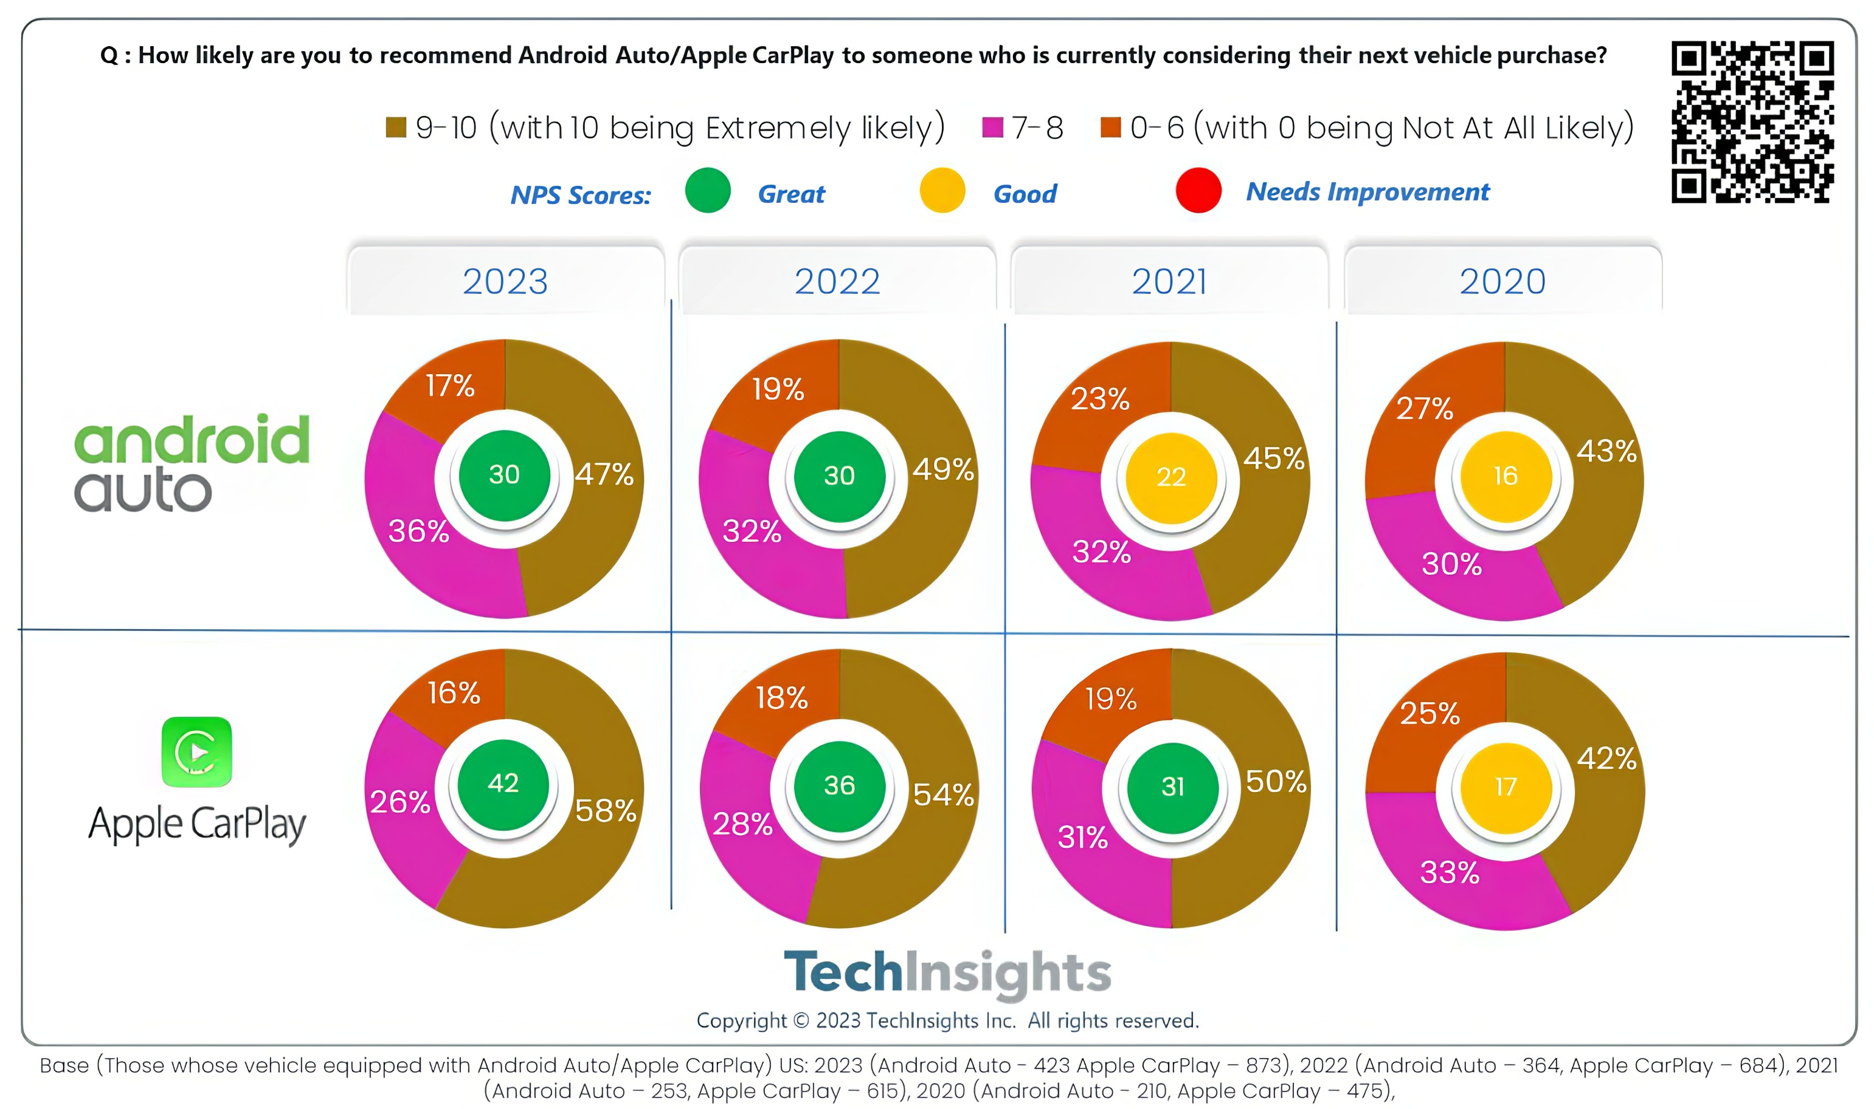

The Smartphone Challenge for In-Vehicle AI
Over the years, there has been a notable increase in promoters and a corresponding decrease in detractors for both mirroring systems, indicating a positive trend in user sentiment.
Notably, the Net Promoter Score (NPS) among Android Auto users has displayed an upward trajectory over the years, although it remained constant between 2022 and 2023.
Promoters of the Apple CarPlay system have steadily increased over the years.

Slide 19
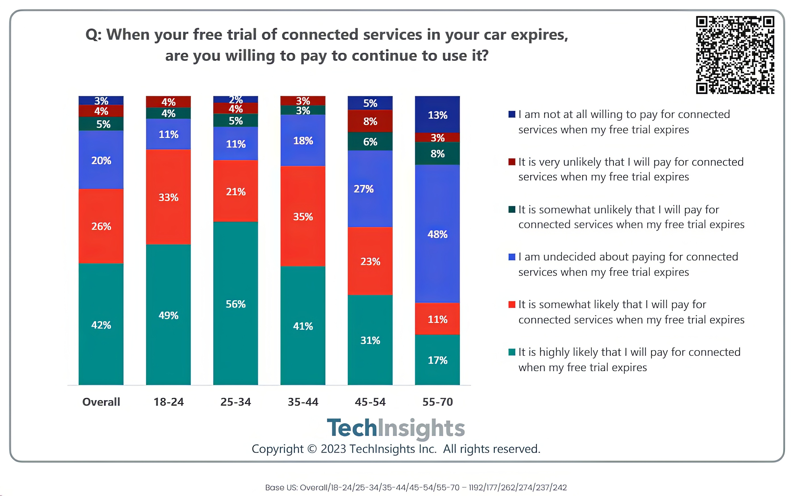
Paid-for Connectivity Currently Excludes Older Drivers
Only 17% of US 55-70 year olds are highly likely to pay for connected services when their free trial expires
This contrasts with 56% of 25-34 year olds

Slide 20
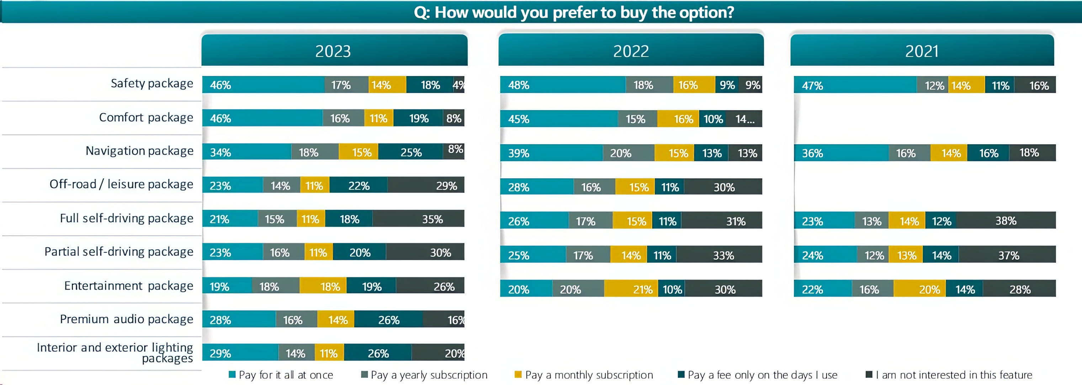
Subscription Interest Varies by Feature
Features that drivers were likely to want every day (safety & comfort packages) had the highest preference for paying up-front
For an entertainment package, 55% of US car owners surveyed would prefer some form of subscription or pay-per-use model, vs. 19% who prefer to pay up-front

Slide 21
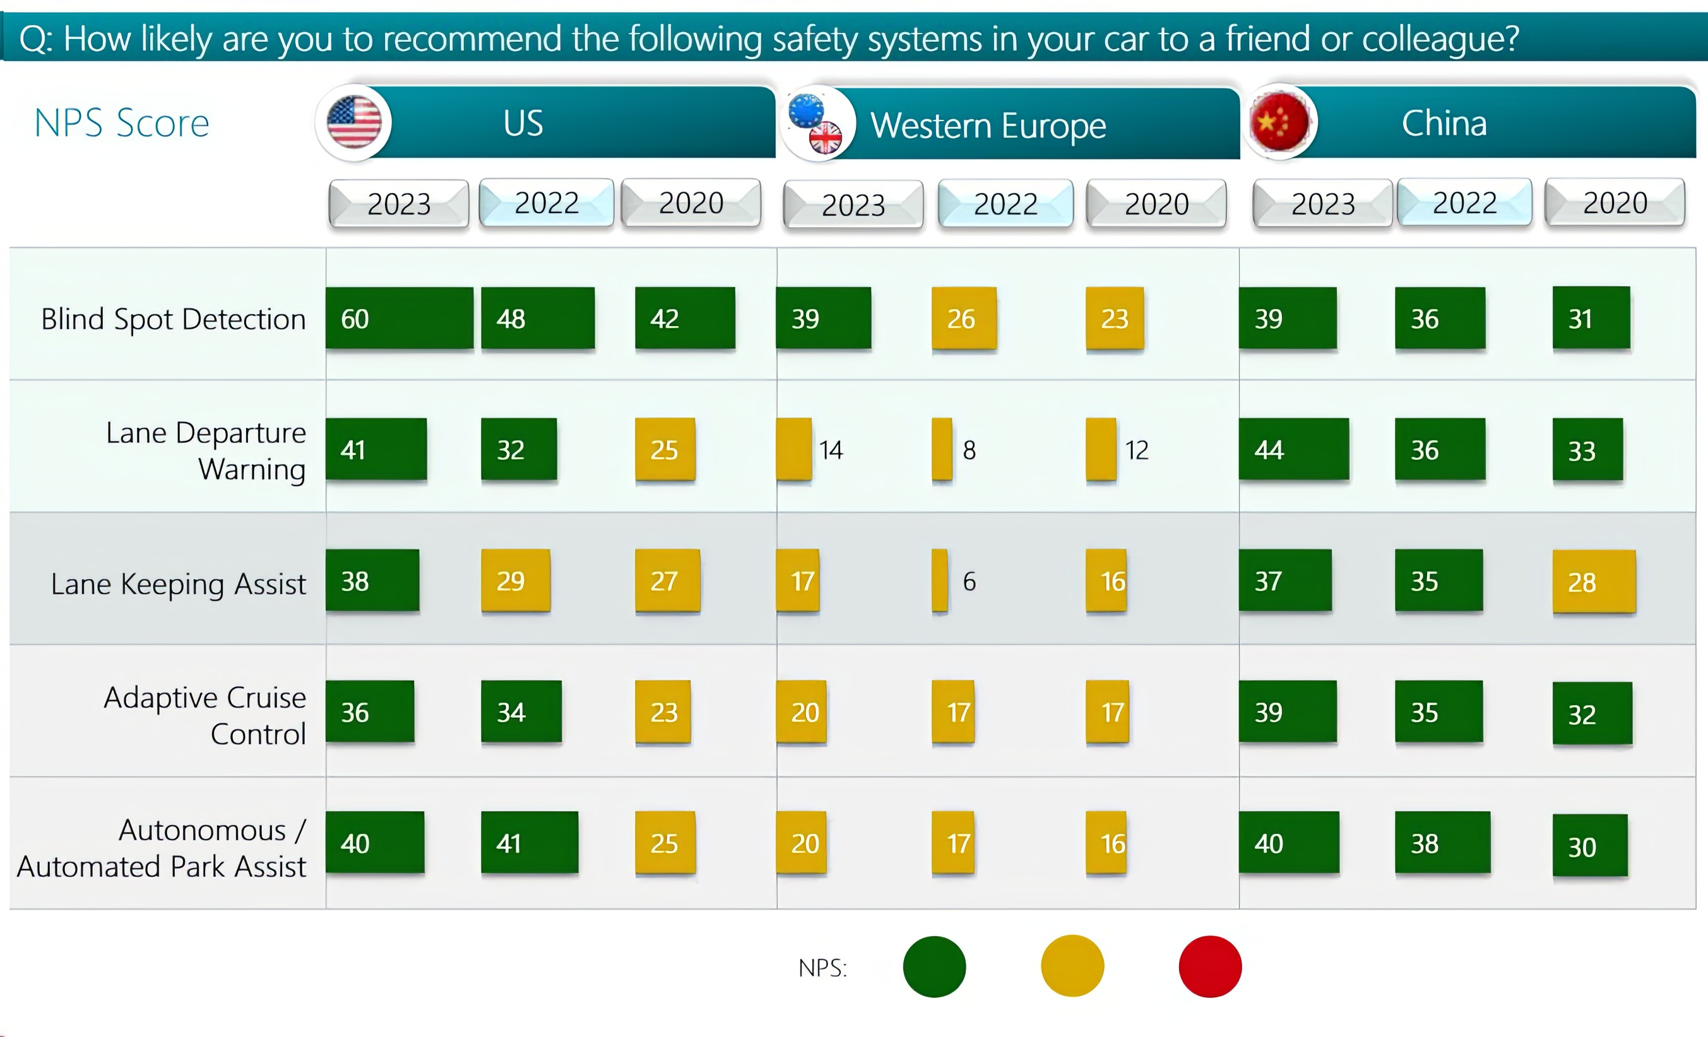
Net Promoter Scores for ADAS are Improving

Slide 22
Conclusions

Slide 23
Conclusions
Conclusions
AI in Automotive is NOT new – but beware of hype around whatever the “flavor of the day” is
The focus is currently on Generative AI – but planning is needed for the risks.
Digital Assistants will lead the way
Well-established trends for more compute and more connectivity will aid AI adoption – but AI will likely NOT cause a step change in these trends
Consumers love smartphone projection
Older drivers the least likely to pay for connectivity
Owners WILL pay for subscriptions and downloads – but willingness varies hugely by feature.
Automotive AI opportunities are REAL!
Success for automotive suppliers will be predicated on balancing speed of execution with the operational risks, and focusing on what non-automotive-centric suppliers cannot deliver as well as those with deep automotive expertise

Slide 24

Any Questions?
Roger C. Lanctot
Director – Automotive Connected Mobility
rlanctot@techinsights.com

